Slide 1
Practicing Abstinence
Chapter #8 Lesson 3

Slide 2
Dating Decisions
Priorities: are the goals, tasks, values, and activities that you judge to be more important than others.
You and your date deserve to be treated consideration and respect.
Be yourself and communicate thoughts and feelings honestly.
Never feel pressured to do anything that goes against your values or family’s values.

Slide 3
Setting Limits
PARENT/FAMILY MORALS & VALUES
WHO WILL BE THERE?
WHERE WILL YOU GO?
HOW WILL YOU GET THERE?
WHAT WILL YOU DO WHEN THEY GET THERE?
ABSTINENCE: THE DELIBERATE DECISION TO AVOID SEXUAL ACTIVITY

Slide 4
Abstinence
Intimacy: a closeness between two people that develops over time.
Infatuation: exaggerated feelings of passion.
Self Control: a person’s ability to use responsibility to override emotions.
Set Limits for expressing affection - Communicate with partner
Talk with trusted adult – Seek low pressure dating situations
Date someone who respects and shares your values.

Slide 5
Avoiding Risk Situations
Avoid places where alcohol and other drugs are present.
Avoid being alone with a date at home or in an isolated place.

Slide 6
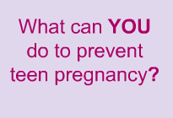
Consequences
Sexually Transmitted Diseases: are infectious diseases spread from person to person through sexual contact
Unplanned Pregnancy
Mental/Emotional Health ( guilt, hurt, regret, anxiety )
Social Health (family tension, loss of friendships)

Slide 7
MTV -Teen Mom -

Slide 8
Committing to Abstinence
Communicate with partner:
Choose a relaxed and comfortable time and place.
Begin on a positive note, perhaps by talking about your affection for the other person.
Be clear in your reasons for choosing abstinence.
Be firm in setting limits in your physical relationships.

Slide 9
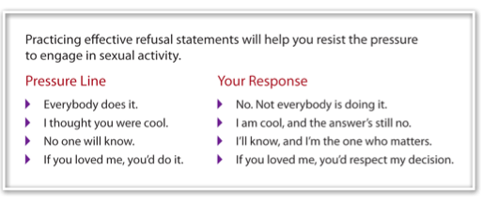
Using Refusal Skills to Say No to Peer Pressure

