Slide 1
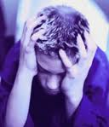
Chapter #5 Lesson 1
Dealing with Anxiety and Depression

Slide 2
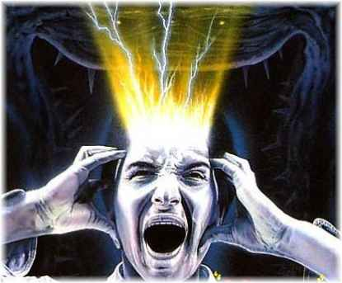
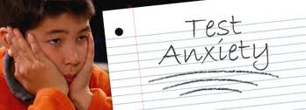
Understanding Anxiety
Anxiety: the condition of feeling uneasy or worried about what may happen.
Brief feelings of anxiety are common and natural responses to stress.
Usually, once the stressful situation is over, so is the anxiety it created.

Slide 3
More Than Sad : Teen Depression

Slide 4
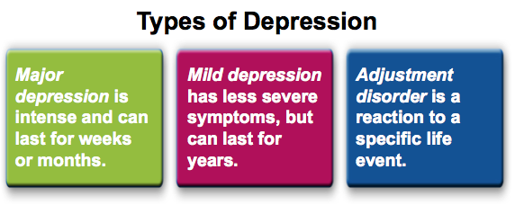
Understanding Depression
Depression: is a prolonged feeling of helplessness, hopelessness, and sadness.
15-20 % teens are diagnosed with depression – 2x as high in Girls than in Boys
Apathy: lack of strong feeling, interest, or concern.

Slide 5
More Than Sad : Teen Depression

Slide 7
More Than Sad : Teen Depression

Slide 8
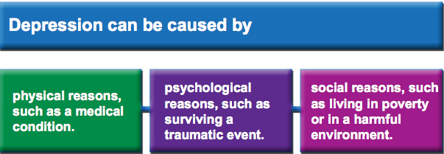
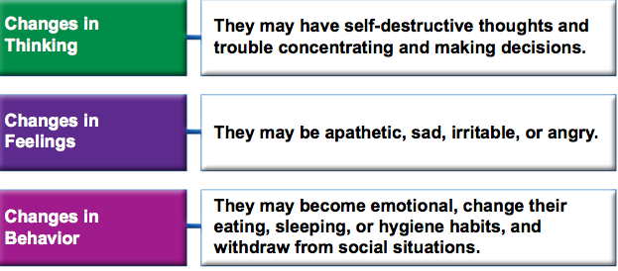
Causes and Effects of Depression

Slide 9
More Than Sad : Teen Depression

Slide 10
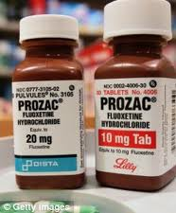
Getting Help for Depression
If you recognize signs of depression in yourself or a friend, discuss
your concerns with a trusted adult.
Depression is a treatable illness!!!
Health professionals can develop a depression-treatment plan that may include:

Slide 11
More Than Sad : Teen Depression

Slide 12
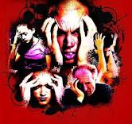
Chapter #5 Lesson 2
Mental Disorders

Slide 13
Understanding Mental Disorders
Mental Disorder: an illness of the mind that can affect the thoughts, feelings, and behaviors of a person, preventing them from leading a happy, healthful, and productive life.
Stigma: a mark of shame or disapproval that results in an individual being shunned or rejected by others.

Slide 14
Anxiety Disorders
Anxiety Disorder: A condition in which real or imagined fears are difficult to control

Slide 15
Phobia: A strong, irrational fear of something specific, such as heights or social situations.

Slide 16
Cotton Ball Phobia!!!!

Slide 17
Obsessive Compulsive Disorder
Persistent thoughts, fears, or urges (obsessions) leading to uncontrollable repetitive behaviors (compulsions). For example, the fear of germs leads to constant hand washing.

Slide 18
Post Traumatic Stress Disorder
A condition that may develop after exposure to a terrifying event. Symptoms include flashbacks, nightmares, emotional numbness, guilt, sleeplessness, and problems concentrating.

Slide 19
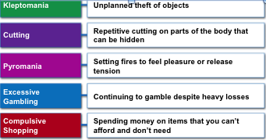
Impulse Control Disorders
People with impulse control disorders cannot resist the urge to hurt themselves or others.

Slide 20
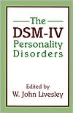
Misc. Mental Disorders
Eating disorders like anorexia nervosa, bulimia nervosa, or binge eating commonly occur during the teen years. Eating disorders can lead to unhealthful weight loss and death.
A person with a mood disorder experiences extreme moods that are more severe than the normal highs and lows everyone experiences.
Conduct Disorder : Patterns of behavior in which the rights of others or basic social rules are violated
Examples of conduct disorder include stealing, cruelty, lying, aggression, violence, truancy, arson, and vandalism.
Teens with personality disorders are unable to regulate their emotions.
They may feel distressed in social situations or may behave in ways that are distressing to others.

Slide 21
Bipolar Disorder
Bipolar Disorder or manic-depressive disorder is marked by extreme mood changes , energy levels , and behavior.

Slide 22
Schizophrenia :
Schizophrenia is a mental disorder in which a person loses contact with reality.
Symptoms include unpredictable behavior, delusions, hallucinations, and thought disorders.

Slide 23
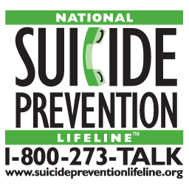
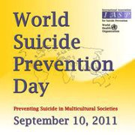
Chapter #5 Lesson 3
Suicide Prevention

Slide 24
Knowing the Facts of Suicide
Alienation : feeling isolated and separated from everyone else.
Suicide: the act of intentionally taking one’s own life
3rd leading cause of death 15-19 year olds
90% suffering from depression, mental disorder, substance abuse.
Cluster Suicide: a series of suicides occurring with a short period of time and involving several people in the same school or community.
5% of all teen suicides

Slide 25
Strategies to Prevent Suicide
Warning Signs of Suicide
Direct statements such as “I wish I were dead.”
Indirect statements such as “I can’t take it anymore.”
Writing poems, song lyrics, or diary entries that deal with death
Direct or indirect suicide threats
An unusual obsession with death

Slide 26
Strategies to Prevent Suicide
Warning Signs of Suicide
Withdrawal from friends
Dramatic changes in personality, hygiene, or appearance Impulsive, irrational, or unusual behavior
A sense of guilt, shame, or rejection; negative self-evaluation
Deterioration in schoolwork or recreational performance
Giving away personal belongings

Slide 27
Strategies to Prevent Suicide
Warning Signs of Suicide
Substance abuse
Complaints about physical symptoms, such as stomachaches, headaches, and fatigue
Persistent boredom and indifference
Violent actions, rebellious behavior, or running away Intolerance for praise or rewards

Slide 28
Depression / Teen Suicide

Slide 29
How Can You Help!!
Show that you care and are concerned.
Help them seek professional help.
Take any and all talk seriously. Show empathy.
Stress temporary nature of that problems or feelings.
Make clear that you know they want to end their pain- but suicide is not the answer.
Ask if they have a specific plan and means to follow through with it.
Suggest they talk to a trusted adult.
DO NOT AGREE TO “KEEP A SECRET.
* Boy walking down the hallway and spills his books story.

Slide 30
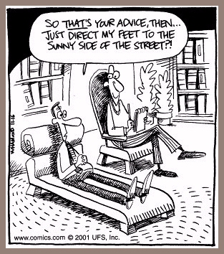
Chapter #5 Lesson 4
Getting Help

Slide 31
When Help is Needed
Feeling trapped or worrying all the time
Feelings that affect sleep, eating habits, schoolwork, job performance, or relationships
Becoming involved with alcohol or other drugs
Becoming increasingly aggressive, violent, or reckless

Slide 32
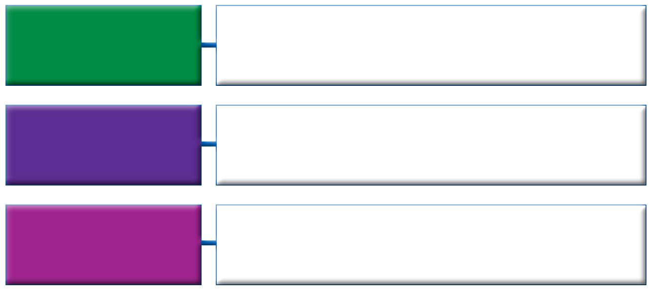
Mental Health Professionals
Counselor
A professional who handles personal and educational matters
School Psychologist
A professional who specializes in the assessment of learning, emotional, and behavioral problems of schoolchildren
Psychiatrist
A physician who diagnoses and treats mental disorders and can prescribe medications

Slide 33
Mental Health Professionals
Neurologist
A physician who specializes in physical disorders of the brain and nervous system
Clinical Psychologist
A professional who diagnoses and treats emotional and behavioral disorders with counseling. Some can prescribe medications
Psychiatric Social Worker
A professional who provides guidance and treatment for emotional problems in a hospital, mental health clinic, or family service agency

Slide 34
Treatment Methods
Psychotherapy: An ongoing dialogue between a patient and a mental health professional
Behavior Therapy : A treatment process that focuses on changing unwanted behaviors through rewards and reinforcements
Cognitive Therapy : A treatment method designed to identify and correct distorted thinking patterns that can lead to feelings and behaviors that may be troublesome, self-defeating, or self-destructive
Family Therapy : Treatment that focuses on helping the family function in more positive and constructive ways by exploring patterns in communication and providing support and education
Group Therapy : Treating a group of people who have similar problems and who meet regularly with a trained counselor.
Drug Therapy : : The use of certain medications to treat or reduce symptoms of a mental disorder.

