Slide 1
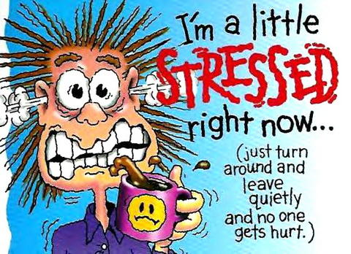
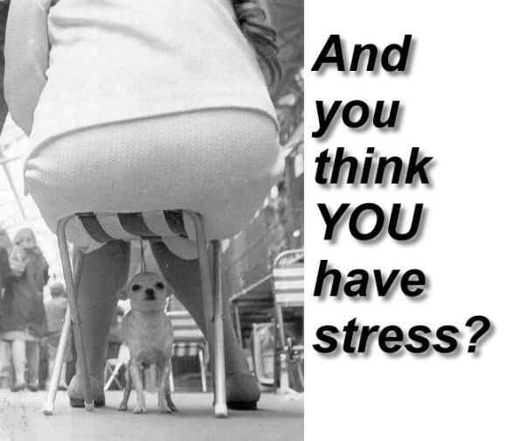
Chapter #4 Lesson#1
Understanding Stress

Slide 2
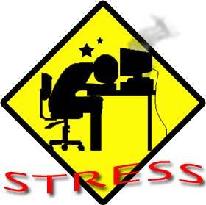
What is Stress?
Stress: is the reaction of the body and the mind to everyday challenges and demands.
Perception: is the act of becoming aware through the senses.
Stress can be positive or negative!!

Slide 3
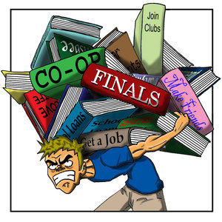
Causes of Stress
Stressor : anything that causes stress.
People, objects, places, events, and situations are all potential stressors.

Slide 4
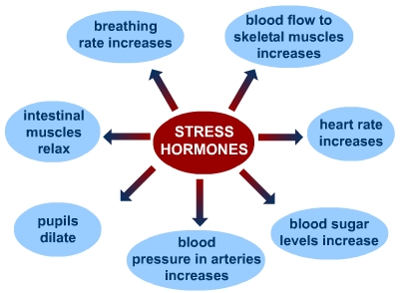
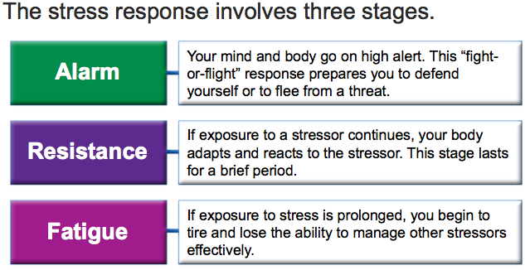
Your Body’s Response to Stress

Slide 5
Stress and Your Health
Psychosomatic Response: a physical reaction that results from stress rather than an injury or illness.
Headache
Weakened immune system
High blood pressure
Bruxism- clenching of jaw- grinding of teeth
Digestive disorders

Slide 6
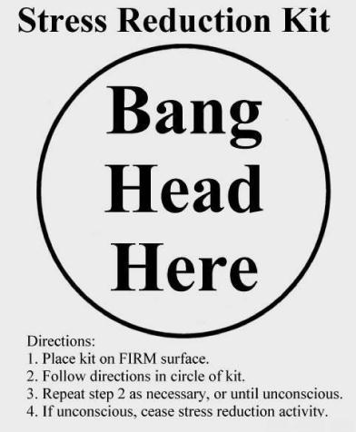
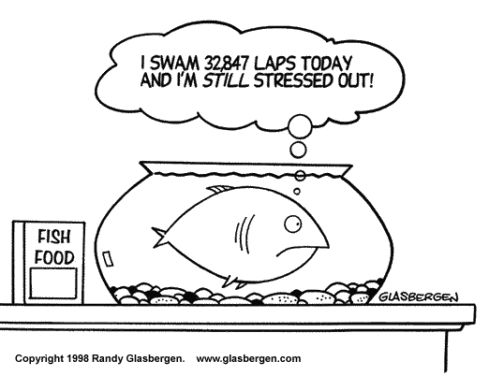
Chapter #4 Lesson 2
Managing Stress

Slide 7
When Stress Becomes A Problem
Identifying what is stressful is the first step in learning how to manage stress.
The effects of stress are “additive”, meaning they build up over time. Unless you find ways to manage it it will take a physical and /or mental toll.
Chronic Stress: stress that is associated with long-term problems that are beyond a person’s control.

Slide 8
Stress Management Techniques
Strategies for Avoiding and Limiting Stress

Slide 9
Handling Stress and Reducing Its Effects
To lower the impact of stress on your health, try these tips:
Relaxation Response: a state of calm.

Slide 10
Stay Healthy And Building Resiliency
Get Adequate Rest
Adequate sleep can help you face the challenges and demands of the next day.
Using time-management skills will allow you to get the eight to nine hours of sleep that you need each night.
Get Regular Physical Activity
Participating in regular physical activity benefits your overall health.
Physical activity can release pent-up energy, clear your mind, increase your energy level and your endurance, and help you sleep better.
Eat Nutritious Foods
Eating a variety of healthful foods and drinking plenty of water not only helps your body function properly, but it also reduces the effects of stress.
Poor eating habits can contribute to stress, causing weakness, fatigue, and a reduced ability to concentrate

Slide 11
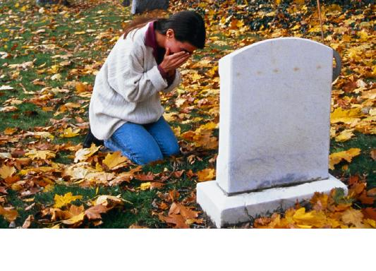
Chapter #4 Lesson 3
Coping with Loss and Grief

Slide 12
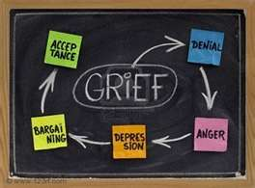
Stages of Grief (Dr. Elisabeth Kubler-Ross)
Stages of Grief: a variety of reactions that may surface as an individual
makes sense of how a loss affects them.
1. Denial or Numbness (Can not believe loss has occurred)
Emotional Release
2. Anger (Why me? Critical, uncooperative)
3. Bargaining (Promises)
4. Depression (Silence/ Withdrawal)
Remorse
5. Acceptance (Face Reality)
Hope

Slide 13
The Grieving Process

Slide 14
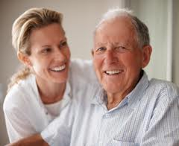
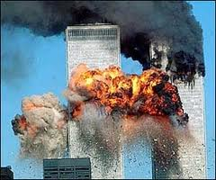
Factors That Influence Grief
How well you know the person
Age of person
Sudden Death vs. Long Term Illness
Traumatic Event : any event that has a stressful
impact sufficient to overwhelm
your normal coping strategies.
Mourning: dealing successfully with difficult changes
in your life.

Slide 15
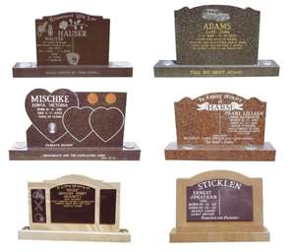
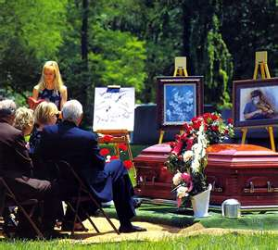
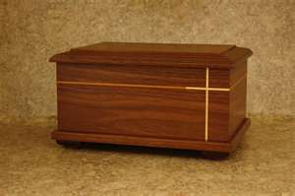
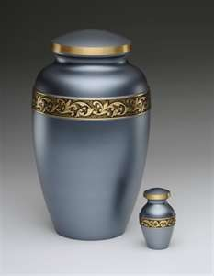
Closure
A coming to and end of the most intense parts of the grieving process.
Closure: acceptance of a loss.
- Funerals -Visitations/Wakes
- Memorial Services - Cemetery

