Slide 1
Unit #2
Mental & Emotional Health
Chapters #3, #4, #5

Slide 2
Chapter #3 Lesson #1
Developing Your Self -Esteem

Slide 3
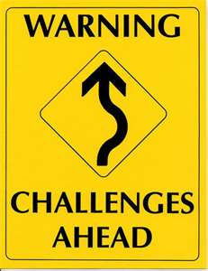
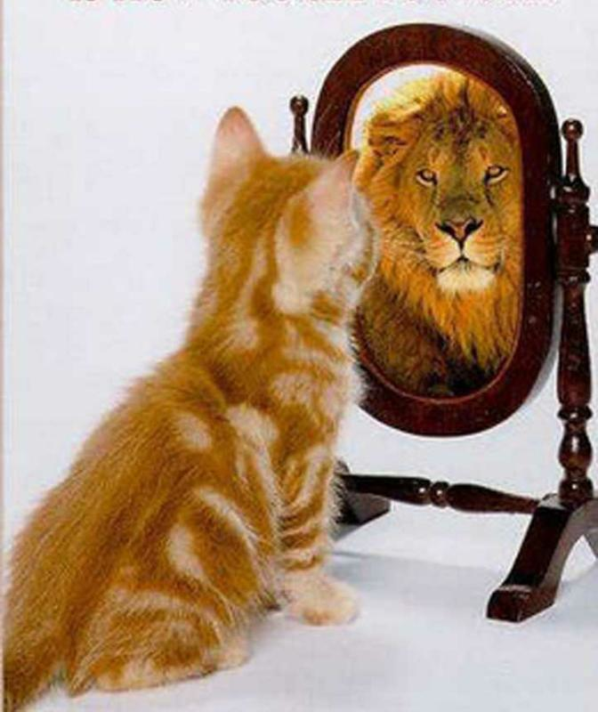
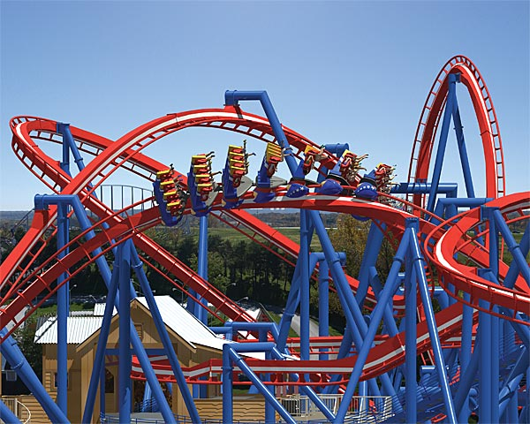
What is Mental and Emotional Health
Mental/Emotional Health: the ability to accept yourself and others, express and manage your emotions and deal with the demands and challenges you meet in your life.
Mentally healthy people are in general:
happy and enjoy their lives
Confident and comfortable with spending time alone
Flexible and can cope with a wide variety of feelings.

Slide 4
Characteristics of Good mental and Emotional health
Resilient:
Having the ability to adapt effectively and recover from disappointment, difficulty, or crisis.

Slide 6
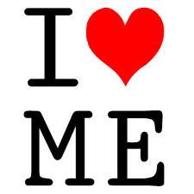
Self -Esteem
Self-esteem – how much you value, respect and feel confident about yourself
Competence – having enough skills to do something.
Self-talk – the encouragement or criticism that you give yourself
Positive self talk = strong self-esteem
**Victor Story**

Slide 7
Improving your self-esteem

Slide 8
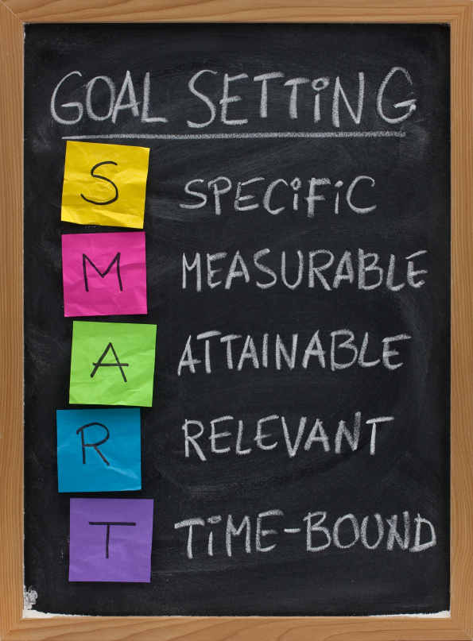
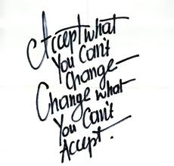
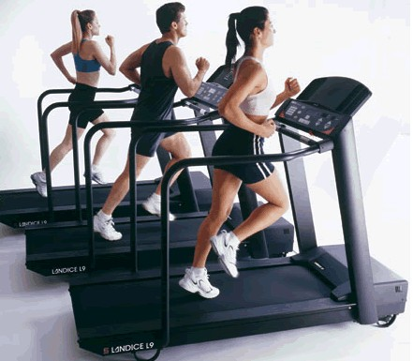
Improving your self-esteem

Slide 9
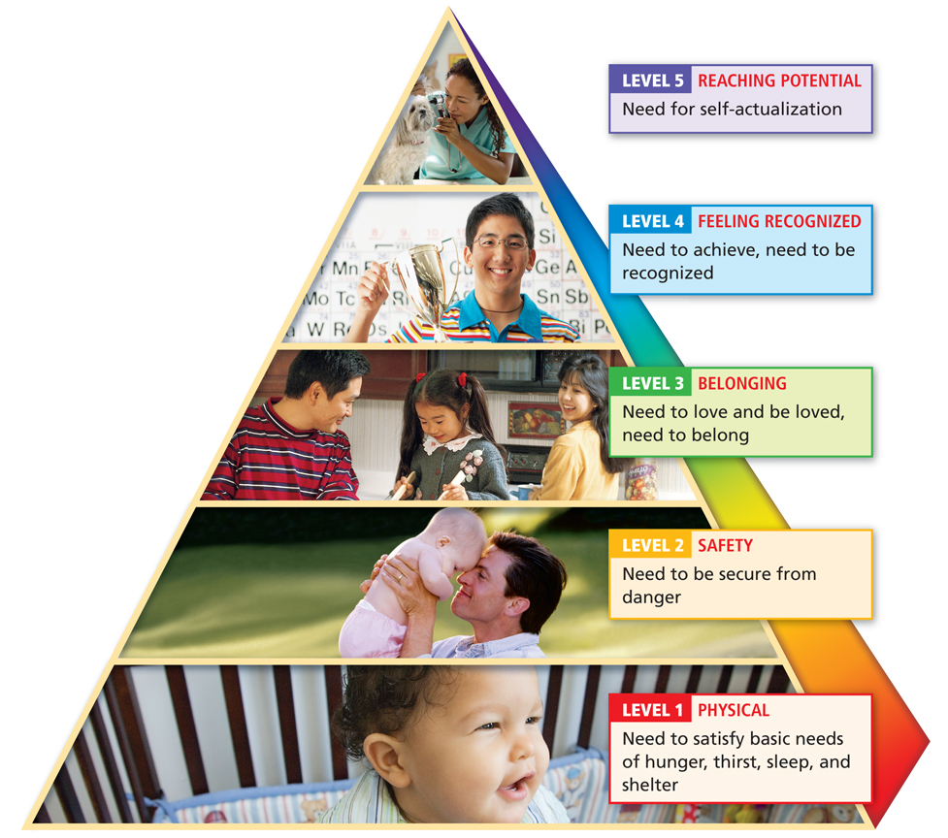
Developing Self-Awareness
Hierarchy of Needs - a ranked list of those needs essential to human growth and development, presented in ascending order, starting with basic needs and building toward the need to reach your highest potential

Slide 10
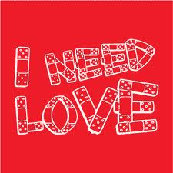
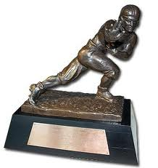
Developing Self-Awareness
Maslow’s hierarchy shows that once our basic physical and safety needs are met, we become interested in meeting these needs:
The need to belong and be loved.
The need to be valued and recognized.
The need to reach our potential or to achieve self actualization.
Self-Actualization - to strive to be the best you can.

Slide 11
Chapter #3 Lesson #2
Developing Personal Identity and Character

Slide 12
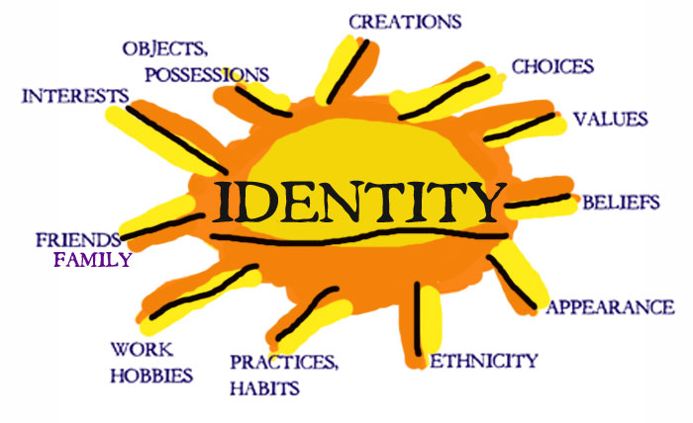
Your Personal Identity
Personal Identity – your sense of yourself as a unique individual.
Role Model – someone whose success or behavior serves as an example for you.
Personality – a complex set of criteria that makes you unique.

Slide 13
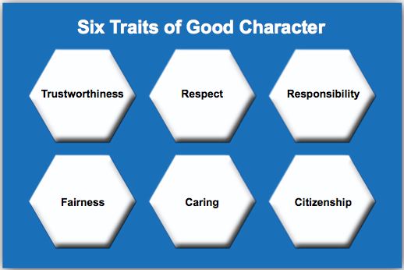
The importance of Good Character
Character – the distinctive qualities that describe how a person thinks, feels and behaves.
Integrity – a firm observance of core ethical values.

Slide 14
Working toward a positive Identity

Slide 15
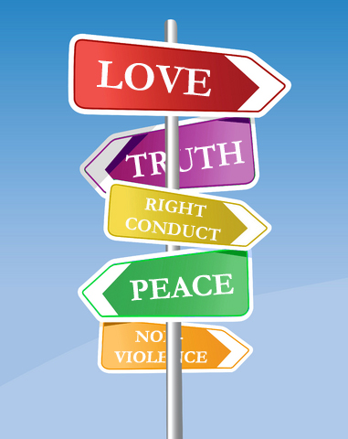
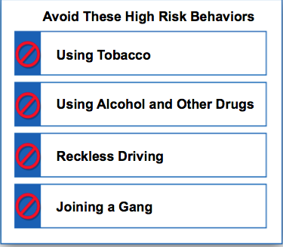
Working toward a positive Identity
Recognize Your Strengths and Weaknesses
Demonstrate Positive Values
Develop a Purpose in Your Life
Form Meaningful Relationships
Constructive Criticism – non hostile comments that point out problems and encourage improvement.
Avoid Unhealthful High-Risk Behaviors
Contribute to the Community

Slide 16
Chapter #3 Lesson #3
Expressing Emotions in Healthy Ways

Slide 17
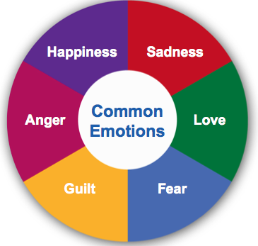
Understanding emotions
Emotions – signals that tell your mind and body how to react
Hormones- chemicals produced by your glands that regulate the activities of different body cells.
E
M
O
T
I
O
N
S
E
M
O
T
I
O
N
S
Hostility – the intentional use of unfriendly or offensive behavior

Slide 18
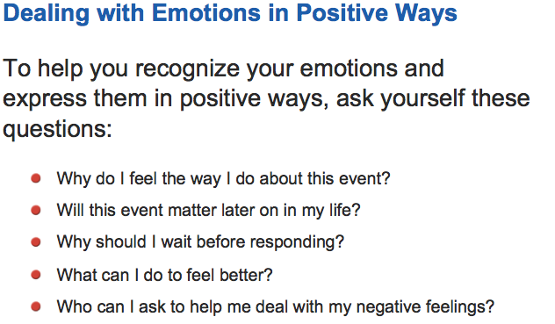
Managing your emotions
Empathy – the ability to imagine and understand how someone else feels.

Slide 19
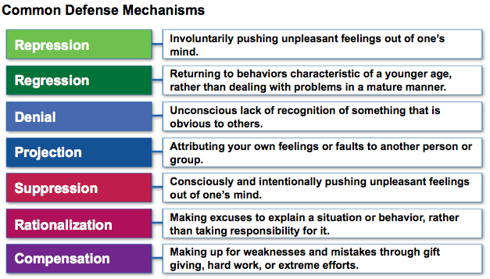
Responding to Difficult emotions
Defense Mechanisms - mental processes that protect individuals from strong or stressful emotions and situations

Slide 20
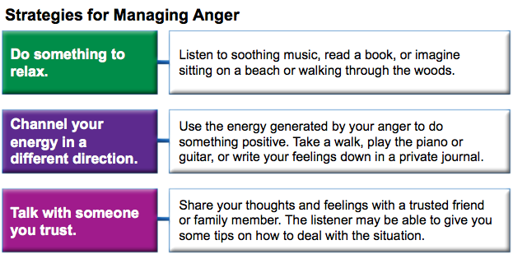
Managing Anger

