Slide 2
Goal Setting Activity
STAND UP
Find a partner, doesn’t matter who it is…
Listen for directions…
How do we create success?

Slide 3
Making the Connection…

Slide 4
Create a New Path…

Slide 5
Chapter 2
Lesson Three: Being a Health Literate Consumer

Slide 6
Making Informed Choices
It is important to be a smart consumer (shopper), especially when your health is involved.
Health Consumer- someone who purchases or uses health products or services.
Its all about making good decisions.
Advertising- a written or spoken media message designed to interest consumers in purchasing a product or service.

Slide 7
What to buy?
Tough Decision

Slide 8
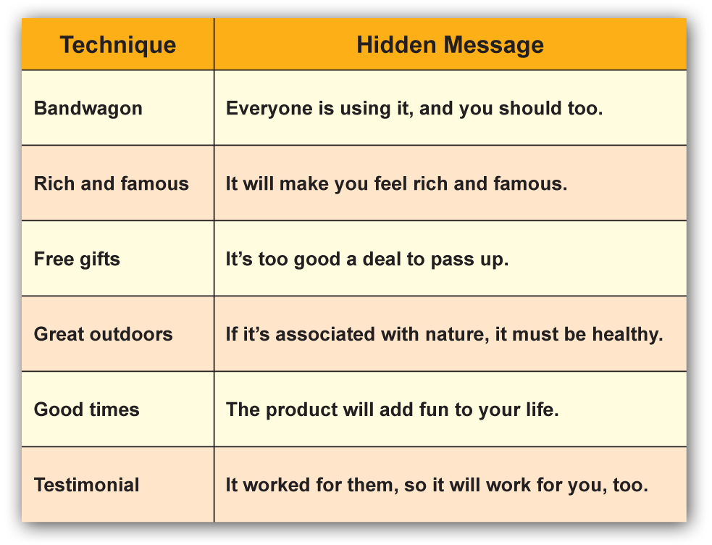
Hidden Messages in Advertising

Slide 9
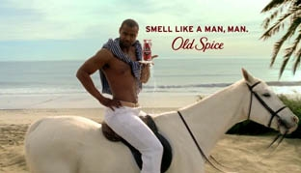
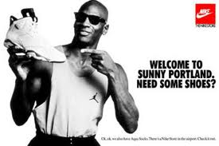
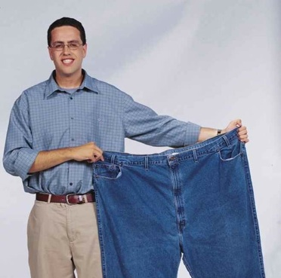
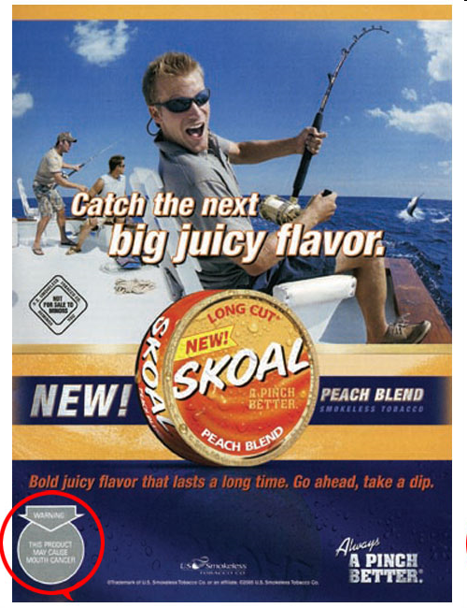

Slide 10
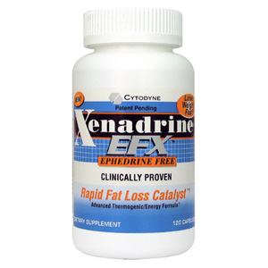
Xenadrine
What type of advertising do you see here?

Slide 11
Sprite
What type of advertising do you see here?

Slide 12
Coors Light
What type of advertising do you see here?

Slide 13
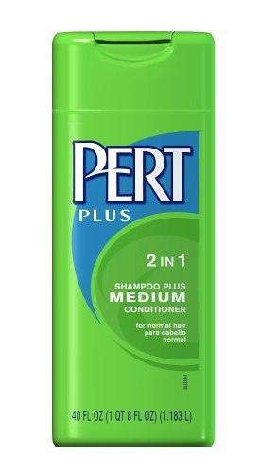
Evaluating Products
Comparison Shopping- judging the benefits of different products by comparing several factors, such as quality, features and cost.
Generic vs. Designer
Cub/Target brand vs. Name brand

