Slide 2
Chapter 2
Taking Charge of Your Health
Lesson One: Building Health Skills

Slide 3
Health Skills
Health Skills- Specific tools and strategies to maintain, protect, and improve all aspects of your health. Also called “life skills.”
The Health Skills
Communication
Refusal
Conflict Resolution
Accessing Information
Analyzing Influences
Practicing Healthful Behaviors
Stress Management
Advocacy
Decision Making
Goal Setting

Slide 4
Communication Skills
Communication is more than just talking
It is a combination of Interpersonal Communication, Refusal Skills, and Conflict Resolution.
Interpersonal Communication- the exchange of thoughts, feelings and beliefs between two or more people. Helps build strong relationships with others.
Refusal Skills- communication strategies that can help you say no when you are urged to take part in behaviors that are unsafe or unhealthful, or go against your values.
Conflict Resolution- the process of ending a conflict through cooperation and problem solving.

Slide 5
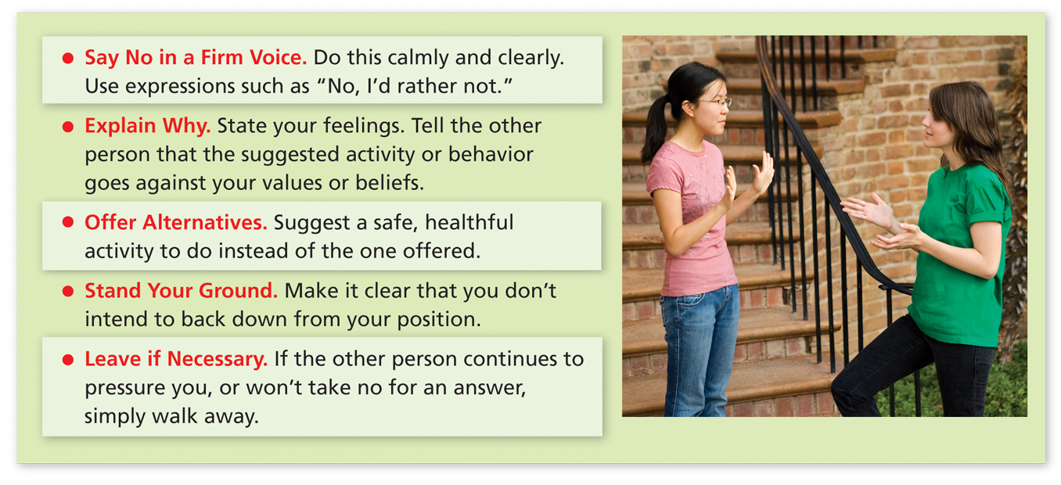
These refusal strategies can help you say no to potentially harmful activities.

Slide 6
Refusal Skill Practice
60 Second Activity
STAND UP
Face the person across from you
What are other situations where you might be asked to do something against your values?

Slide 7
Accessing Information
Knowing how to find and evaluate health information will help you make decisions that benefit your well-being.
“Health Literacy”
Some valid sources include…
Health care providers and professionals
Valid Internet sites, such as those of government agencies and professional health organizations
Parents, guardians, and other trusted adults
Recently published material written by well-known science and health professionals.

Slide 8
Analyzing Influences
“Why do you do the things you do?”
What affects your health…?

Slide 9
Self-Management Skills
Taking charge of your own health
Helps you promote your own well-being.
Practicing Healthful Behaviors
Managing Stress

Slide 10
Managing Stress
Stress- the reaction of the body and mind to everyday challenges and demands.
School, teachers, tests, relationships, family, work, chores, pets, future, college, career, etc.
Stress is normal, but too much can lead to illnesses.

Slide 11
Which Stresses you out more?
Get out your cell phone…
Poll Everywhere question of the day…

Slide 12
Chapter 2
Lesson Two: Making Responsible Decisions and Setting Goals

Slide 13
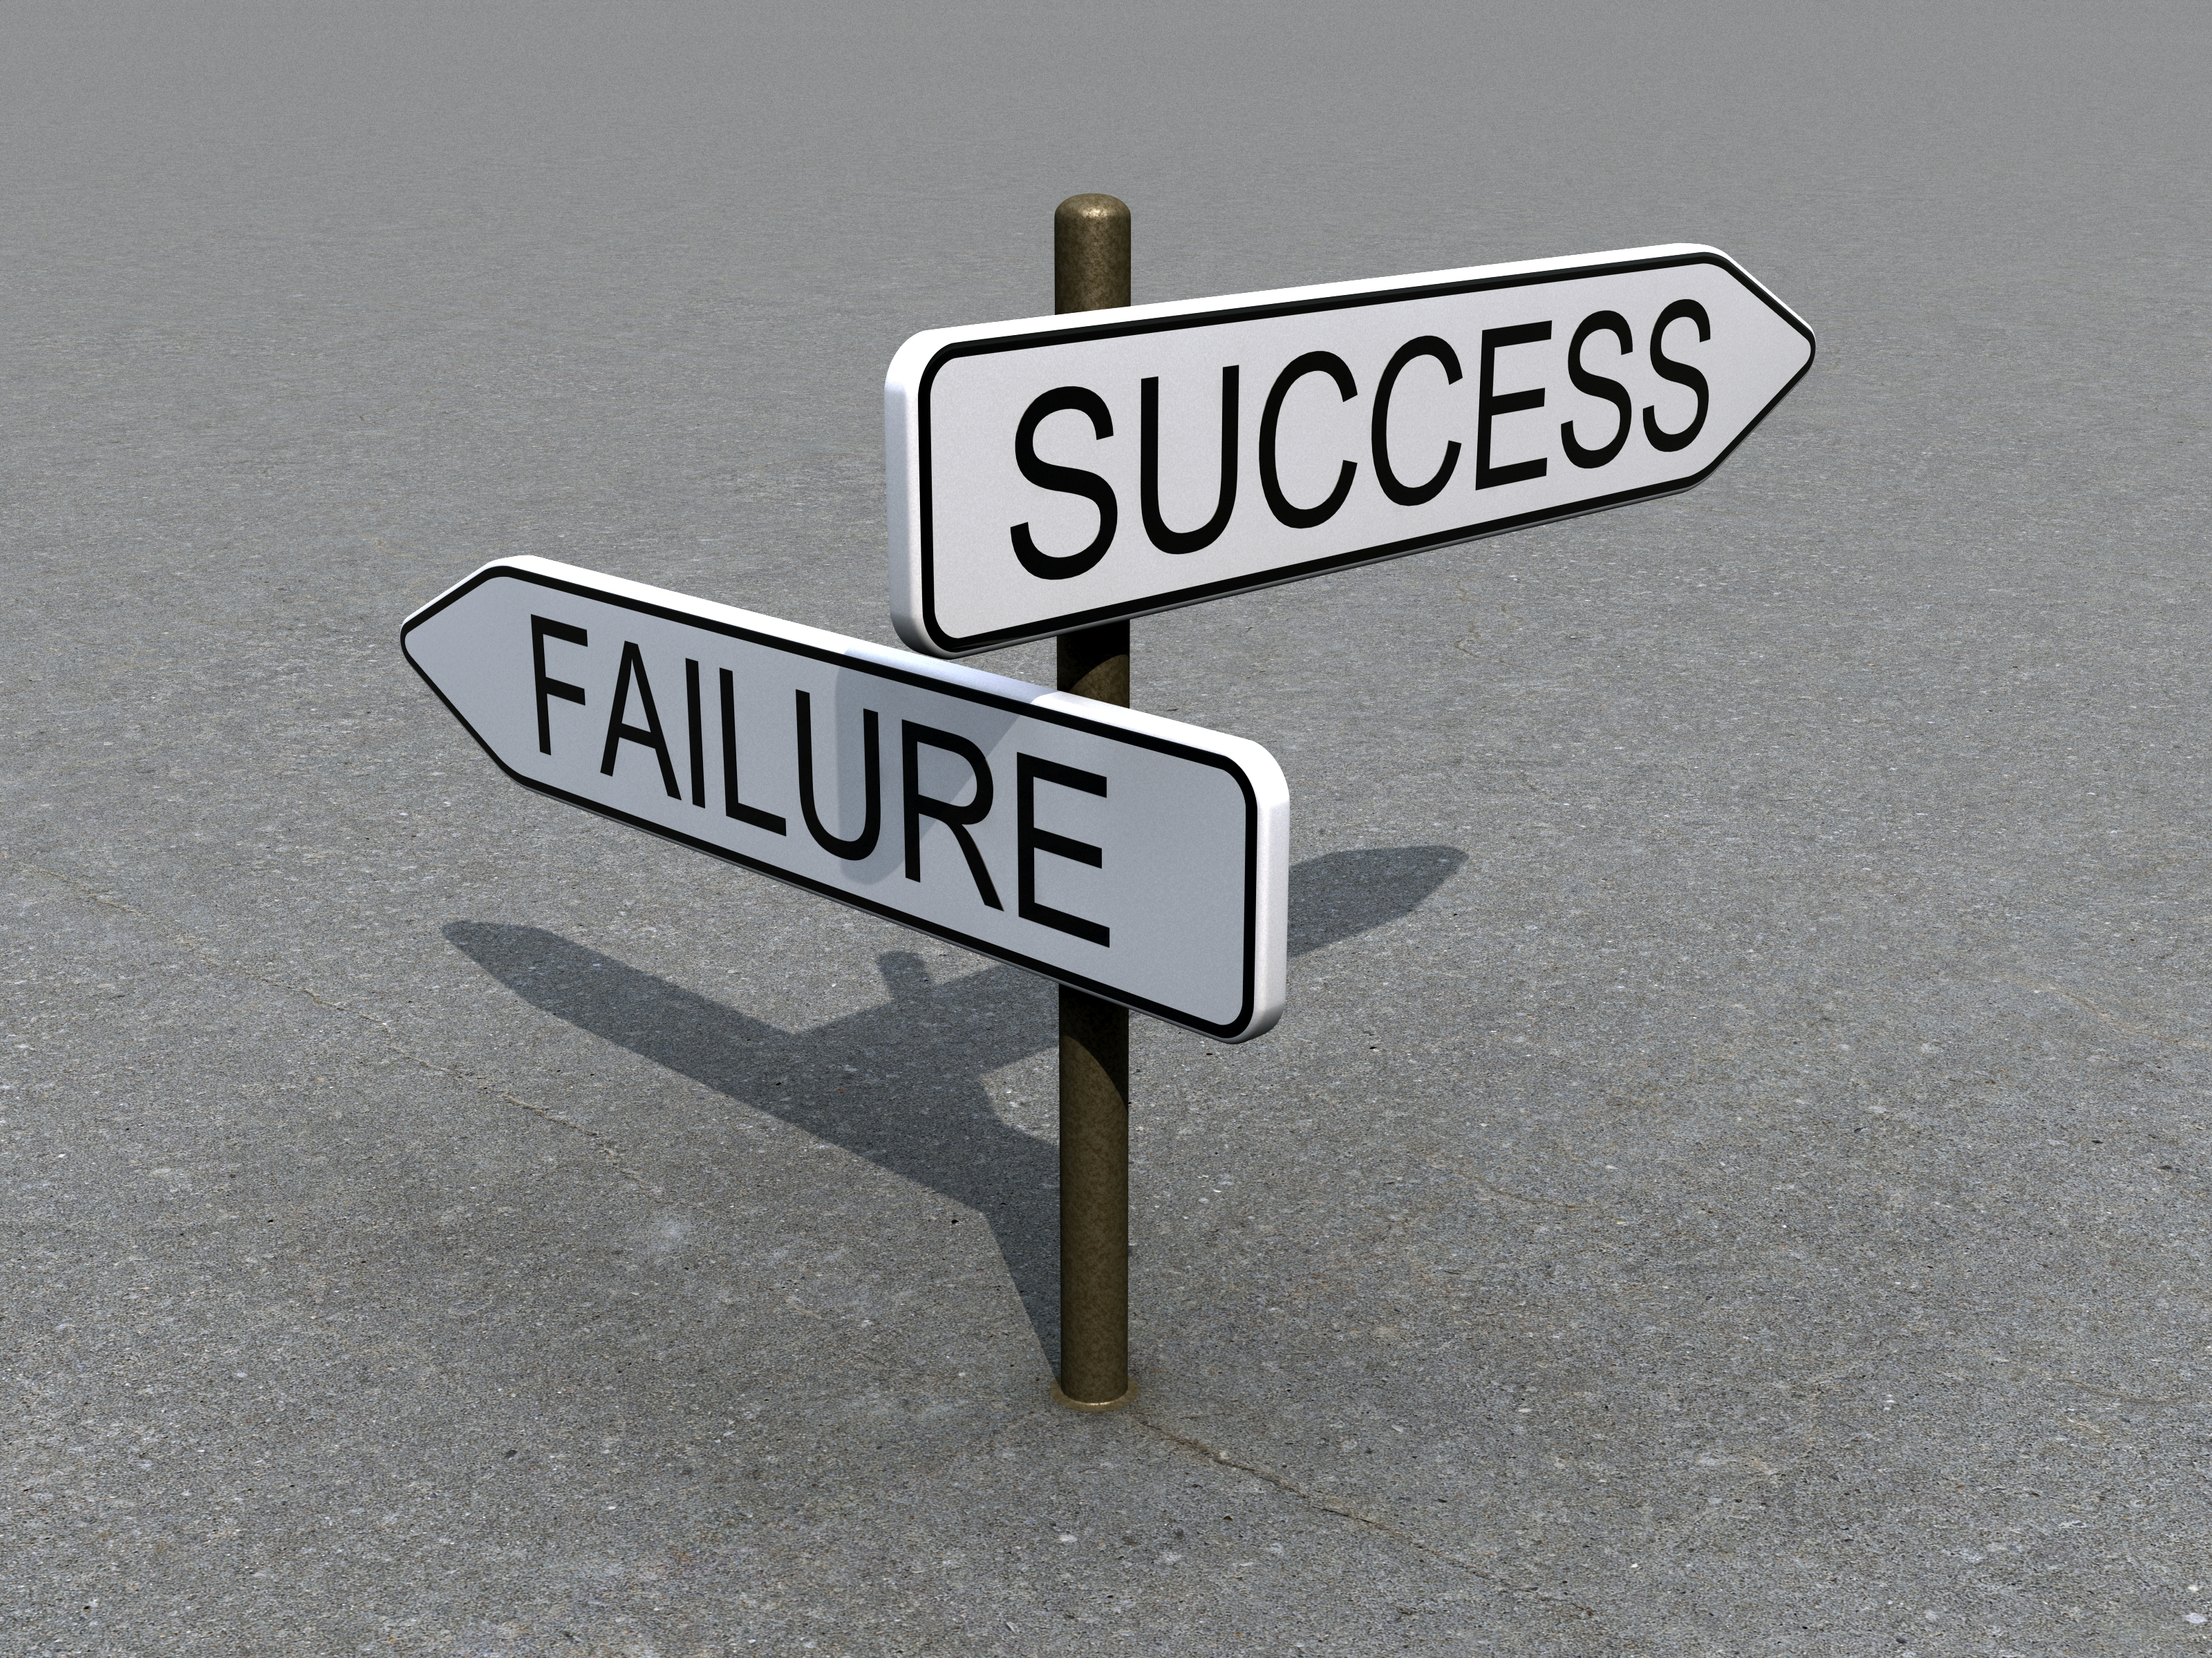
Decision Making
We make decisions everyday.
Some are small, some are life changing.
Consider your Values- ideas, beliefs, and attitudes about what is important that help guide the way you live.

Slide 14
Decision Making Process
Decision Making Skills- steps that enable you to make a healthful decision.
When weighing the options for any decision, ask yourself these questions:
H
(Healthful) Does this choice present any health risks?
E
(Ethical) Does this choice reflect what you value?
L
(Legal) Does this option violate any local, state, or federal laws?
P
(Parent Approval) Would your parents or guardians approve of this choice?

Slide 15
Goal Setting
Goals- those things you aim for that take planning and work.
This is how we plan for the future and reach our potential.
Short-term goals- a goal you can reach in a short amount of time.
Finishing a paper by Friday, eating healthy this week, etc.
Long-term goals- a goal that you plan to reach over an extended period of time.
Examples: Graduate from HS, go to college, save $$ for a trip, etc.
Action Plan- A multistep strategy to identify and achieve your goals.

