Slide 1
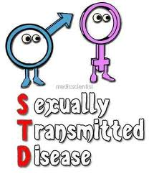
Chapter 24, Lesson 1
Sexually Transmitted Diseases

Slide 2
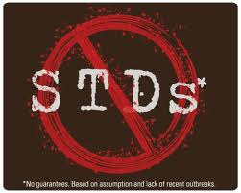
What are STD’s?
STDs: Infections spread from person to person through sexual contact
Also known as: STI: sexually transmitted infections are communicable diseases easily transmitted from one person to another
Must engage in sexual activity that involves direct genital contact or exchange of semen or other body fluids with someone infected with STD

Slide 3
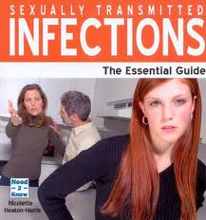
Causes
Some STDs caused by bacterial infection and can be cured with medication
Other STDs caused by viruses and are incurable
Early diagnosis and treatment are crucial to controlling or curing an STD

Slide 4
Symptoms??
Asymptomatic: Individuals show no symptoms or symptoms are mild and disappear after the onset of the infection
This lack of symptoms makes STDs particularly dangerous; may not realize that he/she infected
Risk of contracting STD increases as number of sexual partners increases
Females are more likely to suffer complications from STDs, effects more serious in females then males

Slide 5
25 STDs worldwide; six are considered most common:
Genital HPV infections,
Chlamydia,
Genital Herpes,
Gonorrhea,
Trichomoniasis,
and Syphilis

Slide 6
Genital HPV Infections
Caused by human papillomavirus (HPV), group of more than 100 kinds of viruses; 30 transmitted through sexual contact
HPV infections can cause genital warts, which appear as bumps or growths near or on the genitals.
May result in certain types of cervical cancer
A vaccine treatment is now available for protection against HPV. It’s not a cure, but recommended to reduce then number of cases of cervical cancer

Slide 7
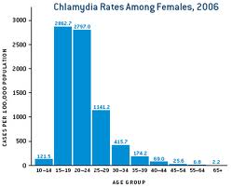
Chlamydia
Bacterial infection affects reproductive organs both males and females
Affecting young females 3 times more often than males
Most common STD among teens

Slide 8
Chlamydia (cont…)
Females develop pelvic inflammatory disease (PID) and suffer chronic pelvic pain or infertility
Infertility in males as well
Pregnant females can deliver prematurely and infants born to infected mothers may develop eye disease or pneumonia as well as fatal complications
Females 5 times more likely to become infected with HIV if exposed to virus

Slide 9
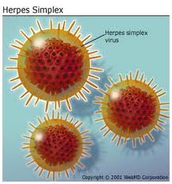
Genital Herpes
Caused by herpes simplex virus
Herpes simplex 1 usually causes cold sores in or near mouth
Herpes simplex 2 typically causes genital sore
Most are unaware they have infection

Slide 10
Genital Herpes (cont…)
First outbreak will usually appear as blisters on genitals or rectum within two weeks of virus being transmitted
Blisters break, leaving sores that can take several weeks to heal
First sores are followed by shorter, less severe outbreaks that can occur on and off for years
Antiviral treatments can lessen frequency of outbreaks, but no cure

Slide 11
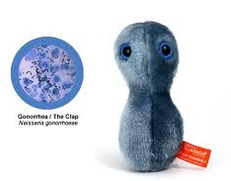
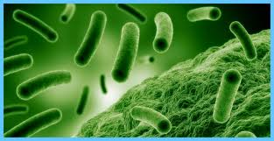
Gonorrhea
Bacterial STD usually affects mucous membranes
2nd most common reported infectious disease in US
Many males are asymptomatic and infected females show only mild symptoms
Left untreated, cause severe health problems, such as infertility
Females can pass infection to babies during childbirth’ babies may contract eye infections that cause blindness

Slide 12
Trichomoniasis
Caused by microscopic protozoan that results in infections of vagina, urethra, and bladder
May not produce symptoms; some males have temporary irritation inside penis, mild discharge, or slight burning during and after urination or ejaculation
Infected females often experience vaginitis, inflammation of vagina characterized by discharge, odor, irritation, and itching.

Slide 13
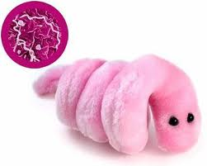
Syphilis
An infection caused by small bacterium called a spirochete, attacks many parts of the body
Develop sores in the genital area lasting a couple of weeks
Passed from one person to another by direct contract with the sores during sexual activity

Slide 14
Syphilis (cont…)
Progresses through three stages:
Primary stage: sore appears on external genitals or vagina; at this stage disease can be easily treated
Second stage: infection produces a skin rash; untreated rash will disappear but infection remains the progresses to third stage
Third stage: can damage internal organs cause brain dementia and may cause death

Slide 15
STD Epidemic
US facing STD epidemic
CDC estimates each year 19 million people are infected with STD
Almost half under age of 24
Any STD cases go undiagnosed and untreated because of:
Embarrassment or fear
Lack of symptoms
Misinformation
Notification policies

Slide 16
Preventing and Treating STD’s
Chapter 24, Lesson 2

Slide 17
Prevention Through Abstinence
Most successful method to prevent the spread of STDs is abstinence
9 million American teens contract STDs annually
Any STDs that are not diagnosed early and treated can result in serious permanent or long-term health consequences
The only method that is 100 percent successful in preventing the contraction of STDs is abstinence

Slide 18
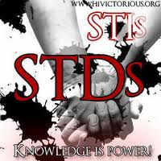
Avoiding High-Risk Behaviors and STDs
High-risk behaviors include:
Being sexually active with more than one person
Engaging in unprotected sex
Engaging in sexual activity with high-risk partners
Using alcohol and other drugs

Slide 19
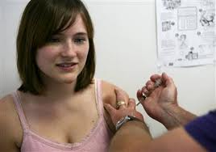
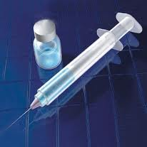
HPV Vaccine
HPV vaccine- vaccine that can prevent cervical cancer, pre-cancerous genital lesions (or sores), and genital warts caused by genital HPV infection
Protects against 4 types of HPV infections
Health officials recommend the vaccine for males/females 9 to 26 years old

Slide 20
Diagnosing and Treating STDs
Only a health care professional can accurately diagnose and treat an STD
Teens who believe they might be infected with an STD should talk to a health care professional
Many public health clinics provide information and treatment free of charge
Not all genital infections are STDs; some are localized skin infections or rashes

Slide 21
Act Responsibly
Everyone has an obligation to prevent the spread of STDs
One way to help control this epidemic is to practice abstinence
Second way is to report any known infections
It is responsibility of any person infected with an STD to notify everyone with whom he or she has had sexual contact
It could save a life

