Slide 1
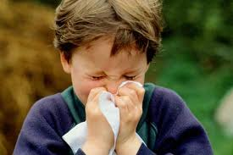
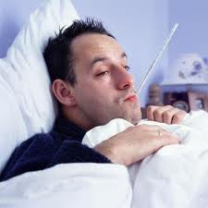
Understanding Communicable Diseases
Chapter 23, Lesson 1

Slide 2
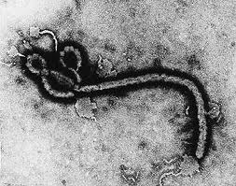
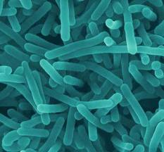
Communicable Diseases
Communicable Disease- disease that is spread from one living organism to another or through the environment
Example: illnesses that are contagious and infectious
Pathogens- Microorganisms that cause disease
Examples- Viruses, Bacteria, Fungi, Protozoa, Rickettsias

Slide 3
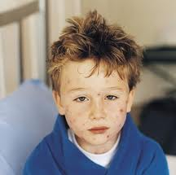
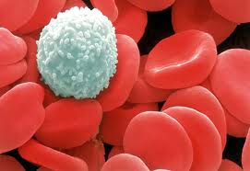
Communicable Diseases
Communicable Diseases occur when pathogens enter the body
If body doesn’t fight invaders, develop an infection
Infection- condition that occurs when pathogens in the body multiply and damage body cells

Slide 4
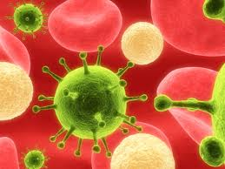
Viruses
2 most common CD-cold and flu, caused by viruses
Virus-piece of genetic material surrounded by a protein coat
Once a virus penetrates a cell, it begins to multiply
New viruses burst out of cell and take over other cells
Immune system kicks in and usually kills virus
Antibiotics do not work against viruses, but sometimes can treat symptoms of virus

Slide 5
How Viruses Work…
Viruses :42

Slide 6
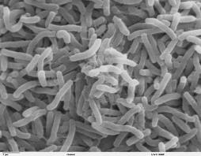
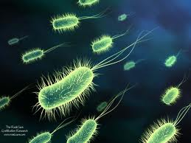
Bacteria
Bacteria-single-celled microorganisms that live almost everywhere on earth
Most harmless
Some helpful, like ones in food
Toxins-substances that kill cells or interfere with their functions
Can be treated with antibiotics
Because of overuse of these drugs, some bacteria have become resistant to antibiotics
Bacterial Growth :16

Slide 7
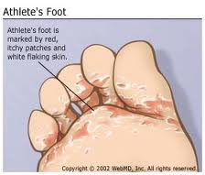
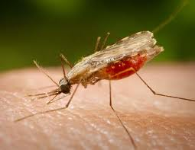
Other Pathogens
Fungi- plantlike organisms that can cause diseases of lunch, mucous membranes and skin
Example: Athlete’s foot
Protozoa- single celled microorganisms that are larger and more complex than bacteria
Example: Malaria
Rickettsias- resemble bacteria, often enter body through insect bites
Example: Typhus

Slide 8
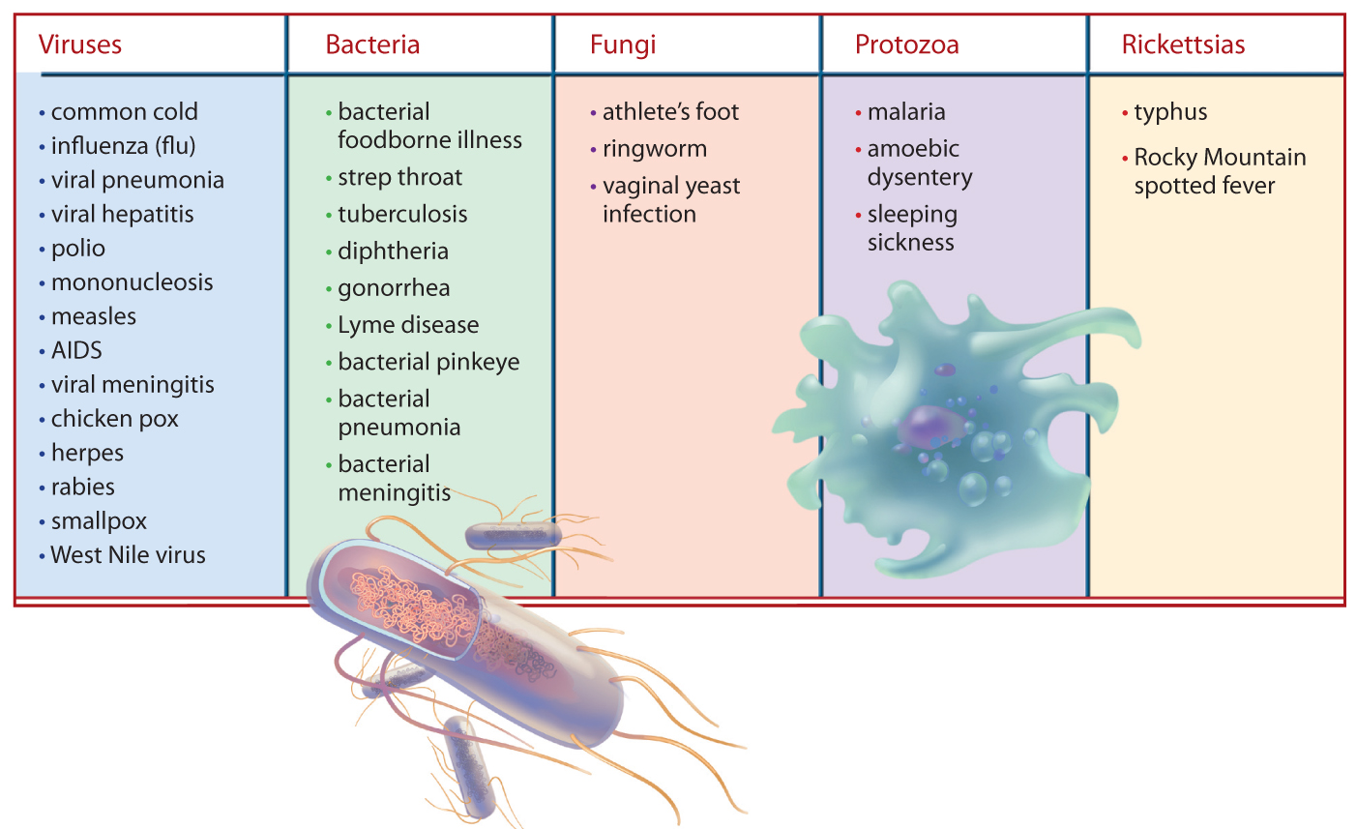
Causes of Communicable Diseases

Slide 9
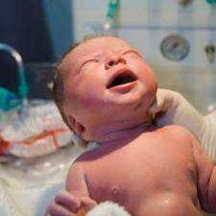
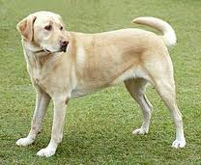
How Diseases Spread
Direct Contact- touching, biting, kissing, sexual contact
Other transmission methods:
Puncture wounds-can get tetanus from rusty nail
Childbirth-pregnant woman transmit an infection to her unborn child through placenta
Contact with infected animals-animal bites and scratches can sometimes transmit disease

Slide 10
How Diseases Spread (cont.)
Indirect Contact- can be just as dangerous
Contaminated Objects- if touch contaminated object (doorknob) could pick up pathogens; pathogens enter body if you rub your eyes; ALWAYS wash your hands regularly!!
Washing Hands 3:39

Slide 11
Other Ways
Vectors- an organism that carries and transmits pathogens to humans or other animals; common ones include: flies, mosquitoes,& ticks
Examples- West Nile, Malaria, Lyme disease… called vector-borne diseases
Contaminated Food and Water- when food improperly handled or stored; bacteria can develop
True for: meat, fish, fruits, vegetables, water supplies (hepatitis A)

Slide 12
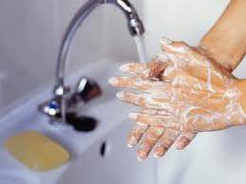
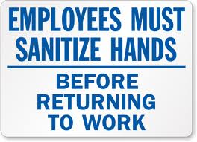
Taking Precautions
Wash Your Hands
Before you eat
After you use the bathroom
After handling pets
Before and after inserting contact lenses or applying makeup
After touching an object handled by an infected person

Slide 13
Taking Precautions (cont.)
What are some ways to protect against Vectors?
Protect Yourself from Vectors
Limit time you spend outdoors at dawn and dusk, when mosquitoes are most active
Wear pants and long-sleeved shirts to avoid insect bites
Use insect repellent and avoid contact with dead birds

Slide 14
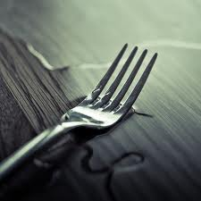
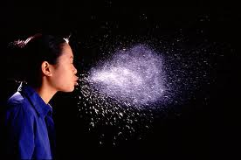
Other Prevention Strategies
Avoid sharing personal items, such as eating utensils
Handle food properly
Eat well and exercise. Getting nutrients your body needs and staying fit will help you fight against infection
Avoid tobacco, alcohol, and other drugs
Abstain from sexual contact
Cover your mouth when you cough or sneeze, and wash your hands after using a tissue

