Slide 1
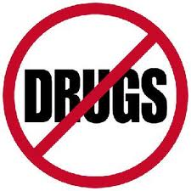
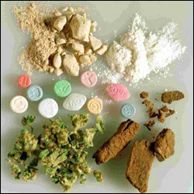
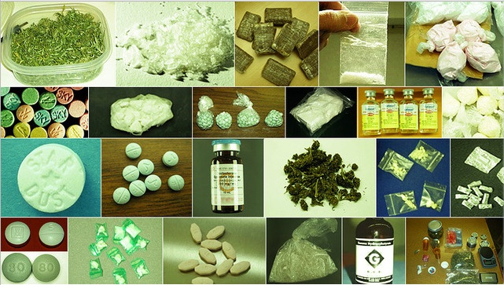
Chapter 22 Illegal Drugs
Lesson 1

Slide 2
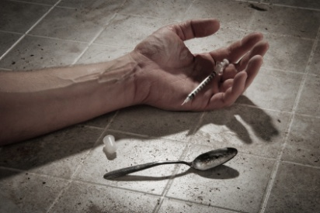
Health Risks of Drug Use
Substance Abuse: is any unnecessary or improper use of chemical substances for unnecessary or improper use of chemical substances for non-medical purposes.
Illegal Drugs: chemical substances that people of any age may not lawfully manufacture, possess, buy, or sell. Using illegal drugs is a crime called illicit drug use.

Slide 3
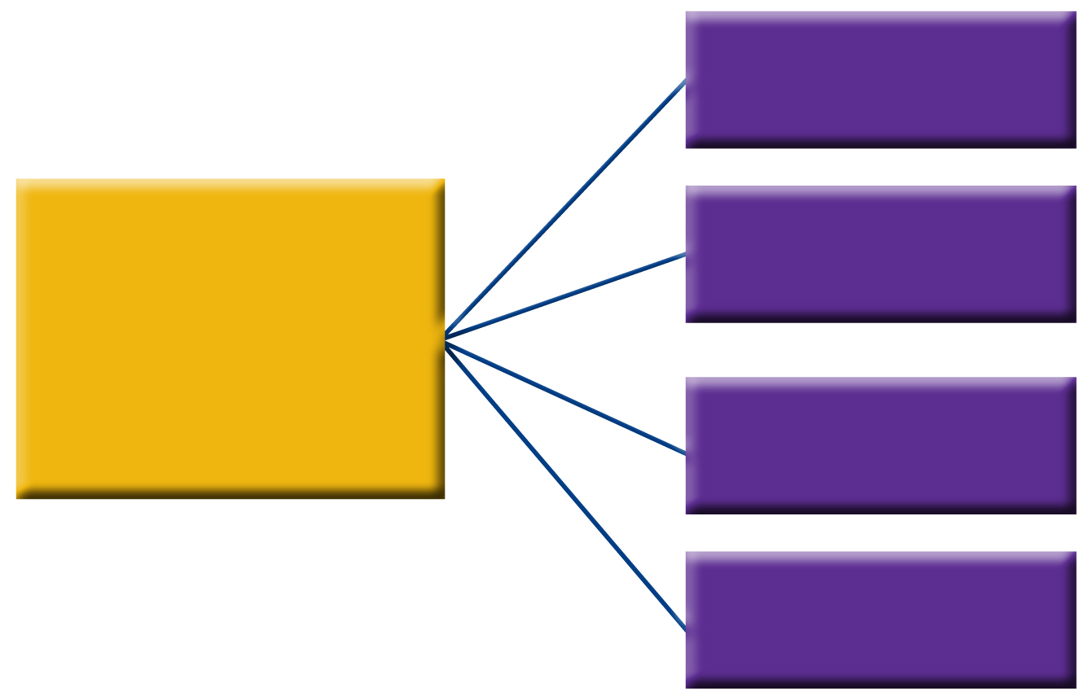
Substance Abuse
Overuse of a drug
Multiple use of a drug
Substance abuse includes:
Use of an illegal drug
Use of a drug with alcohol

Slide 4
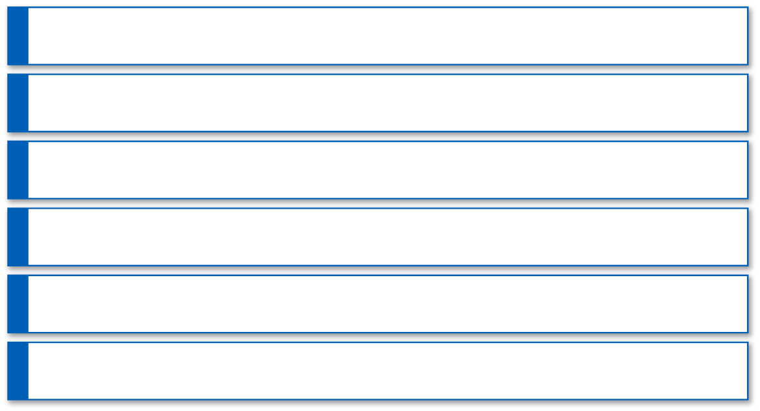
Factors That Influence Teens
Peer Pressure
Family Members
Role Models
Media Messages
Perceptions of Drug Behavior
Misleading Information

Slide 5
Drugs Affect Your Health
Overdose
A strong, sometimes fatal reaction to taking a large amount of a drug.
Tolerance
Body becomes accustomed to the drug and causes the user to need more of the drug to achieve the desired affect.
Psychological Dependence
Develops over time and causes a person to believe that a drug is needed in order to feel good or to function normally.
Psychological Dependence
User develops a chemical need for a drug. Symptoms of withdrawal occur when the effects of the drug wear off. Symptoms can include nervousness, insomnia, headaches, vomiting, chills, and cramps. In some cases, possibly death.
Addiction
A psychological or physiological dependence on a drug. User requires persistent, compulsive use of a substance.

Slide 6
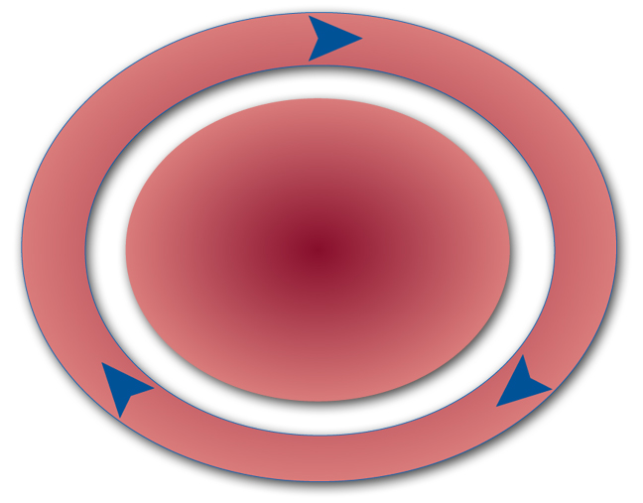
Other Effects of Drug Use
A user takes a drug to experience short-term pleasure.
The Addiction Cycle
The user takes the drug again to relieve withdrawal symptoms and repeat the feelings of short-term pleasure.
As the effects of the drug wear off, the user then experiences symptoms of withdrawal.

Slide 7
Consequences for the Individual
Teens who use illegal drugs may
stop pursuing interests and goals.
be depressed.
engage in dangerous behaviors.
be at risk of suicide.
engage in sexual activity.
be involved in violence or crime.
act recklessly.
be arrested.

Slide 8
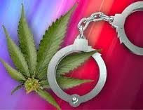
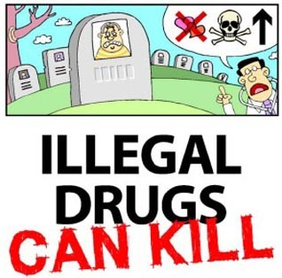
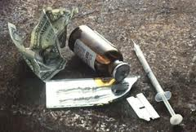
Chapter 22
Lesson #2

Slide 9
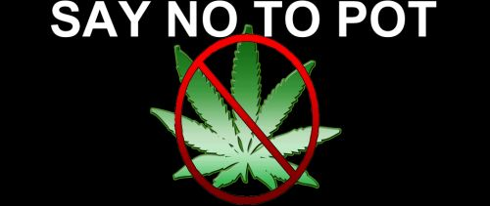
Marijuana
Plant whose leaves, buds, and flowers are usually smoked for their intoxicating effects.
Also known as grass, weed, or pot.
Most widely used of all illegal drugs.
Hashish/Hash: stronger form of marijuana.
Gateway Drug: drug that may lead to the user to try other, more dangerous drugs.
All forms of marijuana are mind-altering and can damage the user’s health.
Combined with other drugs, effects are unpredictable and dangerous.
Users can experience slow mental reflexes and may suffer from sudden feelings of anxiety and paranoia, an irrational suspiciousness or distrust of others.

Slide 10
Marijuana
Health Risks of Marijuana
Hallucinations and paranoia
Lung irritation, coughing
Impaired short-term memory, reaction time, concentration, and coordination
Heart and lung damage
Decreased initiative and ambition
Increased risk of lung cancer
Bloodshot eyes, dry mouth
Weakened immunity to infection

Slide 11
Marijuana
Health Risks of Marijuana
Increased appetite
In females, risk of infertility
Increased risk of stillbirth and birth defects
In males, lowered sperm count and testosterone levels
Changed hormone levels

Slide 12
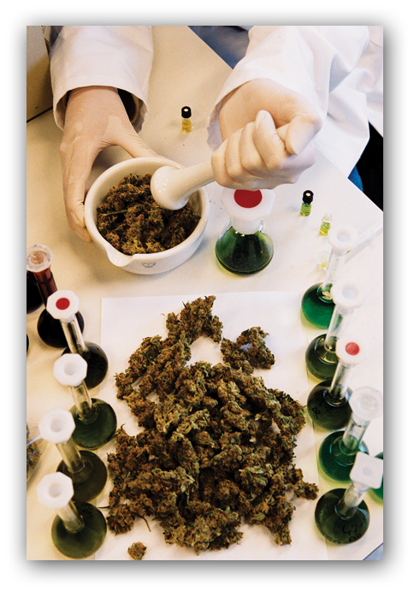
Physical Consequences of Marijuana Use
THC, the main psychoactive ingredient in marijuana, is stored in body fat and traces of it can be present in the blood for as long as a month.

Slide 13
Mental and Emotional Consequences
Mental and Emotional Consequences of Marijuana
dizziness
distorted perception
trouble walking
loss of coordination
impaired memory
trouble with thinking
sleepiness

Slide 14
Inhalants
Substances whose fumes are sniffed or inhaled to give effect.
Inhaled to give the user a “high”.
Solvents, aerosols, glues, paints, varnishes, and gasoline can cause brain damage.
Most depress the central nervous system.
Extremely dangerous, many are labeled as poisons.

Slide 15
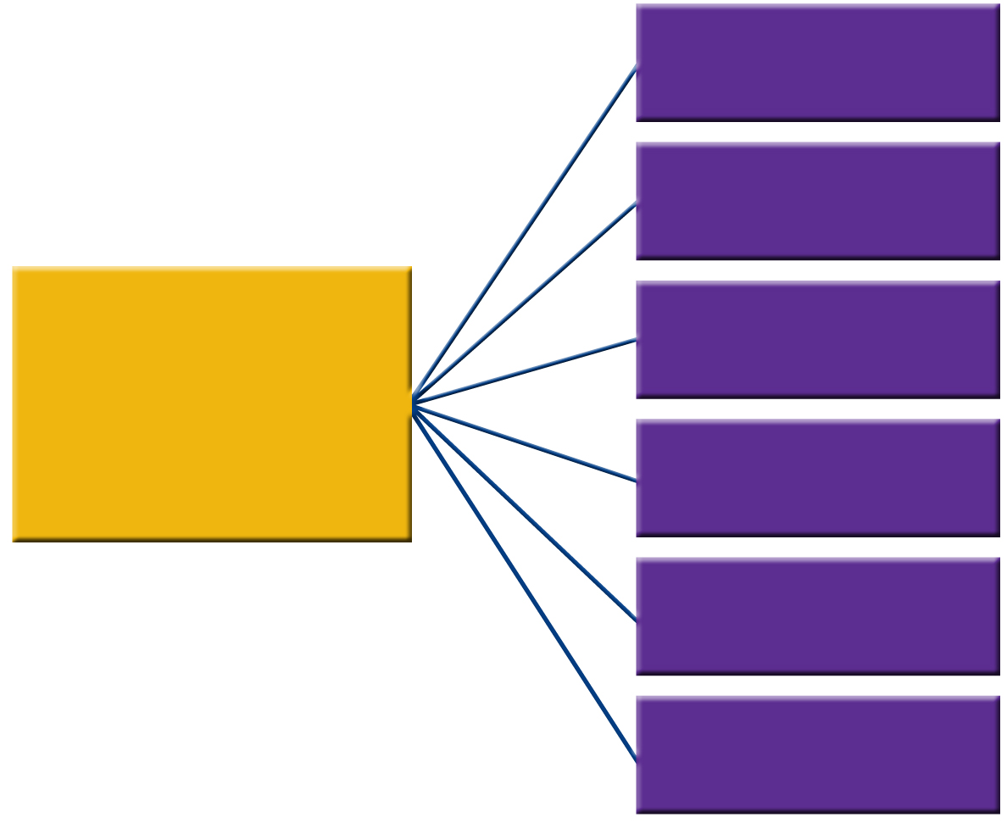
Inhalants
liver and kidney damage
blindness
Inhaling solvents, aerosols, glues, paints, varnishes, and gasoline can cause
brain damage
paralysis
cardiac arrest
death

Slide 16
Inhalants
Immediate Effects of Inhalants
glassy stare
coughing
slurred speech
nosebleeds
impaired judgment
fatigue
nausea
lack of coordination

Slide 17
Steroids
Synthetic substances similar to male sex hormones
Anabolic – muscle building
Androgenic – increased male characteristics
Any nonmedical use of steroids is illegal

Slide 18
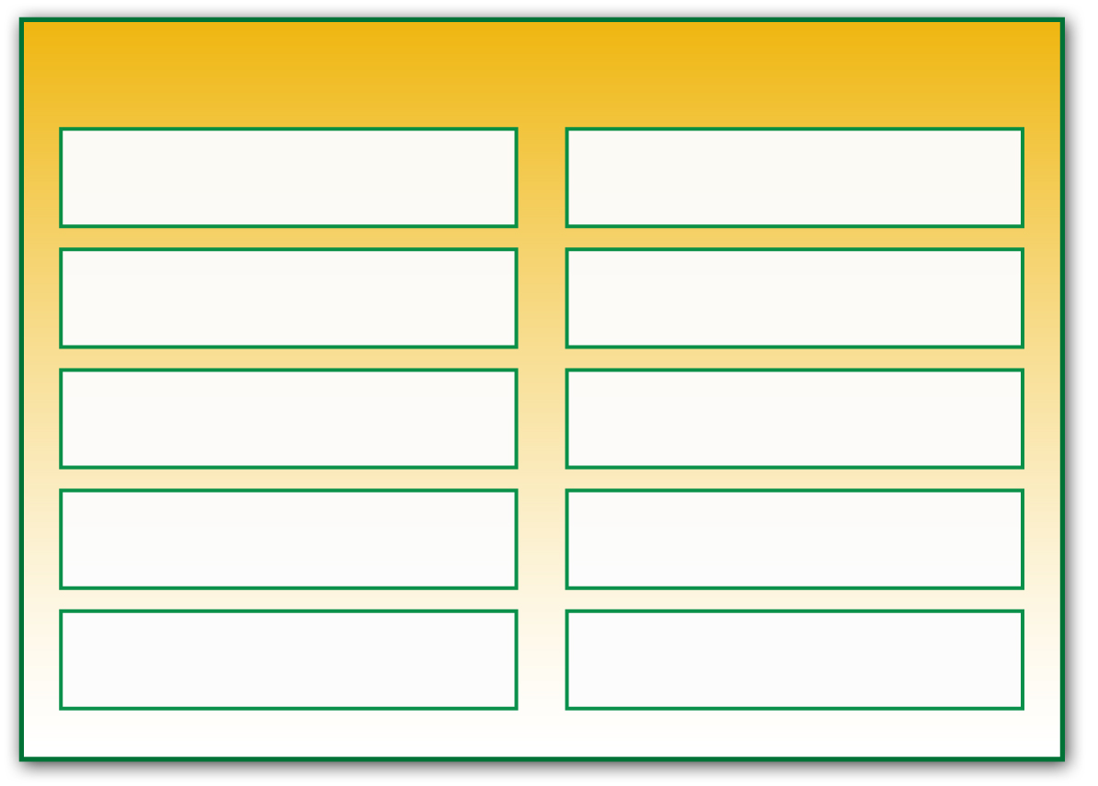
Consequences of Steroid Use
Side Effects of Steroid Use
weak tendons and ligaments
HIV or hepatitis B
weight gain
violent behavior
acne
extreme mood swings
high blood pressure
depression
liver and kidney tumors
paranoia

Slide 19
Consequences of Steroid Use
Effects on Males
Shrinking testicles, reduced sperm count, baldness, development of breasts, increased risk of prostate cancer
Effects on Females
Facial hair, baldness, menstrual cycle changes, a deepened voice

Slide 20
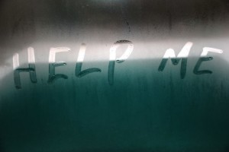
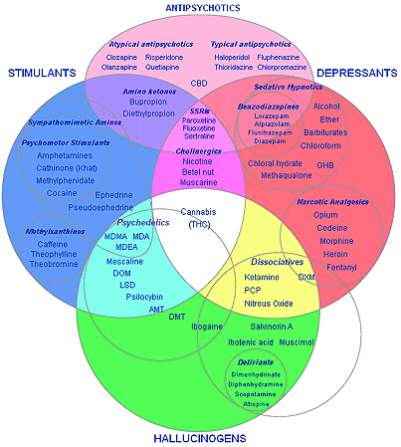
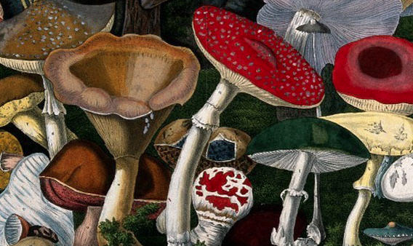
Chapter 22
Lesson 3

Slide 21
Effects of Psychoactive Drugs – chemicals that affect the central nervous system and alter activity in the brain.
Four Main Groups of Psychoactive Drugs
Stimulants
Depressants
Opiates
Hallucinogens

Slide 22
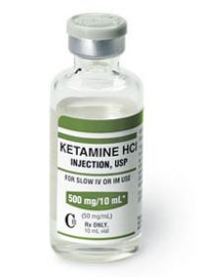
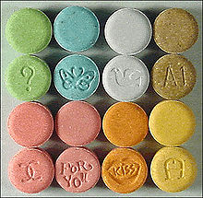
Club Drugs Drugs found at concerts, dance clubs, and drug parties, called raves. Many club drugs are designer drugs, synthetic drugs that are made to imitate the effects of other drugs
Ecstasy
MDMA
Both stimulant and hallucinogenic effects
Rohypnol
“Roofies”
Colorless, odorless, tasteless drug that slows down the central nervous system
“date-rape” drug
GHB
Gamma hydroxybutyric acid
Liquid, powder, tablets, and capsules
“date-rape”
Ketamine
Anesthetic used to treat animals
Causes hallucinations and respiratory failure
Meth
LSD

Slide 23
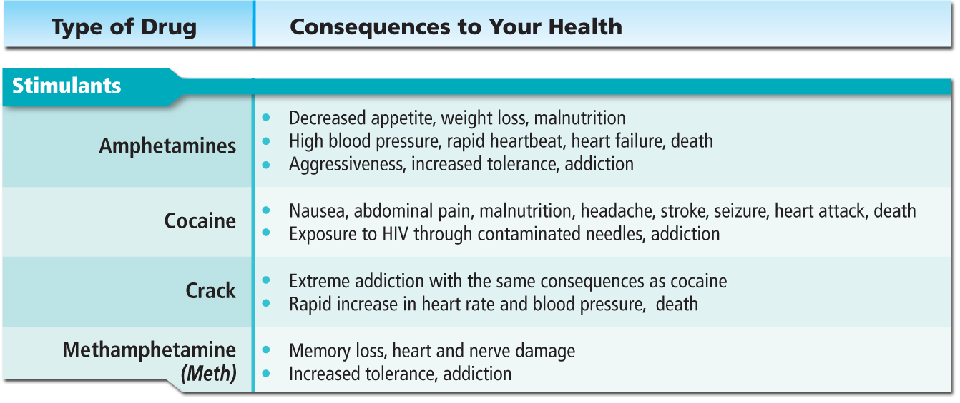
Effects of Psychoactive Drugs

Slide 24
Methamphetamine

Slide 25
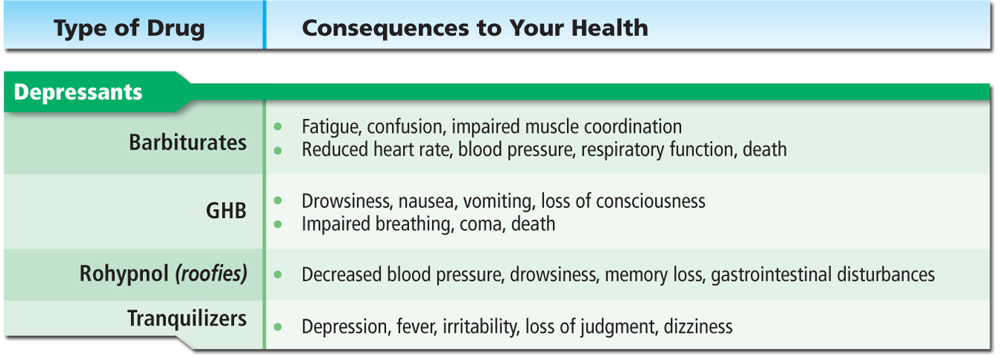
Effects of Psychoactive Drugs

Slide 26
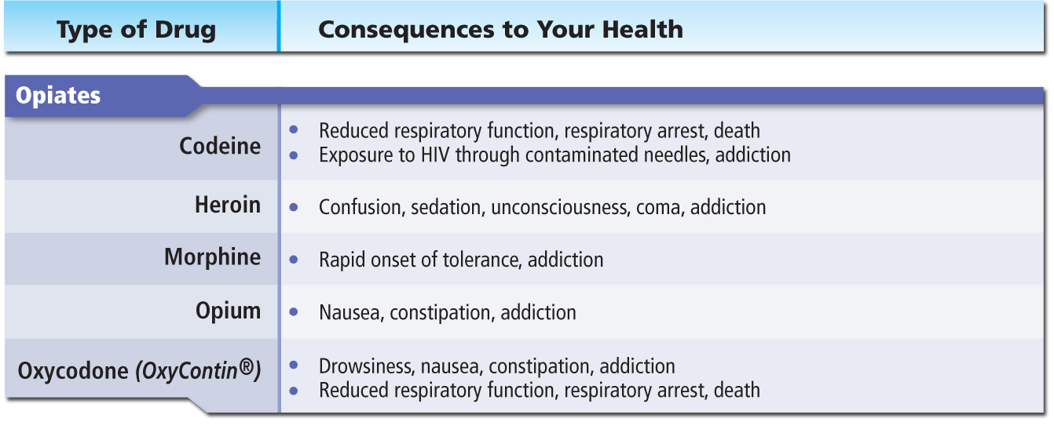
Effects of Psychoactive Drugs

Slide 27
OxyContin

Slide 28
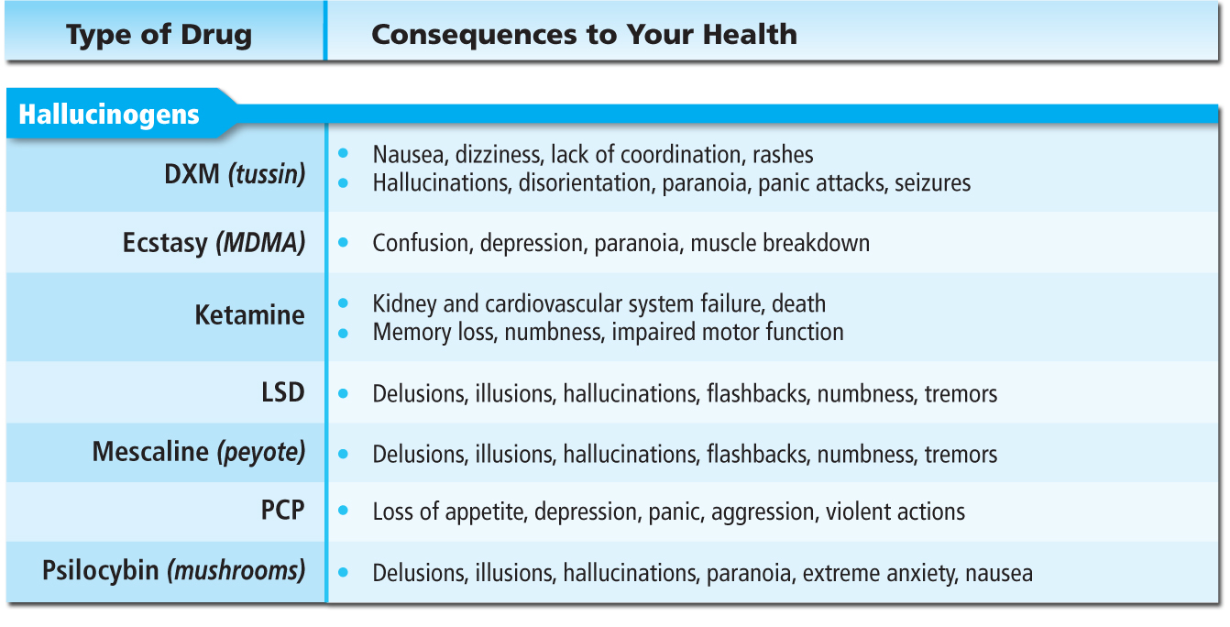
Effects of Psychoactive Drugs

Slide 29
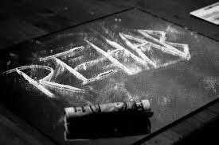
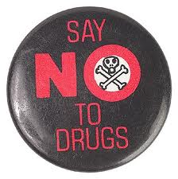
Chapter 22
Lesson 4
“Living Drug-Free”

Slide 30
Living Drug-Free
Protect your health and become a role model to others.
Peer pressure can be intense but the saying “everybody’s doing it” is not true. In fact…
Almost 62% of high school students have never tried marijuana and more than 90% have never tried cocaine.
To commit to remaining drug-free, choose friends who share your attitude about drug use, and avoid places where drugs may be available.
Practice Refusal Skills

Slide 31
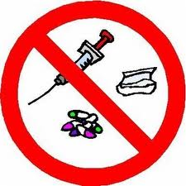
Healthy Alternatives
Hobbies
Sports
Community Activities
Drug Watches – organized community efforts by neighborhood residents to patrol, monitor, report, and otherwise try to stop drug deals and drug abuse.
School Organizations
Drug-Free School Zones – areas within 1,ooo-1,500 feet of schools and designated by signs, within which people caught selling drugs receive especially severe penalties.

Slide 32
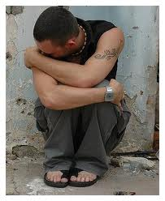
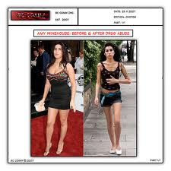
Warning Signs of Drug Use
Lies about the drugs he or she is using, constantly talks about drugs
Stops participating in activities that once were an important part of his or her life
Changes eating or sleeping habits, shows rapid weight loss
Takes unnecessary risks, participates in unsafe behaviors
Gets in trouble with authorities, such as school administrators or police
Seems withdrawn, depressed, tired, and cares less about appearance
Has red-rimmed eyes and runny nose not related to colds or allergies
Has blackouts and forgets what he or she did under the influence
Has difficulty concentrating

Slide 33
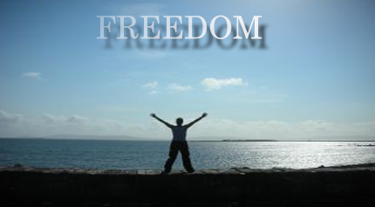
Getting Help
Rehabilitation – the process of medical and psychological treatment for physiological or psychological dependence on a drug or alcohol.
Most will need family, friends, and counseling to end their addiction.
Outpatient drug-free treatment
Usually no medication and use counseling
Short-term treatment
Residential therapy, medication therapy, outpatient therapy
Maintenance therapy
Intended for heroin addicts, usually includes medication therapy
Therapeutic communities
Centers that include highly structured programs that may last 6 to 12 months

Slide 34
Drug Treatment

