Slide 1
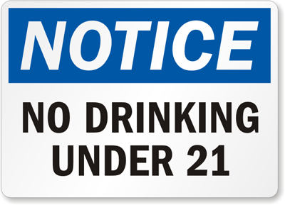
Alcohol
Chapter # 21 Lesson #1
The Health Risks of Alcohol Use

Slide 2
Alcohol
Ethanol: the type of alcohol found in alcoholic beverages
Fermentation : the chemical reaction to of yeast and sugars
Depressant- A drug which slows down the Central Nervous System, heart, and other organs.
Intoxication: the state in which the body ids poisoned by alcohol or another substance, and the person’s physical and mental control is significantly reduced.

Slide 4
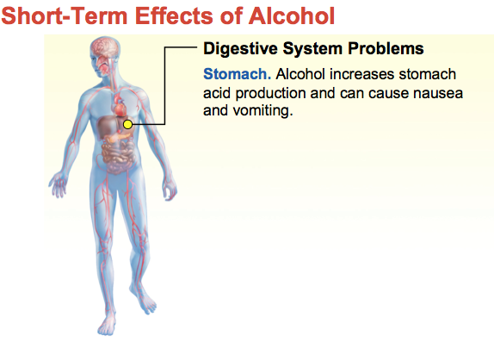
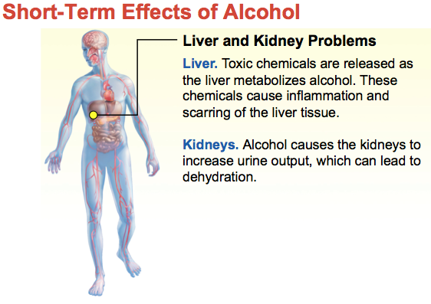
Short-Term Effects of Drinking

Slide 5
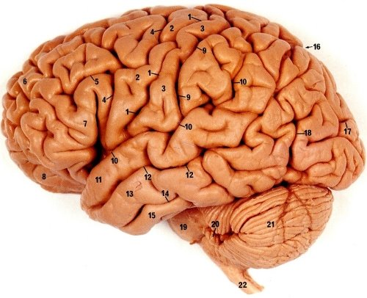
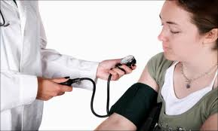
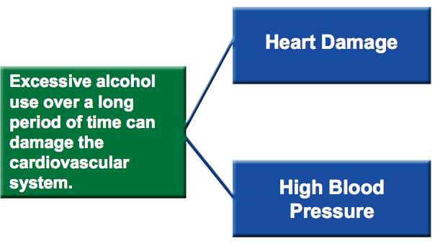
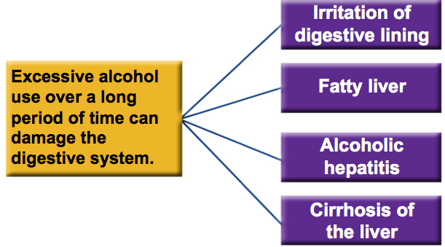
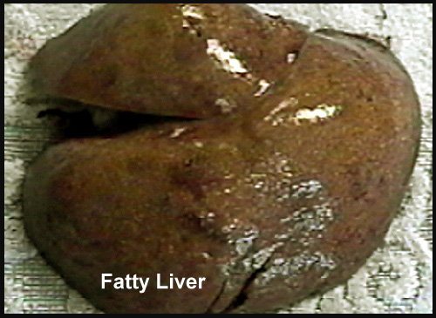
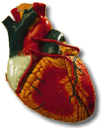
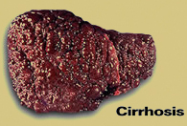
Long-Term Effects

Slide 6
Binge Drinking and Alcohol Poisoning
Binge Drinking : drinking five or more alcoholic drinks at one sitting.
Alcohol Poisoning: a severe and potentially fatal physical reaction to an alcohol overdose.

Slide 8
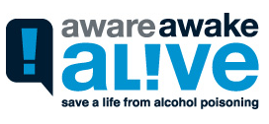
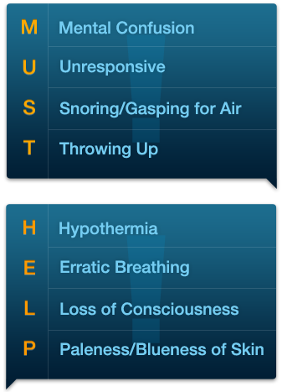

Slide 9
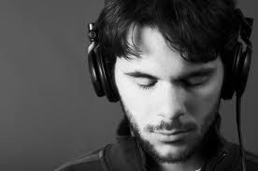
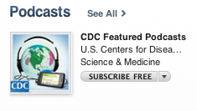
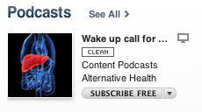
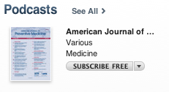
Alcohol Podcasts
Go to the iTunes app…
Search for the following Podcasts…
CDC Featured Podcasts- #89
Wake Up Call for Binge Drinking #1
American Journal of Preventative Medicine #11
Listen and answer questions on worksheet.
1.
2.
3.

Slide 10
Alcohol
Chapter # 21 Lesson #2
Choosing to Live Alcohol -Free

Slide 11
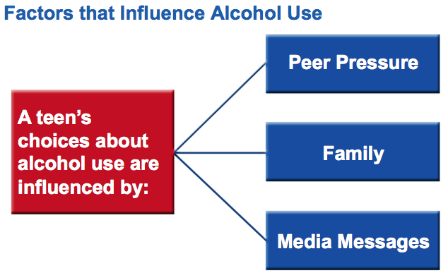
Choosing to Live Alcohol Free
psychological dependence : a condition in which a person believes that a drug is needed in order to feel good or to function normally.
physiological dependence : a condition in which the user has a chemical need for the drug.

Slide 12
Alcohol and Advertising
Companies that produce alcohol spend billions of dollars each year on advertising.
Manufacturers and advertisers never show consumers the negative side of alcohol use.

Slide 13
The other side of Alcohol

Slide 14
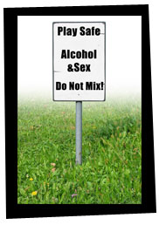
Health Risks of Alcohol Use
Alcohol and the Law:
It is illegal for anyone under the age of 21 to buy, possess, or consume alcohol.
An arrest can limit college and employment options, damage a teen’s reputation, and cause that teen to lose the trust of friends and family members.
Alcohol and Violence :
Teens can protect their health by avoiding situations where alcohol is present.
Teens who drink are also more likely to be victims or perpetrators of violent crimes.
Alcohol and Sexual Activity:
Teens who use alcohol are more likely to
become sexually active at an earlier age,
engage in unprotected sexual activity, and
contract an STD.
Alcohol and School:
Most schools have adopted a zero-tolerance policy for students found using alcohol on school property.
Students who use alcohol may become ineligible for or be suspended from school activities or graduation, or expelled from school.

Slide 15
Alcohol and the Family
Alcohol Abuse : the excessive use of alcohol
Alcoholism: is a disease in which a person has a physical or psychological dependence on drinks that contain alcohol.
It is estimated that 25 percent of all youth are exposed to alcohol abuse within their families.

Slide 16
Avoiding Alcohol

Slide 17
Avoiding Alcohol

Slide 18
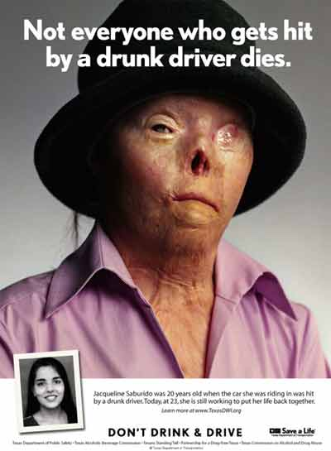
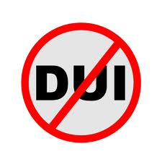
Alcohol
Chapter # 21 Lesson #3
The Impact of Alcohol Abuse

Slide 19
Drunk Driving : Simple Plan

Slide 20
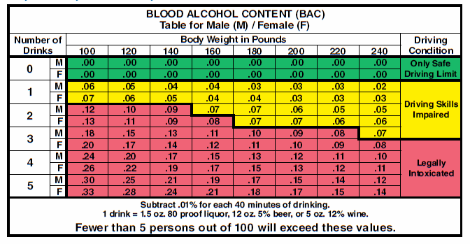
Alcohol and Driving
Blood Alcohol Concentration: the amount of alcohol in a person’s blood, expressed as a percentage.

Slide 21
Drunk Driving: PSA - JOEY

Slide 22
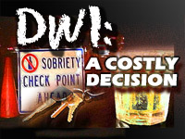
Alcohol and Driving

Slide 23
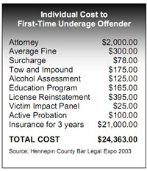
Alcohol and Driving

Slide 24
Drunk Driving Jackie’s Story

Slide 25
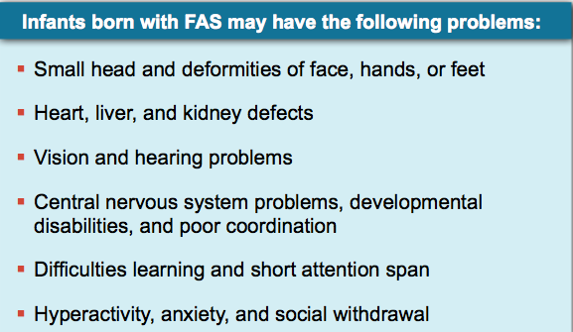
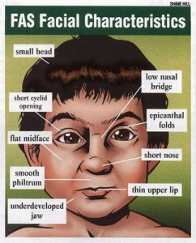
Fetal Alcohol Syndrome
Fetal Alcohol Syndrome : a group of alcohol-related birth defects that include physical and mental problems

Slide 26
Alcoholism
Alcoholic : is an addict who is dependent on alcohol

Slide 27
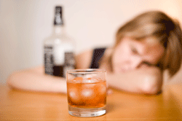
Alcoholism

Slide 28
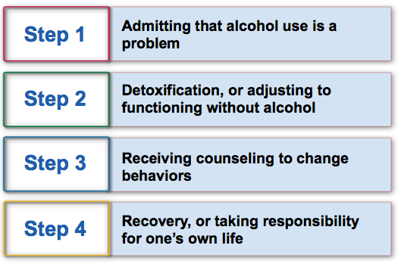
Stages of Alcoholism
Treatment for Alcohol Abuse
Recovery : the process of learning to live an alcohol-free life
Sobriety : living without alcohol

Slide 29
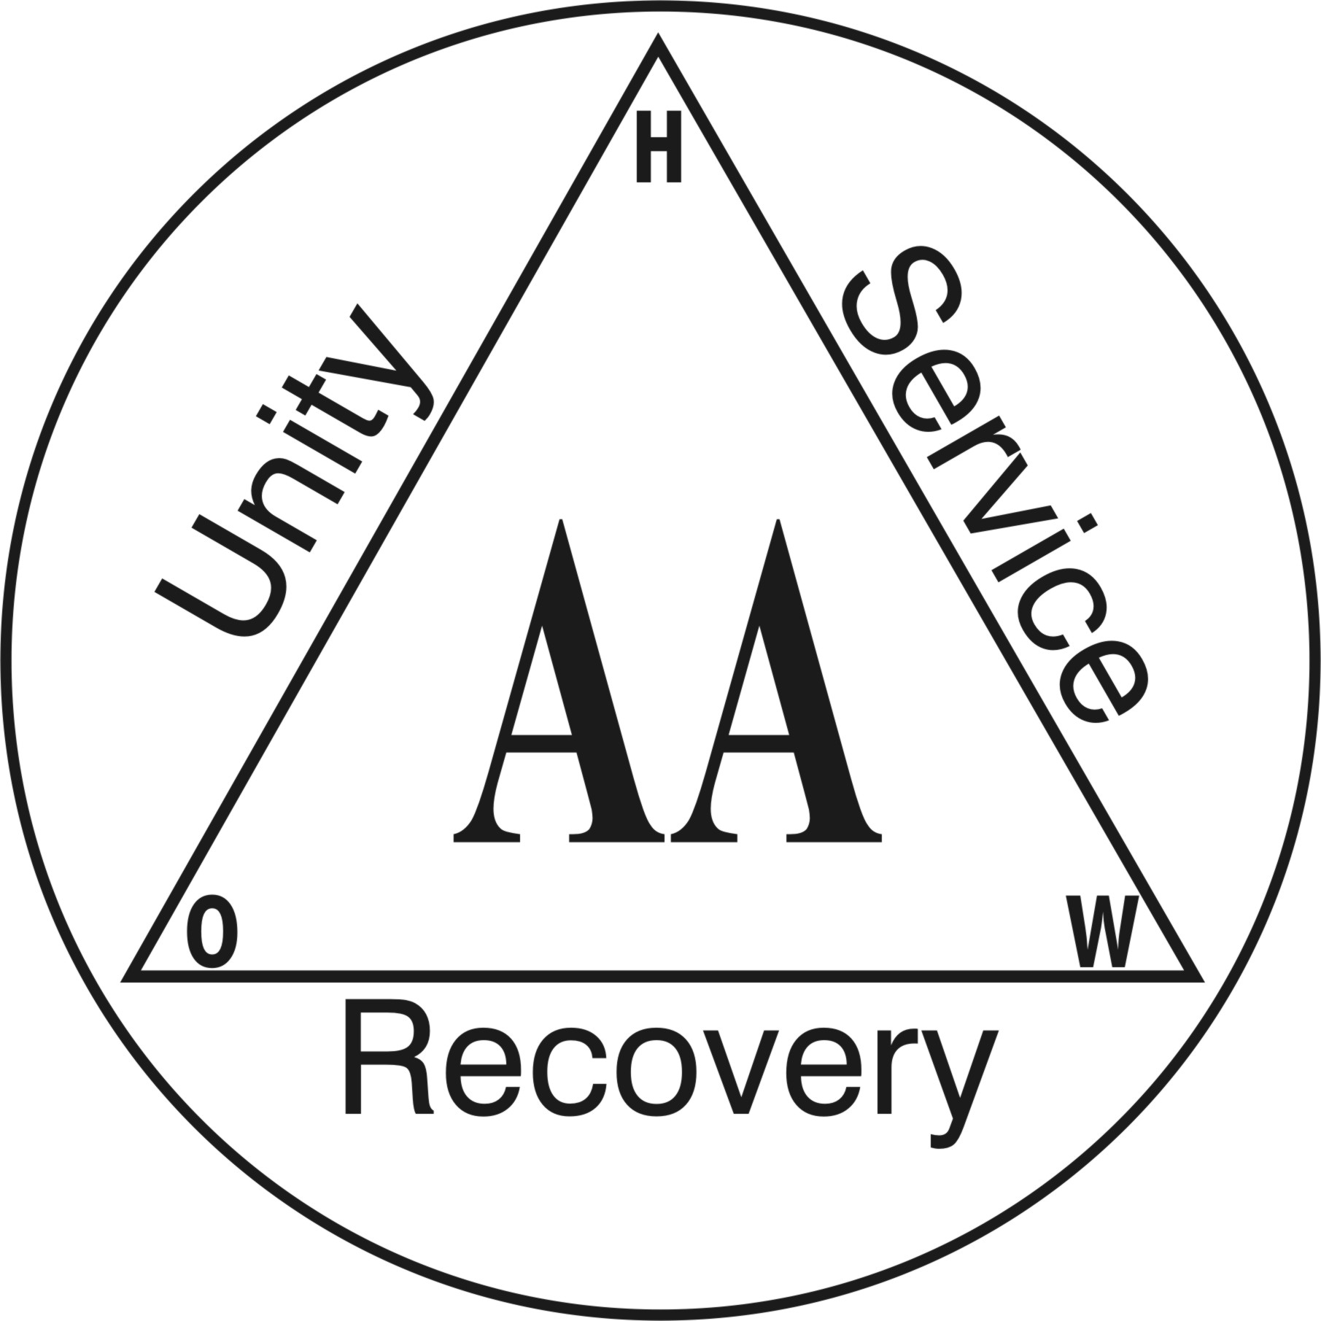
Resources

