Slide 1
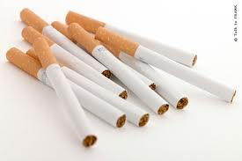
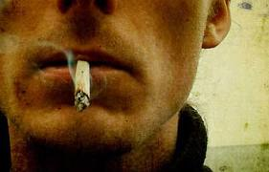
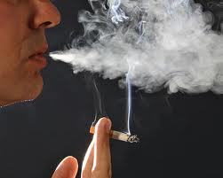
Tobacco
Chapter 20, Lesson 1

Slide 2
The Health Risks of Tobacco Use
Advertisements are with healthy, attractive people sending messages that tobacco has no health consequences
Medical studies show tobacco-leading cause of most preventable deaths and disability in US
Linked to lung disease, cancers, and heart diseases
90% adult smokers began habit as teenagers
Most teens think they can quit whenever they want
Reality is quitting is difficult

Slide 3
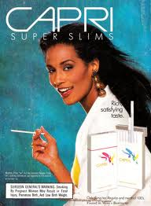
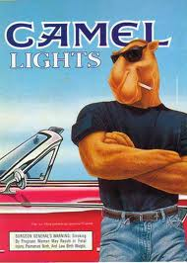
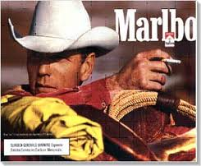
Different Types of Ads
Rugged, Tough
Man
Beautiful, thin woman
Cool Dude, Cool Car

Slide 4
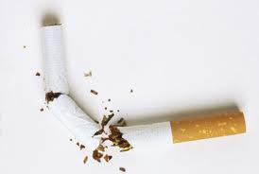
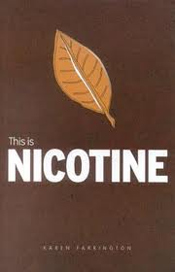
Nicotine
Addictive drug: a substance that causes physiological or psychological dependence
Nicotine: the additive drug found in tobacco leaves
Nicotine is a stimulant
Stimulant: drug that increases the action of the central nervous system, the heart, and other organs
Using raises blood pressure and increases heart rate

Slide 5
Poisonous Substances in Tobacco Smoke
Carcinogen: cancer causing substance
Tar: a thick, sticky, dark, fluid produced when tobacco burns
Damages respiratory system by paralyzing and destroying cilia
Cilia: tiny hair like structures that line upper airways and protect body against infection
Damages lung tissue, reducing lung function
Smokers susceptible to diseases: bronchitis, pneumonia, emphysema, heart disease, cancer
87% cancer deaths result from smoking

Slide 6
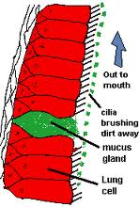
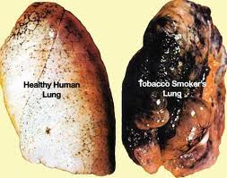
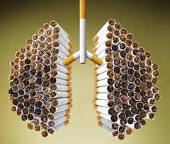
Tar Destroys Cilia

Slide 7
Still Want to Smoke?

Slide 8
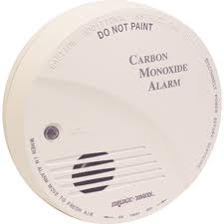
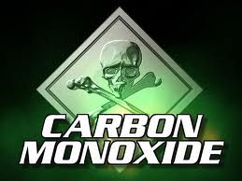
Poisonous Substances in Tobacco Smoke
Carbon Monoxide: colorless, odorless and poisonous gas
Absorbed more easily than oxygen
CM deprives body tissues and cells from oxygen

Slide 9
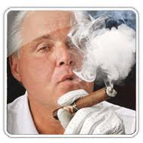
Pipes and Cigars
Cigars contain significantly more nicotine and produce more tar and carbon monoxide than cigarettes
1 cigar contains as much nicotine as 20 cigarettes
Pipe and cigar smokers have increase risk of cancer in the lips, mouth, throat, larynx, lungs, and esophagus

Slide 10
Smokeless Tobacco
Smokeless (spit) tobacco: sniffed through the nose, held in the mouth, or chewed
Not safe alternative smoking
Smokeless tobacco are absorbed into the levels up to three times the amount of single cigarette
Leukoplakia: thickened, white, leathery looking spots on the inside of the mouth that can develop into oral cancer
Cancers from smokeless tobacco: mouth, throat, larynx, esophagus, stomach, and pancreas
8-10 plugs a day = 2 packs of cigarettes a day

Slide 11
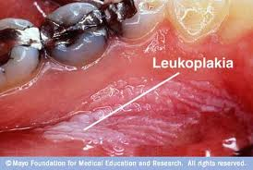
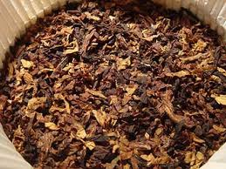
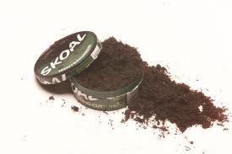
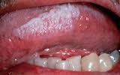
Leukoplakia
Chewing Tobacco

Slide 12
Harmful Effects of Tobacco Use
Short-term effects:
Brain chemistry changes- additive property causes body to crave more of drug; user may experience withdrawal symptoms like : headaches, nervousness, trembling as soon as 30 minutes after tobacco use
Respiration and heart rate increase
Taste buds are dulled and appetite is reduced
Users have bad breath, yellow teeth, smelly hair, skin, and clothes

Slide 13
Harmful Effects of Tobacco Use
Chronic bronchitis- occurs when cilia in bronchi become damaged that they are useless; leads to build up tar in lungs, causing more chronic coughing excessive mucous secretion
Emphysema- disease that destroys tiny air sacs in lungs, person with emphysema uses up 80% of his/her energy to just breathe
Lung cancer- 90% of lung cancer deaths are caused by smoking
Coronary heart disease and stroke- nicotine constricts blood vessels, cuts down blood flow to limbs
Arteriosclerosis- hardened arteries, plaque build up
Weakened immune system long term use makes body vulnerable

Slide 14
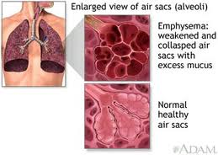
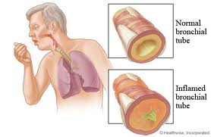
Chronic Bronchitis
Emphysema

Slide 15
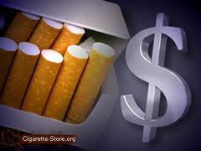
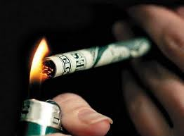
Other Consequences of Tobacco Use
Costs to society- tobacco related illness cost in US about $167 billion each year
Costs to individuals: one pack a day spends $3,561 a year
Legal consequences: under 18 illegal, on school grounds leads to suspension or expulsion

Slide 16
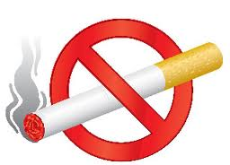
Choosing to Live Tobacco-Free
Chapter 20, Lesson 2

Slide 17
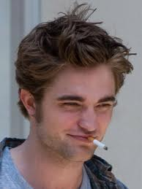
Teens and Tobacco
Why Some Teens Use Tobacco
Falsely believe will control weight or cope with stress
May think it makes them mature
Truth is smoking reduces body's capacity for physical activity, so may lease to weight gain
Dependency of tobacco may increase users stress level
Teens influenced by movies, tv, advertisements: convince teens that tobacco is glamorous

Slide 18
Reduced Tobacco Use Among Teens
CDC reports 88% of high school students nationwide do not smoke. This number is up from 65% a few years ago
Tobacco Legislation: 1988, tobacco companies and 46 states reached a legal settlement the restricts tobacco advertising aimed at young people
Illegal for anyone under the age of 18 to purchase tobacco in US
No-smoking Policies: limited smoking in public places and businesses
Family values: teens whose parents avoid tobacco use are more likely to avoid tobacco use themselves
Health Risks: more teens understand tobacco use can lead to diseases

Slide 19
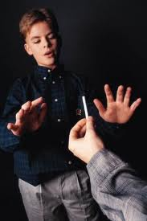
Benefits of Living Tobacco-Free
Better cardiovascular endurance and lung function if you don’t use tobacco
Living tobacco-free has mental/emotional and social benefits:
sense of freedom,
not dependent on addictive substance,
less stress
don’t have to worry about tobacco-related health problems
more confidence in social situations because you look and feel better

Slide 20
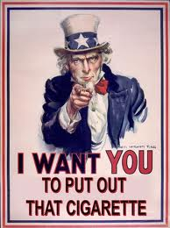
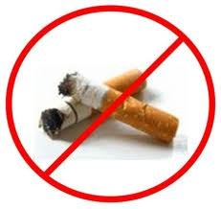
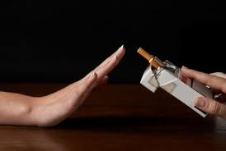
Strategies for Avoiding Tobacco
Surround yourself with positive influences
Reduce peer pressure
Be prepared with refusal skills: be assertive and leave situation if pressure continues; be confidant and stand up for your healthy choices

Slide 21
Quitting Tobacco Use
Teens who use tobacco give these reasons for quitting:
Being to have health problems, such as asthma, coughing or respiratory infections
Realize high cost of tobacco
Realize using can lead to other risky behaviors, alcohol and other drugs
Understand damaging effects of secondhand smoke; don’t want to harm others
Feel more powerful because not controlled by an addiction to nicotine

Slide 22
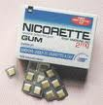
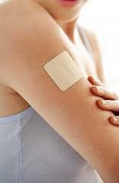
Ending the Addiction Cycle
Nicotine withdrawal-the process that occurs in the body when nicotine, an addictive drug, is no longer used
Symptoms: irritability, difficulty concentrating, anxiety, sleep disturbances, cravings for tobacco
Nicotine Substitutes-products that deliver small amounts of nicotine into the user’s system while he or she is trying to give up the tobacco habit
Examples: gum, patches, nasal sprays, inhalers

Slide 23
Nicoderm CQ

Slide 24
Electronic Cigarette

Slide 25
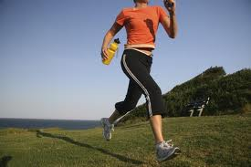
Getting Help to Quit Tobacco Use
Prepare for the quit day: set a target date, stick to it
Get support and encouragement
Access professional health services
Replace tobacco use with healthy behaviors

Slide 26
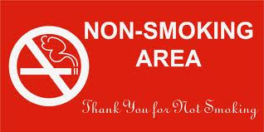
Promoting a Smoke-Free Environment
Chapter 20, Lesson 3

Slide 27
Health Risks of Tobacco Smoke
Environmental tobacco smoke (ETS), or secondhand smoke, air that has been contaminated by tobacco smoke
Mainstream smoke: the smoke exhaled from the lungs of a smoker
Sidestream smoke: the smoke from the burning end of a cigarette, pipe, or cigar
More dangerous than mainstream smoke because it’s exhaled by smoker, it contains lower concentrations of carcinogens, nicotine, and tar
Young children who are exposed to ETS are more likely to develop asthma than their peers who are not exposed to ETS

Slide 28
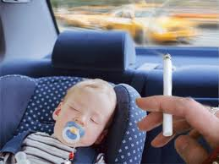
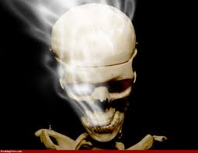
Health Risks to Nonsmokers
Causes 3,000 deaths from lung cancer every year

Slide 29
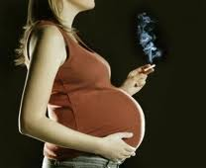
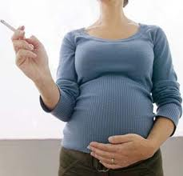
Health Risks to Unborn Children and Infants
Choosing to live tobacco-free is one of the healthiest choices a pregnant female can make for her baby
Smoking during pregnancy can seriously harm the developing fetus
Infant may also suffer from growth and developmental problems during early childhood
Babies of mothers who smoked during pregnancy or who are exposed to ETS are more likely to die of sudden infant death syndrome (SIDS)

Slide 30
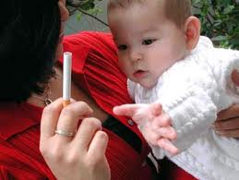
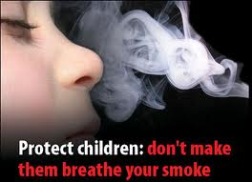
Health Risks to Young Children
Children of smokers tend to have a higher incidence of sore throats, ear infections, and upper respiratory problems than children of nonsmokers
Secondhand smoke can slow lung development

Slide 31
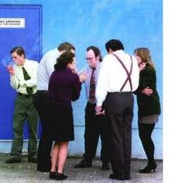
Reducing Your Risks
If family member smokes, encourage that person to quit by telling him/her health effects of tobacco smoke
Open windows to allow fresh air in
Suggest somewhere else to smoke

Slide 32
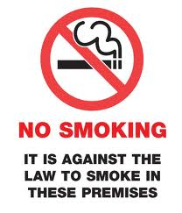
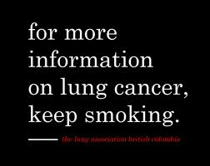
Creating a Smoke-Free Society
Medical research shows that any exposure to secondhand smoke can cause health problems
According to US Surgeon General, only way to fully protect people from damaging health effects of ETS is to prohibit smoking in public places

