Slide 1
The Role of Medicines
Chapter 19, Lesson 1

Slide 2
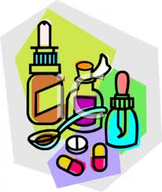
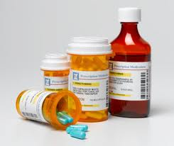
Types of Medicines
Medicines- drugs that are used to treat or prevent diseases or other conditions.
Drugs- substances other than food that change the structure or function of the body or mind.
All medicines are drugs, but not all drugs are medicines.

Slide 3
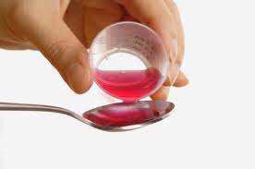
Medicines
Four Categories of Medicines that Treat or Prevent Illness
Medicines that help prevent disease
Medicines that fight pathogens
Medicines that manage chronic conditions, help maintain or restore health, and regulate body’s systems
Medicines that relieve pain and other symptoms

Slide 4
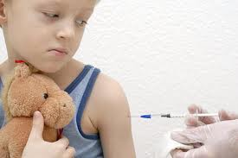
Preventing Disease
About 95% of children receive:
vaccines- a preparation that prevents a person from contracting a specific disease.
Vaccines contain weakened or dead pathogens that cause the disease.
When injected into the body, the vaccine produces antibodies that fight those pathogens.
Your body creates memory cells that provide long lasting protection.
Antitoxins- Help neutralize the effect of the toxins.
They fight bacteria that produce substances toxic to the body.
They also help the body produce antibodies.

Slide 5
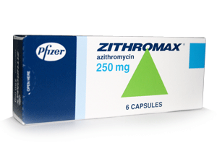
Fighting Pathogens
Medicines help your body fight pathogens that cause illness.
Antibiotics- a class of drug that destroy disease-causing microorganisms, called bacteria
Antibiotics, such as penicillin, work either by killing bacteria or preventing it from reproducing
Originally, antibiotics were considered miracle drugs because they saved so many lives
Can cause side effects like nausea or stomach pain
Bacteria can develop a resistance to antibiotics if they are overused or the patient doesn’t finish taking the full prescription

Slide 6
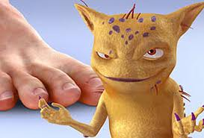
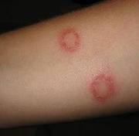
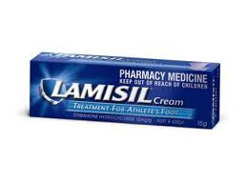
Antivirals and Antifungals
Antibiotics are only effective against bacteria.
They do not cure illnesses caused by viruses.
Anti-virals are available to treat some viral illnesses, such as the flu.
Anti-fungals suppress or kill fungus cells, such as athlete’s foot or ringworm.

Slide 7
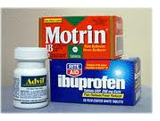
Relieving Pain
The most commonly used medicines are analgesics,
or pain relievers.
Range from mild medicines, such as aspirin, to strong narcotics, such as opium-based morphine and codeine.
Used to relieve pain, reduce fever, fight inflammation, or redness and swelling.
Aspirin, acetaminophen, and Ibuprofen are the most common.
Aspirin can cause stomach upset, dizziness, and ringing in the ears.
Should not be given to people under 20. (Reyes Syndrome)

Slide 8
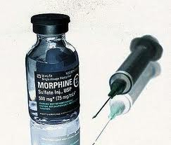
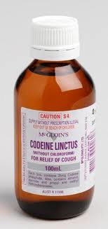
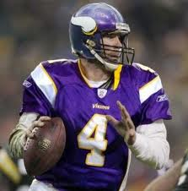
Pain Reliever Dependence
Certain type of pain relievers can be addictive.
Usually narcotics (morphine, codeine, etc).
Can become physically or psychologically dependent on them.
Brett Favre

Slide 9
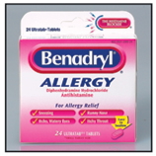
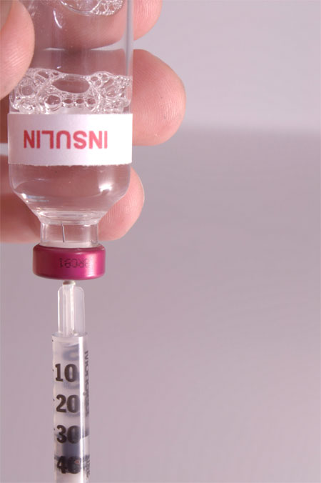
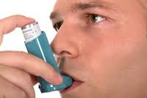
Managing Chronic Conditions
Allergy Medicines- antihistamines reduce allergy symptoms such as sneezing, itchy or watery eyes, and a runny nose.
An allergic reaction can lead to death.
Body-Regulating Medicines- some medicines regulate body chemistry.
Insulin used by people with diabetes regulates the amount of sugar in their blood.
Asthma sufferers use medicine, like an inhaler, to control asthma symptoms.

Slide 10
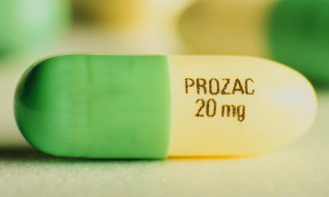
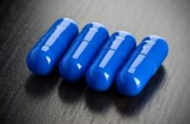
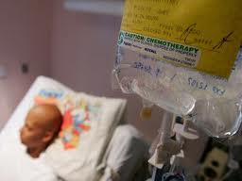
Antidepressant and Antipsychotic Medicines
Medicines that help people suffering from mental illnesses.
Help regulate brain chemistry, or stabilize moods.
Ex. Mood disorders, schizophrenia, and depression.
Cancer Treatment Medicines
Some cancers can be treated or even cured.
These medicines can reduce rapid cell growth and stop the spread of cancer cells.
Ex. Chemotherapy and radiation therapy.

Slide 11
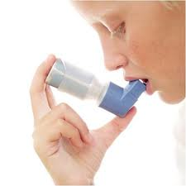
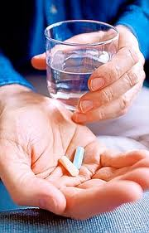
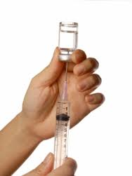
Taking Medicines
Medicines can be delivered to the body in many ways.
Method of use is determined by:
what the medicine is used for
how it will most quickly and effectively help the person.

Slide 12
4 Ways to Take Medicines
Oral Medicines
Taken by mouth
Topical Medicines
Applied to the skin
Inhaled Medicines
Delivered in a fine mist or powder
Injected Medicines
Delivered through a shot

Slide 13
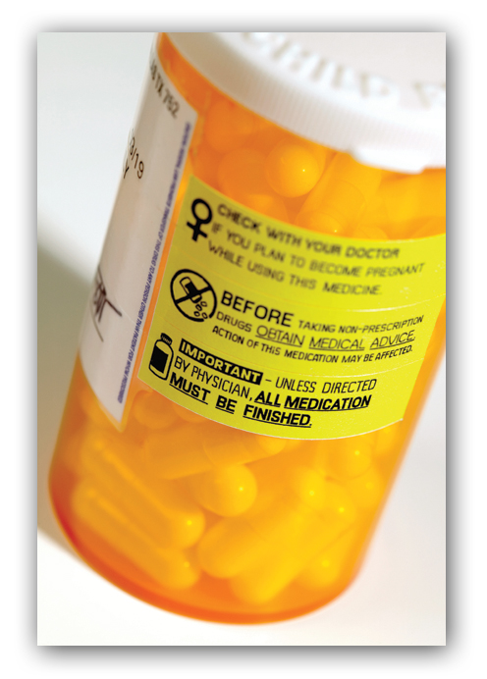
Reactions to Medicines
Medicines can cause:
side effects- reactions to medicine other than the one intended.
Some can be mild, such as drowsiness; others can be severe and even cause death.

Slide 14
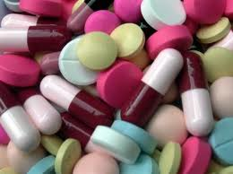
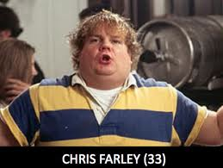
Medicine Interactions
Combining 2 or more medicines can change the effect of some drugs.
Additive Interaction- medicines work together in a positive way.
Antagonistic Interaction- when the effect of one medicine is canceled or reduced when taken with another medicine.
Synergistic Effect- results in a greater effect than when each medicine is taken alone.

Slide 15
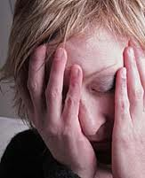
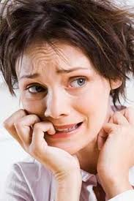
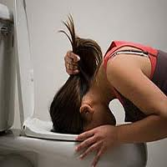
Tolerance and Withdrawal
Tolerance- a condition in which the body becomes used to the effect of a medicine.
The body requires increasingly larger doses to produce the same effect.
Withdrawal- occurs when a person stops using a medicine that he or she has become physiologically dependent.
Symptoms can include nervousness, insomnia, severe headaches, vomiting, chills and cramps.

Slide 16
Using Medicines Wisely
Chapter 19, Lesson 2

Slide 17
Standards for Medicines
All new medicines in the United States must meet standards set by the Food and Drug Administration (FDA).
Safe
Medically Effective

Slide 18
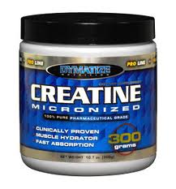
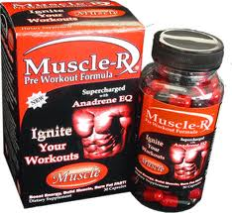
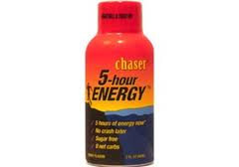
Supplements
The FDA does not regulate herbal and dietary supplements.
Many people believe they are safe because they are advertised as “natural.”
Don’t believe everything they claim.
Energy drinks are an example of a product with wild claims unsupported by the FDA.

Slide 19
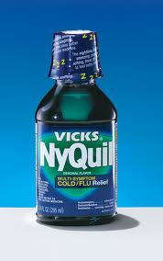
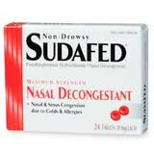
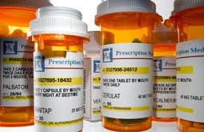
Types of Medicines
Prescription Medicines- medicines that are dispensed only with the written approval of a licensed physician or nurse-practitioner.
Provide only the amount of a medicine that is needed to treat your condition.
Over-the-Counter (OTC) Medicines- medicines you can buy without a doctor’s prescription.
Examples- ibuprofen, Nyquil, Sudafed, Tylenol, etc…

Slide 20
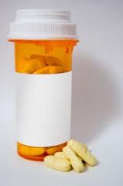
Medicine Labels
The FDA requires that all prescription and OTC medicine labels contain information telling consumers how to use the medicine safely and effectively.
Prescription labels must include…
Special instructions
Doctor’s name
Patient’s name
The pharmacy’s name and address
The date the prescription was filled
The prescription number
Whether refills are allowed

Slide 21
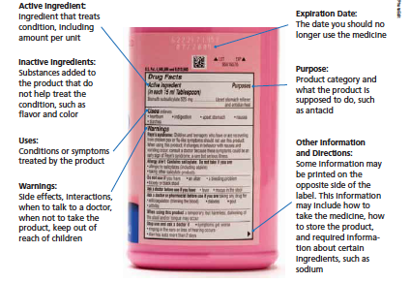

Slide 22
Medicine Misuse
Medicine Misuse- using a medicine in ways other than the intended use.
Examples include…
Failing to follow the instructions on or in the package.
Giving a prescription medicine to a person for whom it was not prescribed, or taking another person’s medicine.
Taking too much or too little of a medicine.
Taking a medicine for a longer or shorter period than prescribed or recommended.
Discontinuing use of a medicine without informing your health care provider.
Mixing medicines without the knowledge or approval of your health care provider.

Slide 23
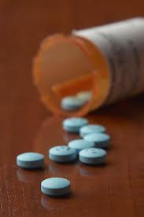
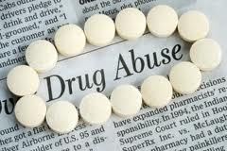
Medicine Abuse
Medicine Abuse- intentionally taking medicines for nonmedical reasons.
96% of teens use medicines correctly.
Abusing any medicine is dangerous and illegal.
Drug Overdose- a strong, sometimes fatal reaction to taking a large amount of a drug.

Slide 24
Medicine Abuse
Don’t use drugs to lose weight.
Don’t use drugs to stay awake while studying.
Don’t use drugs to fit in with peers.

