Slide 1
Chapter One
Lesson 1: What is Health?

Slide 2
What are some characteristics of healthy people?
This means you!

Slide 3
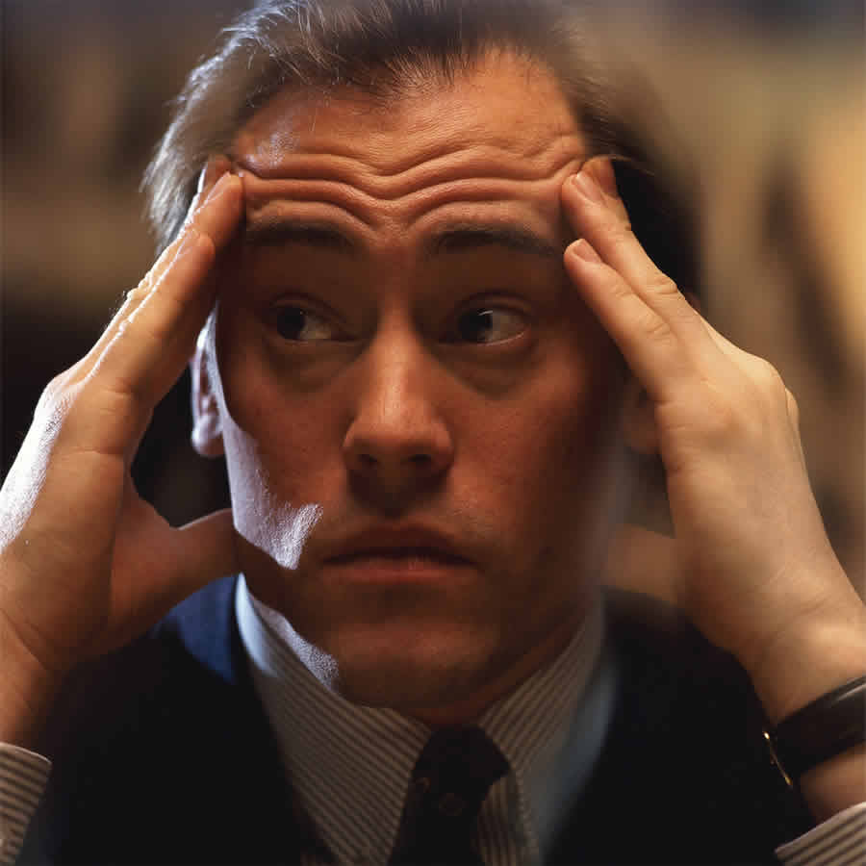
Taking Charge of Your Health
Health- The combination of your Physical, Mental/Emotional, and Social Well-Being.
Purpose- To gain knowledge and skills to take charge of your health for a lifetime.

Slide 4
Foundation of Health is Balance
3 Elements of Health
Physical Health- All about how well your body functions and how the body systems work together.
Mental/Emotional Health- Reflection of how you feel about yourself, how you meet the demands of your daily life and how you cope with the problems that occur in life.
Social Health- The way you get along with others and how well you communicate with people.

Slide 5
Examples of…
Physical Health | Mental/Emotional Health | Social Health
Good or Bad

Slide 6
5 Tips for Physical Health
Get eight to ten hours of sleep each night.
Eat nutritious meals and drink eight cups of water each day.
Engage in 30 to 60 minutes of physical activity every day.
Avoid the use of tobacco, alcohol, and other drugs.
Bathe daily, and floss and brush your teeth every day.

Slide 7
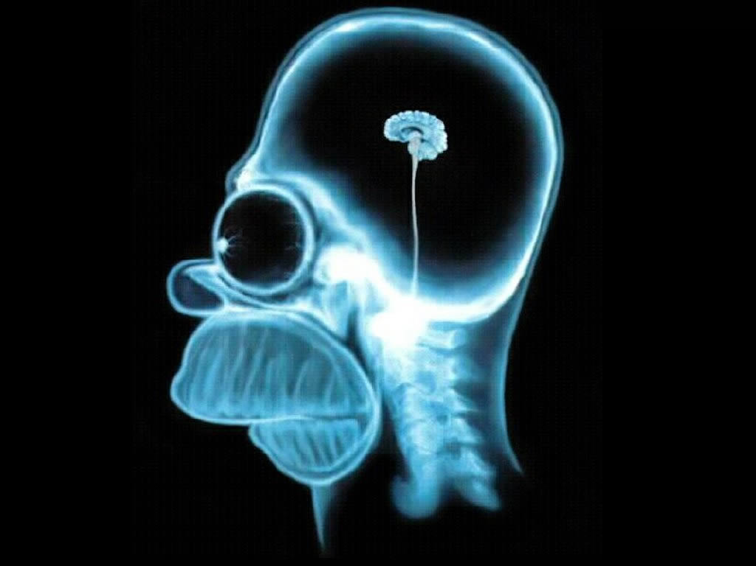
Mental/Emotional Health
Characteristics of Mentally and Emotionally Healthy People
Enjoy challenges.
Accept responsibility for their actions.
Have a sense of control over their lives.
Can express their emotions in appropriate ways.
Usually can deal with life’s stresses and frustrations.
Have a positive outlook.
Make thoughtful and responsible decisions.

Slide 8
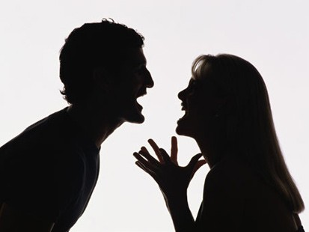
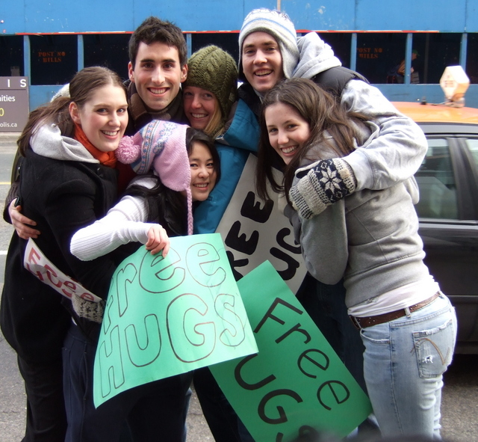
Social Health
Tips for Maintaining Healthy Relationships to Care for Your Social Health
Seek and lend support when needed.
Communicate clearly and listen to others.
Show respect and care for yourself and others.

Slide 9
The Health Triangle
The 3 elements of Health are interconnected
To be truly health, you must maintain balance in all 3 areas.
Wellness- Overall state of well-being or total health.
High level of health in all 3 areas.

Slide 10
Health Continuum
Neutral
Where are you today?
We practice healthy habits to avoid chronic disease or an ongoing condition or illness, such as, heart disease, obesity, or cancer.

Slide 11
Get out your cell phones…
No, seriously…
Poll Everywhere question of the day…

Slide 12
Chapter One
Lesson Two: What Affects Your Health?

Slide 13
Influences on Your Health
heredity
physical environment
social environment
culture
attitude
behavior
the media and tech.

Slide 14
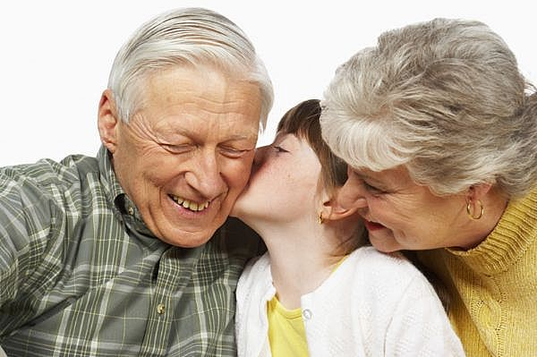
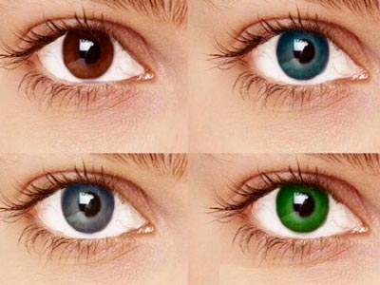
Influences
Heredity- Refers to all the traits that were biologically passed on to you from your parents.
We cannot control our heredity.
Examples: Hair color, eye color, body type, risks for heart disease, diabetes, and other illnesses.

Slide 15
Influences
Environment- The sum of all your surroundings.
Physical Environment- Neighborhood, school, air and water quality, recreational facilities, etc.
Social Environment- People around you; friends and family, peer pressure, bullies, etc.
Culture- The collective beliefs, customs and behaviors of a group.
USA---Minnesota---Zimmerman---High School
Religion, Language, Food, Traditions, etc.
The physical places in which you live.
The people who make up your world.
The culture you live in.

Slide 16
Influences
Attitude- The way you view things.
“Glass half full or glass half empty?”
Behavior- The control we have over our actions.
Drinking and Driving vs. Calling a Friend
Rock Climbing vs. Riding a Bike

Slide 17
Influences
Media and Technology are two of the most powerful influences on your health.
Radio, television, and Internet
Print; newspapers and magazines.
TV Personalities become role models
Positive and Negative
Models and Athletes

Slide 18
Charles Barkley
Is he right or is he wrong?

Slide 19
Chapter One
Lesson Three: Health Risks and Your Behavior

Slide 20
Identifying Health Risks
Everyday we are faced with some degree of risk.
Risk Behaviors- Actions that can potentially threaten your health or the health of others.
We need to identify threats to our health so we can make safe and responsible decisions.

Slide 21
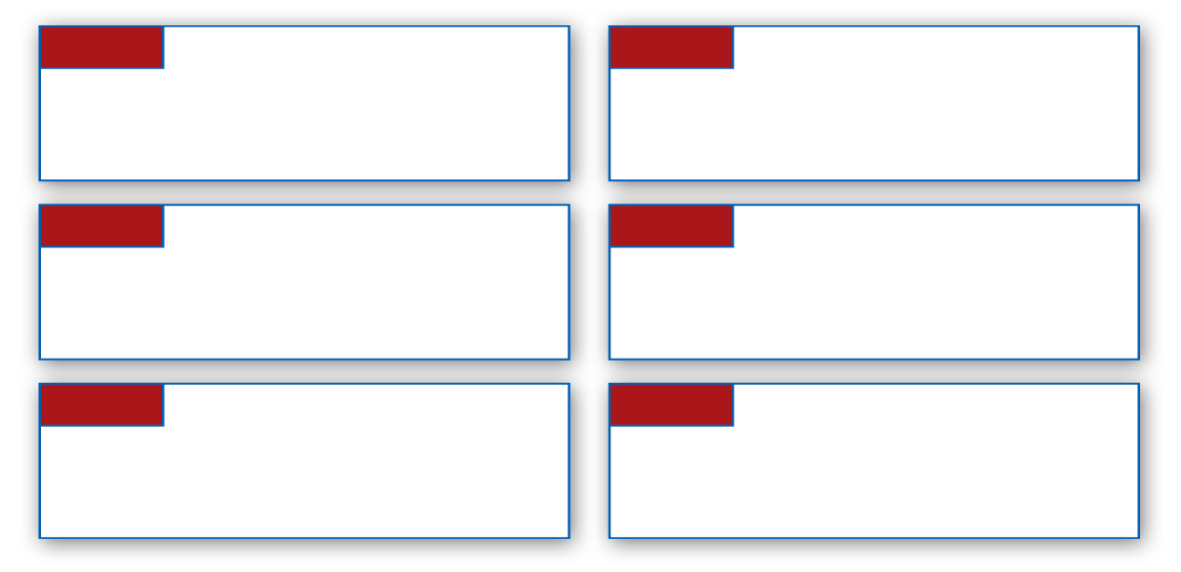
Recognizing Risk Behaviors
The Centers for Disease Control and Prevention (CDC) has identified six of the most significant risk behaviors for young people under age 24.
1
4
Tobacco use
Alcohol and other drug use
2
5
Unhealthy dietary behaviors
Sexual behaviors
3
6
Inadequate physical activity
Behaviors that contribute to injuries and violence

Slide 22
Risks & Consequences
Long Term vs. Short Term Risks
Cumulative Risks- Related risks that can increase in effect with each added risk.
Eating high fat diet, smoking, speeding, using a cell phone.
Can you name a few…?

Slide 23
How to Avoid or Reduce Risks
Prevention- Taking steps to keep something from happening or getting worse.
Practicing healthy habits to keep a person well and free from disease and other ailments.
Ex. Seatbelts, sunscreen, wearing a helmet, getting regular check-ups.
Abstinence- A deliberate decision to avoid high-risk behaviors, including sexual activity, and the use of tobacco, alcohol, and other drugs.

Slide 24
Lifestyle Factors
Lifestyle Factors- The personal habits or behavior related to how a person lives.
Get eight hours of sleep each night.
Start each day with a healthy breakfast.
Eat a variety of nutritious foods each day.
Be physically active for 30 to 60 minutes most days of the week.
Maintain a healthy weight.
Abstain from smoking or using other tobacco products.
Abstain from the use of alcohol and other drugs.

Slide 25
Chapter One
Lesson Four: Promoting Health and Wellness

Slide 26
Importance of Health Education
Today, America spends $2.3 Trillion each year on health care, or $7,600 per person.
Much of that could be avoided if people made healthier decisions and took responsibility for their wellness.
Health Education- Includes providing accurate health information and teaching health skills to help people make healthy decisions.

Slide 27
Why Health Education?
You do not want to be like Homer Simpson…

Slide 28
Becoming Health Literate
To become an informed individual who can make sound health decisions, one must know how to:
Find health information
Decide if the information is correct
Assess the risks and benefits of treatment
Figure out how much medicine to take
Understand test results

Slide 29
Health Literacy
Health Literacy- Refers to a person’s capacity to learn about and understand basic health information and services to use these resources to promote one’s health and wellness.
“So, What?” paper
Research Project
Article Reviews
Webquests
iPads

Slide 30
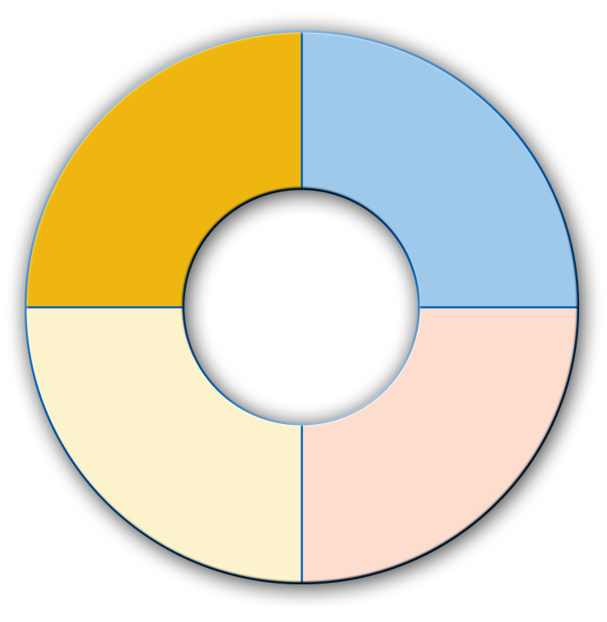
What can you do?
a critical thinker and problem solver
a responsible, productive citizen
Qualities of a Health-Literate Individual
a self-directed learner
an effective communicator

