Slide 1
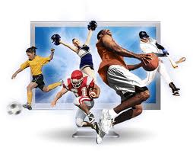
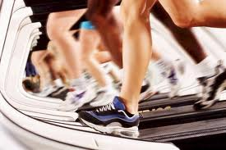
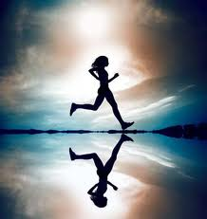
Chapter 12
Lesson 1

Slide 2
Physical Activity and Your Health
Physical Activity
Any form of movement that causes your body to use energy.
Benefits all systems in body as well as mental/emotional and social health.
Not just “working out.” Can include daily activities as well.

Slide 3
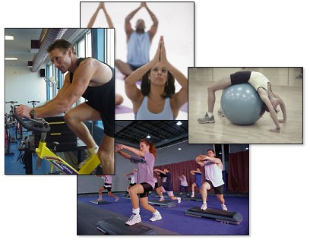
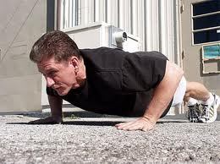
Physical Benefits
Physical Fitness
Ability to carry out daily tasks easily and have enough reserve energy to respond to unexpected demands.
Teens should try for at least 60 minutes every day
Strengthen bones, boost energy, improve posture, healthy weight, reduce risk of serious diseases
Exercise
Purposeful physical activity that is planned, structured, and repetitive, and that improves or maintains physical fitness.

Slide 4
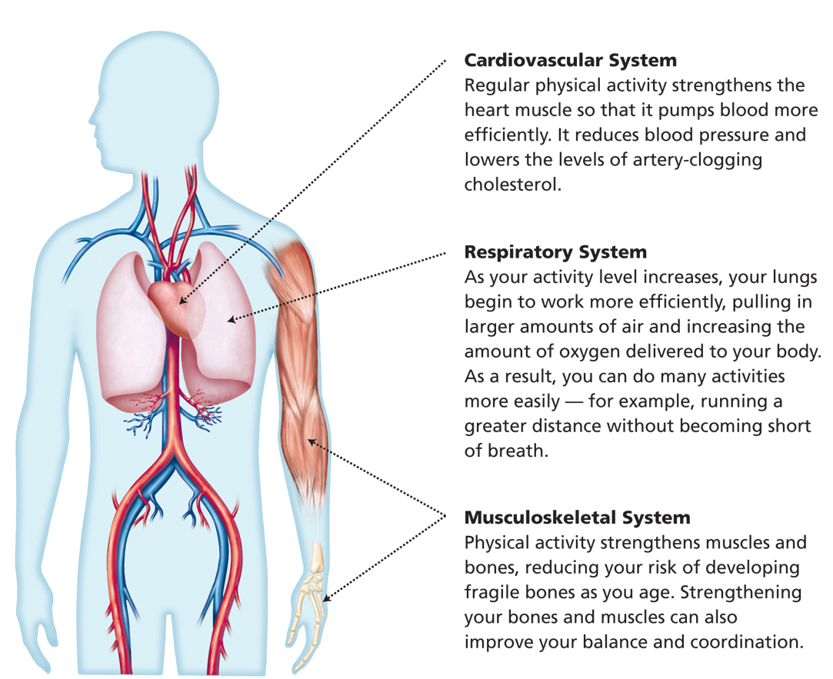
Physical Benefits

Slide 5
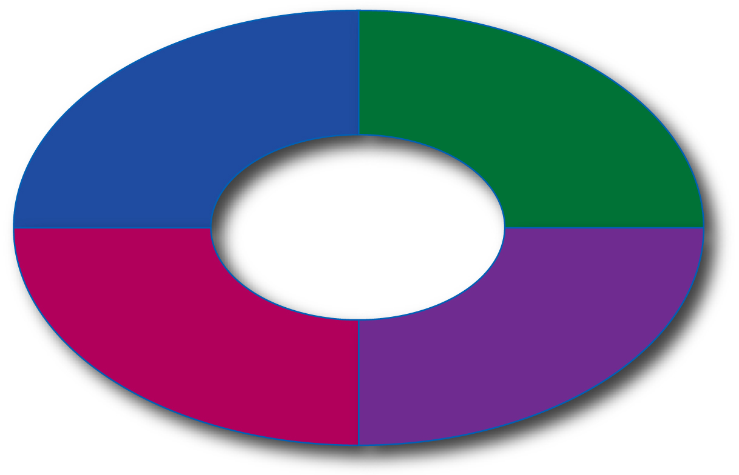
Mental and Emotional Benefits
Mood Enhancement
Stress Relief
Mental and Emotional Benefits
Improved Self-Esteem
Better Sleep

Slide 6
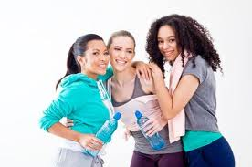
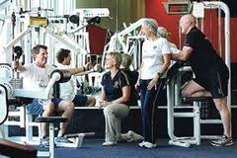
Social Benefits
Spend time with friends
Make new friends
Develop skills to improve your relationships
Increase self-esteem
Give you confidence
Manage stress

Slide 7
Sedentary – involves little physical activity, such as, watching television, playing video games, surfing internet. Can lead to health problems.
Risks of Being Inactive
Health Problems that May Result from Being Sedentary
Unhealthful weight gain and obesity
Cardiovascular disease
Type 2 diabetes
Certain types of cancer
Asthma and other breathing problems
Osteoporosis
Osteoarthritis
Psychological problems
Premature death

Slide 8
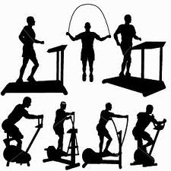
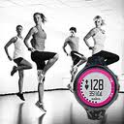
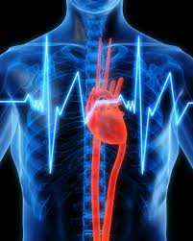
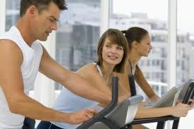
Chapter 12
Lesson 2

Slide 9
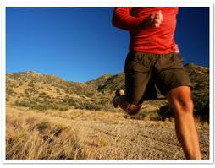
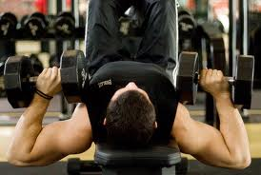
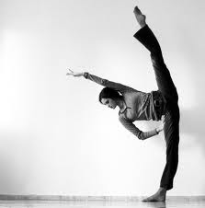
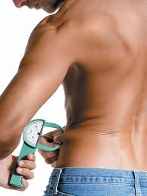
Elements of Physical Fitness
Cardiorespiratory Endurance
Ability of your heart, lungs, and blood vessels to send fuel and oxygen to your tissues during long periods of moderate to vigorous activity – 3 minute step test
Muscular Strength
Amount of force your muscles can exert – curl-ups (sit-ups) and push-ups
Muscular Endurance
Ability of your muscles to perform physical tasks over a period of time without tiring – curl-ups and push-ups

Slide 10
Elements of Physical Fitness
Flexibility
Ability to move your body parts through their full range of motion
Sit-and-reach
Body Composition
Ratio of fat to lean tissue in your body

Slide 11
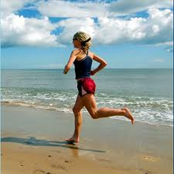
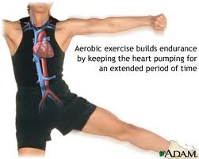
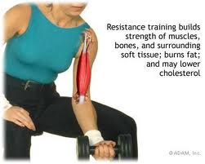
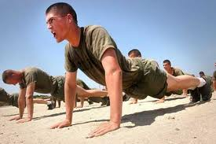
Getting Fit
Aerobic Exercise
Rhythmic activities that use large muscle groups for an extended period of time. Raise heart rate and increase the use of oxygen.
Great for improving Cardiorespiratory Endurance
Target Heart Rate

Slide 12
Getting Fit
Anaerobic Exercise
Intense, short bursts of activity in which the muscles work so hard that they produce energy without using oxygen.
Great for improving Muscular Strength and Endurance
Isometric Exercise
Little to no movement of body part
Isotonic Exercise
Combine movement of joints with contraction of muscles
Isokinetic Exercise
Exert resistance against a muscle as it moves through a range of motion at a steady rate of speed

Slide 13
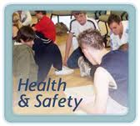
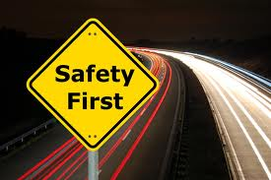
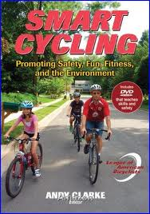
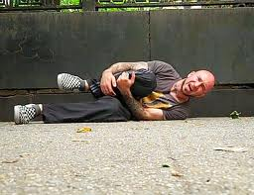
Chapter 12
Lesson 4

Slide 14
Safety First
Use the correct safety equipment for an activity.
Pay attention to other people, objects, and the weather.
Play or exercise at your skill level and know your limits.
Warm up before exercise and cool down afterward.
Stay within the areas designated for a given activity.
Obey all rules and restrictions.
Practice good sportsmanship.

Slide 15
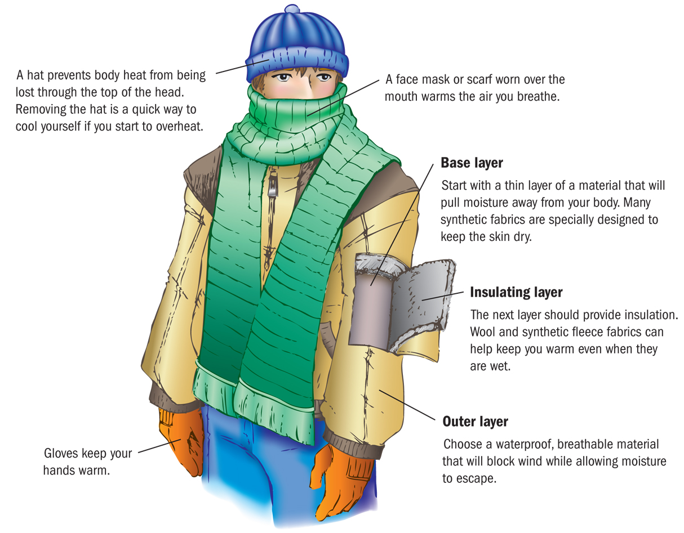
Watching the Weather

Slide 16
Cold-Weather Risks
Tips for Cold-Weather Activity
Warm up and cool down, even in cold weather.
Drink plenty of fluids. Cold air can lead to dehydration.
Cover your nose and mouth to prevent breathing cold, dry air.
If you have asthma, talk to your doctor before exercising outdoors in cold weather.

Slide 17
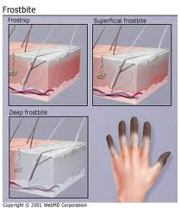
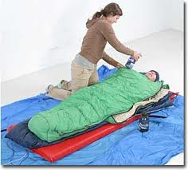
Cold-Weather
Hypothermia
Dangerously low body temperature
Occurs because of extreme cold, submersion in cold water, windy conditions
Drowsiness, weakness, confusion, breathing and heart rate slow down, followed by shock and heart failure
Requires emergency medical help
Frostbite
Damage to the skin and tissues caused by extreme cold.
Skin becomes pale, hard, and numb
Warm body part slowly, possibly seek medical help

Slide 18
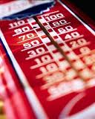
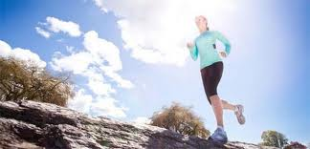
Hot-Weather Risks
Heat Exhaustion
Physical stress on the body caused by overheating
Heavy sweating, clammy skin, dizziness, confusion, fainting, etc…
Rest in shady area, drink cold water, fan your skin, seek medical help

Slide 19
Hot-Weather Risks
Overexertion
Overworking the body
Heatstroke
Dangerous condition in which the body loses its ability to cool itself
Can cause sudden death, seek medical help

Slide 20
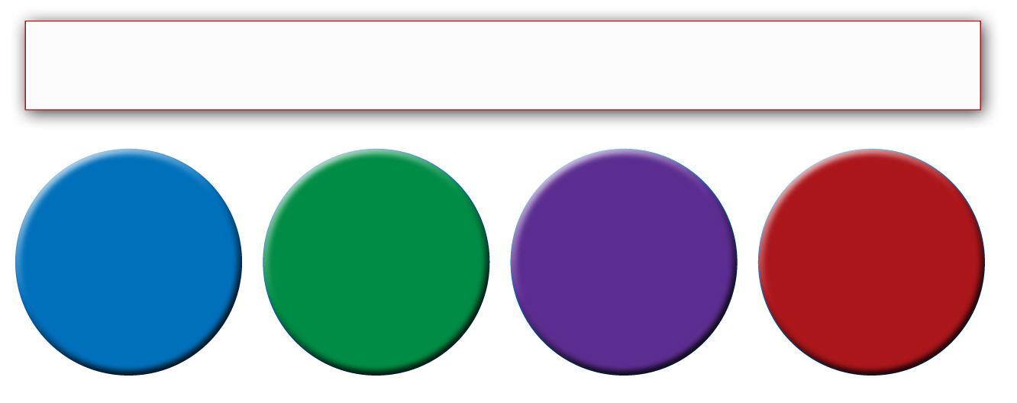
Sun and Wind Protection
Sun and wind can pose a hazard in both hot and cold weather and can lead to:
Skin Cancer
Eye Damage
Windburn
Sunburn

Slide 21
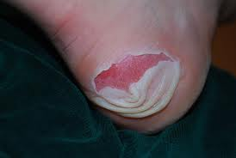
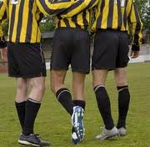
Minor Injuries
Minor Injuries
Blisters
Muscle Cramps
Strains
Tendonitis

Slide 22
Minor Injuries
The P.R.I.C.E. Procedure
Protect the affected area with a bandage or splint to prevent further injury.
Rest the muscle or joint for at least a day.
Ice the affected area for 10 to 15 minutes at a time, three times a day for two days after the injury.
Compress the affected area to reduce swelling.
Elevate the injured area above the level of your heart to keep the swelling down.

Slide 23
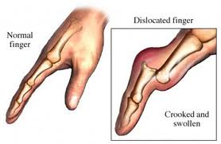
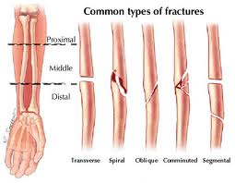
Major Injuries
Major injuries require immediate medical care.
Fractures are broken bones.
Dislocations occur when a bone pops out of its normal position in a joint.
A concussion is an injury to the brain that can result in a severe headache, unconsciousness, or memory loss.

