Slide 1
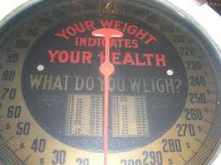
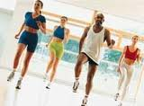
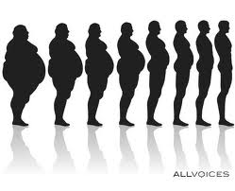
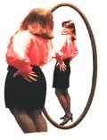
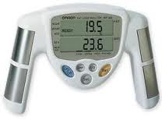
Chapter 11
Lesson 1

Slide 2
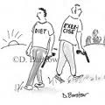
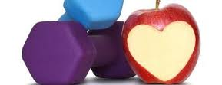
Energy balance is the balance between
Your Energy Balance
the calories you take in
the calories you burn

Slide 3
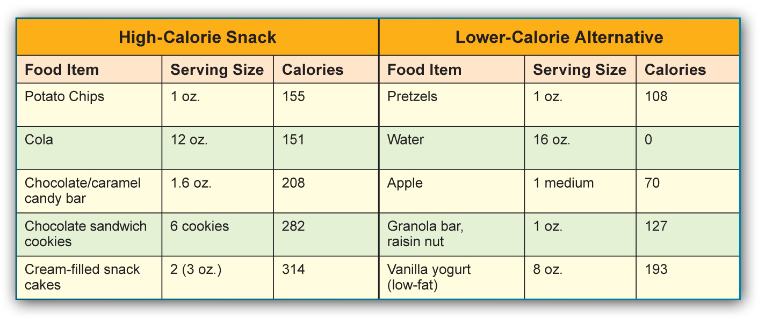
How Many Calories?

Slide 4
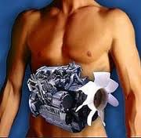
Energy Balance
Rule: foods high in fat will also be high in calories.
1 gram fat = 9 calories
1 gram carbs & protein = 4 calories
Metabolism
The process by which the body breaks down substances and gets energy from food.
Converts foods into fuel
3,500 calories = 1 pound
Healthy way to gain or lose weight is 1-2 pounds per week

Slide 5
Maintaining a Healthy Weight
Overweight
Body Mass Index
Heavier than the standard weight for your height.
BMI is helpful but does not tell the whole story. Very important to also consider your body composition – ratio of fat to lean tissue. Many people believe this is more important than body weight.

Slide 6
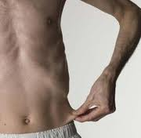
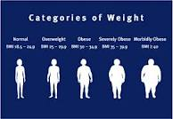
Your Weight and Your Health
Obese
Underweight
Having an excess of body fat.
17% of teens in the US are overweight. This percentage has tripled since the 1980’s.
Below the standard weight range for your height.
May have trouble fighting off disease.

Slide 7
Weighing Too Much
Health Problems Associated with Being Overweight
Hypertension
Cardiovascular disease
Type 2 diabetes
Osteoarthritis
Gallbladder disease
Asthma and other respiratory problems
Certain types of cancer

Slide 8
Managing Your Weight
Target a healthy weight.
Learn your ideal weight range.
Set realistic goals.
Eat healthfully and exercise regularly.
Personalize your plan.
Eat foods you enjoy.
Put your goals and plan in writing.
Write down your goals and your plan.
Evaluate your progress.
Track your weight on a weekly basis.

Slide 9
Healthful Ways to Lose Weight
Healthful Ways to Lose Weight
Choose nutrient-dense foods.
Watch portion sizes.
Eat fewer foods that are high in fats and added sugars.
Enjoy your favorite foods in moderation.
Be active.
Tone your muscles.
Stay hydrated.

Slide 10
Healthful Ways to Lose Weight
Healthful Ways to Gain Weight
Select foods from the five major food groups that are higher in calories.
Choose higher-calorie, nutrient-rich foods.
Eat nutritious snacks.
Get regular physical activity.

Slide 11
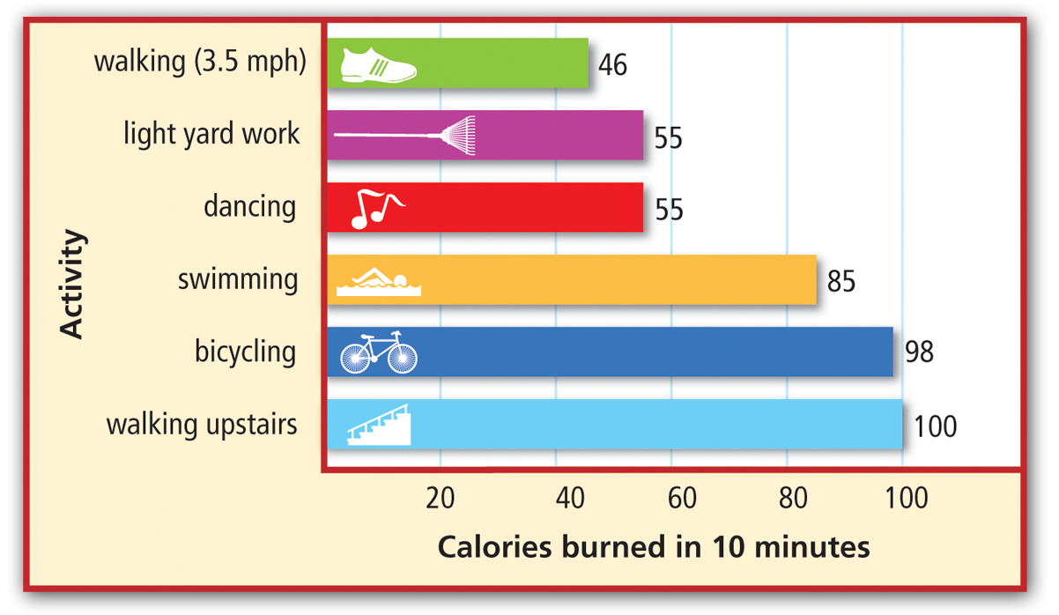
Physical Activity and Weight Management
This graph shows how many calories a person weighing 125 to 175 pounds can burn doing each activity for 10 minutes.

Slide 12
Physical Activity and Weight Management
What Can Physical Activity Do for You?
It helps relieve stress.
It promotes a normal appetite response.
It increases self-esteem, which helps you keep your plan on track.
It helps you feel more energetic.

Slide 13
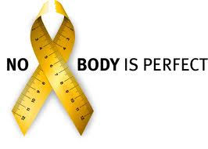
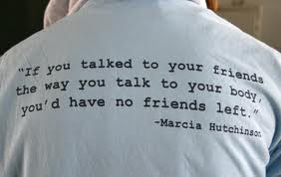
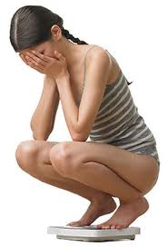
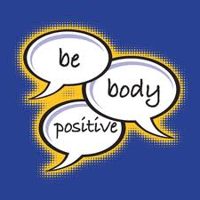
Chapter 11
Lesson 2

Slide 14
Body Image
Body Image
Body Image
The way you see your body
Many feel insecure about their changing bodies.
The sooner one accepts their body, the happier they will be.
Influenced by models, athletes, actors, and media.
Overweight and underweight teens may feel pressured by their friends and others to look a certain way.

Slide 15
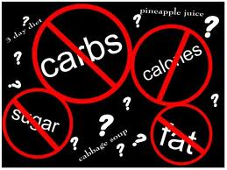
Fad Diets
Fad Diets
Weight-loss plans that tend to be popular for only a short time.
Typically promise quick, easy results
Usually lose weight temporarily, but regain when diet is over.
Weight-Cycling: repeated pattern of losing and regaining body weight.
Can pose serious health risks
Most teens should not diet

Slide 16
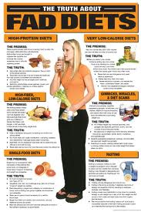
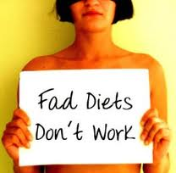
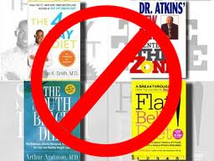
Types of Fad Diets
Miracle Foods
Promise you can “burn fat” by eating lots of single food types.
Magic Combinations
Certain foods will trigger weight loss when combined with other foods.
Liquid Diets
Replace solid food with ultra-low-calorie liquid formulas.
Diet Pills
Claim to suppress your appetite. “Block” or “Flush” fat from body.
Fasting
Deprives body of needed nutrients. Short-term can be safe but long-term may lead to serious health consequences.

Slide 17
Eating Disorders Extreme, harmful eating behaviors that can cause serious illness or even death
Anorexia Nervosa
An irrational fear of weight gain leads people to starve themselves.
Avoid food and meals
Eating only a few kinds of food in small amounts
Weighing or counting calories in everything they eat
Exercising excessively
Weighing themselves repeatedly
Can lead to serious consequences for body and sudden cardiac death

Slide 18
Eating Disorders
Bulimia
Cycles of overeating and purging, or attempts to rid the body of food. Binging and purging.
Vomit, laxatives, fasting, exercise excessively
Normal weight range for height
Dehydration, sore throat, swollen glands, damaged teeth, stomach, intestines, or kidneys, irregular heart rhythms, heart failure, death.

Slide 19
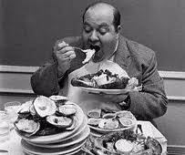
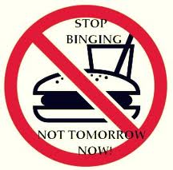
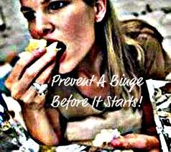
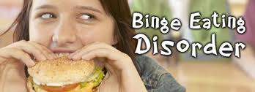
Eating Disorders
Binge Eating
People overeat compulsively
Large amount of food in a short period of time
Consequences
Overweight / obese
High blood pressure
Type 2 diabetes
Cardiovascular disease

Slide 20
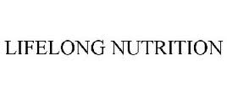
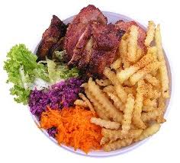
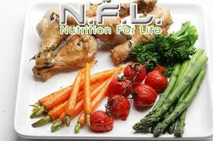
Chapter 11
Lesson 3

Slide 21
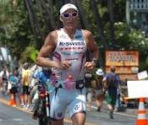
Lifelong Nutritional Needs
Factors that Affect Your Nutritional Needs
Age
As you get older, your calorie needs will change based on your activity level.
Gender
Females tend to need fewer calories but more of some nutrients than males.
Activity Level
The more active you are, the more calories your body needs.

Slide 22
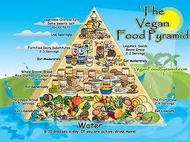
Vegetarian Diets – eats mostly or only plant-based foods
Types of Vegetarians
Vegans eat only plant-based foods.
Lacto-ovo vegetarians also include dairy foods and eggs in their diet.
Lacto vegetarians include dairy foods in their diet.
Ovo vegetarians include eggs in their diet.
Dietary Supplements – products that supply one of more nutrients as a supplement to, not a substitute for, healthful foods.

Slide 23
Foods that people eat can trigger certain diseases or health conditions. People with these conditions may need to avoid or limit certain foods in order to avoid health problems.
Health Conditions
Diabetics
Control carbohydrate intake to control blood sugar.
Food Allergies
Avoid the foods and food ingredients they are allergic to.
Lactose Intolerance
Consume less lactose.
Gluten Intolerance
Avoid glutens.
Celiac Disease
Avoid grains and grain-based products.
High Blood Pressure
Reduce salt intake.
High Cholesterol
Reduce intake of saturated fats and trans fats.

Slide 24
Nutrition for Athletes
Athletes need:
a balanced diet that supplies enough nutrients to support health.
more calories to provide additional fuel.
more calories from nutrient-dense foods and foods higher in carbohydrates.
more protein and carbohydrates than inactive people.

Slide 25
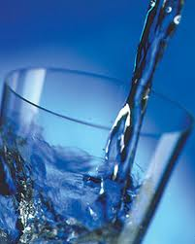
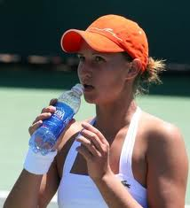
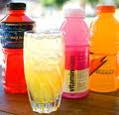
Hydration
Teen girls 9 cups of noncaffeinated fluids each day
Teen boys 13 cups
Dehydration can lead to:
Fatigue, dizziness, light-headedness, cramping
Electrolytes
Minerals that help maintain the body’s fluid balance
Sodium, chloride, and potassium
To prevent dehydration…drink before, during, and after your exercise.

Slide 26
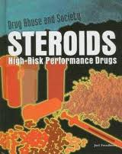
Performance Enhancers – substances that boost athletic ability. Many pose health risks, especially for teens. Illegal by many sports organizations.
Avoiding Performance Enhancers
These dangerous drugs have the same effect as male hormones (known as androgens) and are used to boost muscle growth.
Anabolic Steroids
Androstenedione
Andro is a weaker form of the androgens that the body produces naturally. It is used to build muscle.
Creatine
This compound helps release energy and can cause cramps, nausea, and heart, liver, and kidney damage.
Energy drinks contain high amounts of caffeine and provide energy by increasing your heart rate. These beverages can lead to dehydration.
Energy Drinks

Slide 27
Eating Before Competition
Provides your body with energy it needs throughout competition
Eat 3-4 hour before competition
Choose meals that are high in Carbohydrates and low in fat and protein
Fat and protein stay in digestive system longer
Pasta, rice, vegetables, breads, fruits
Drink plenty of fluids before, during, after competition

