Slide 1
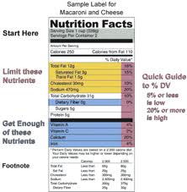
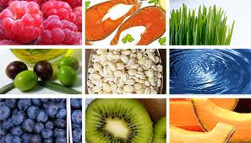
Chapter 10 – Nutrition for Health
Lesson 1

Slide 2
Favorite Food Most Disliked Food

Slide 3
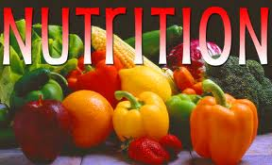
Importance of Nutrition
The food you eat affects your health and quality of life.
Nutrition:
The process by which your body takes in and uses food.
Nutrients:
Substances in food that your body needs to grow, to repair itself, and to supply you with energy.
Calorie:
Unit of heat used to measure the energy your body uses and the energy it receives from food. Calories in food provide energy your body needs for activities.

Slide 4
Why Nutrition Matters
Cardiovascular disease
Eating a variety of healthful foods can lower your risk of developing other conditions, including:
Certain cancers
Stroke
Osteoporosis

Slide 5
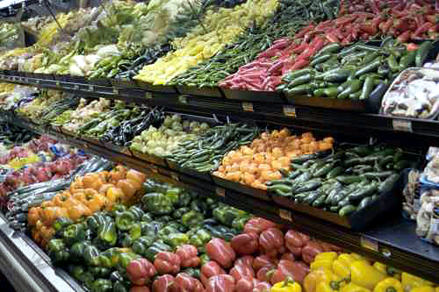
Nutrition and Your Health
A variety of healthy foods.

Slide 6
Influences on Food Choices
Hunger:
Natural physical drive to eat, prompted by the body’s need for food.

Slide 7
Appetite:
The psychological desire for food. Eating when one is already full or has no need to eat.
Food and Emotions:
Eating in response to an emotional need, like when you feel stressed, frustrated, lonely, or sad. Snacking out of boredom or use food as a reward.
Can lead to weight gain. On the other hand if one loses their appetite they may not eat and this could deprive the body of needed nutrients. Recognizing your emotions is important because it can affect your eating habits.

Slide 8
Food and Your Environment
Family and culture
Friends
Environmental Influences
Time and money
Advertising

Slide 9
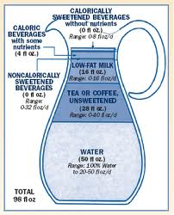
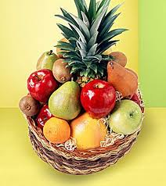
Chapter 10
Lesson 2

Slide 10
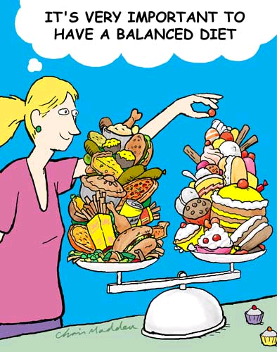
Is this a good diet?

Slide 11
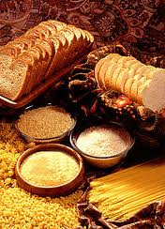
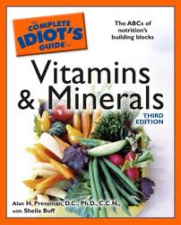
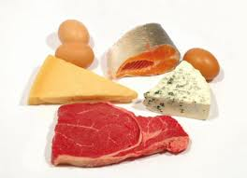
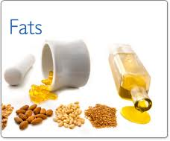
Nutrients
Giving Your Body What It Needs
Everything you eat contains nutrients. Your body uses nutrients in many ways:
As an energy source
To heal, and build and repair tissue
To sustain growth
To help transport oxygen to cells
To regulate body functions
Six Types Of Nutrients
Carbohydrates
Proteins Provide energy
Fats
Vitamins
Minerals Perform variety of other functions / regulate
Water

Slide 12
Carbohydrates
Carbohydrates – Starches and sugars found in foods.
Body’s preferred source of energy
Provides 4 calories per gram
Health experts recommend that 45 to 65 percent of your daily calories come from carbohydrates.

Slide 13
Types of Carbohydrates
There are three types of carbohydrates:
Simple
Complex
Fiber

Slide 14
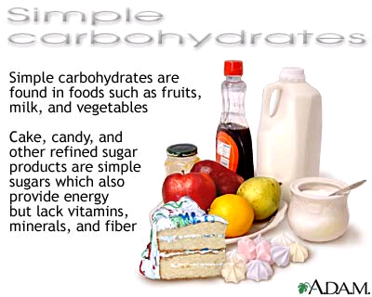
Simple Carbohydrates
Are simple sugars
They are found in fruits, some vegetables and milk
Sugars are called (fructose, lactose, maltose and sucrose)
Provide short bursts of energy

Slide 15
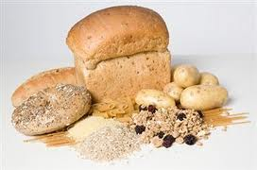
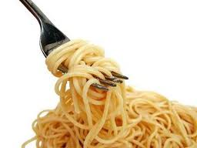
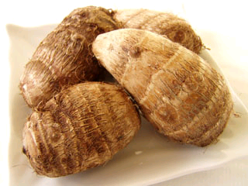
Complex Carbohydrates
Commonly known as starches / long energy
Long chains of sugars linked together
Sources include: grains, grain products such as bread and pasta, beans, and root vegetables such as potatoes.

Slide 16
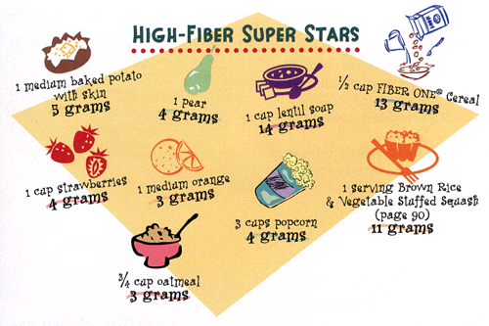
Fiber
Found in tough, stringy part of fruits, vegetables, and grains. Special form of complex carbohydrate.
Cannot be digested or used as energy but has important functions…reduce cancer, heart disease, type 2 diabetes.
Helps move waste through system, prevents constipation, appendicitis, and other intestinal problems.
--Recommend 26 - 38 grams per day
--

Slide 17
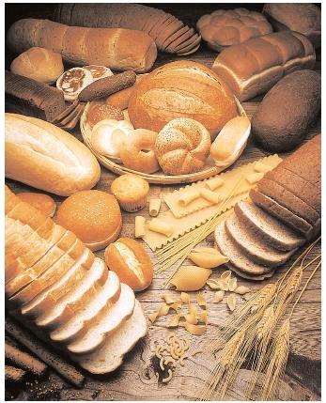
Role of Carbohydrates
Body converts your sugars to glucose. Glucose that is not used is converted into glycogen and stored in muscles and the liver. When people consume more than is used or needed, it is stored as fat.

Slide 18
Proteins
Nutrients that help build and maintain body tissues.
Muscle, bone, connective tissue, teeth, skin, blood and vital organs.
Supplies 4 calories per gram.
Made of chains of Amino Acids, your body can make all but 9 of the 20 different amino acids.
The 9 are called essential amino acids because they must come from the foods you eat.

Slide 19
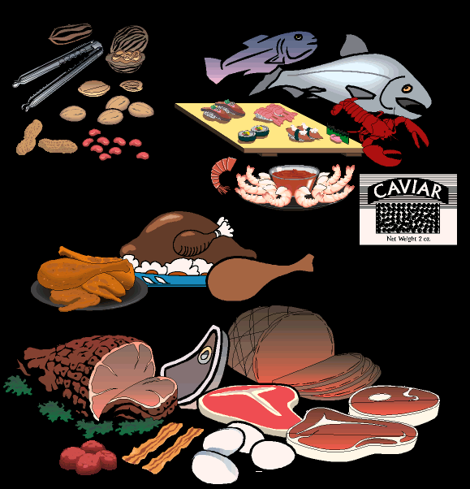
Nuts
Fish
Poultry
Meat
Good Sources of Protein

Slide 20
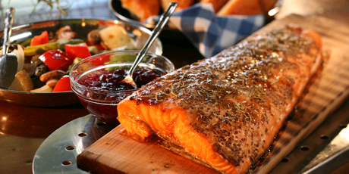
Complete Proteins
Contain all 9 of the essential amino acids.
Animal products such as fish, meat, poultry, eggs, milk, cheese, yogurt, and many soybean product.

Slide 21
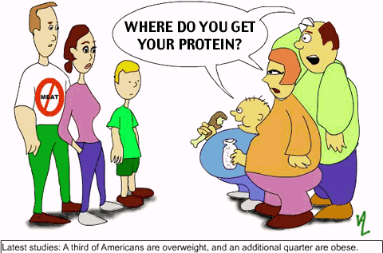
Incomplete Protein
Lack some of the essential amino acids.
Legumes, nuts, whole grains and seeds.
Combining incomplete proteins may be equivalent to complete protein.

Slide 22
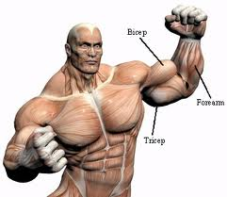
Role of Proteins
Basic building material of all your body cells.
Muscles, bones, skin, and internal organs
Protein hemoglobin in your red blood cells carries oxygen to all cells.
Help in the production of hormones, chemicals that regulate the activities of your body systems.
Not as effective as carbohydrates, put can also be used as energy.
10 – 15% of daily calories should come from protein
Teen girls 46 grams per day / Teen boys 52 grams per day

Slide 23
Fats
Type of lipid, which is a fatty substance that does not dissolve in water.
Supplies 9 calories per gram.
Less than 25-35% of calories should come from fat

Slide 24
Types of Fats
Unsaturated Fats
Eating unsaturated fats in moderate amounts may lower your risk of heart disease.
Saturated Fats
Consuming too many saturated fats may increase your risk of heart disease.
Trans Fats
Trans fats can raise your total blood cholesterol level, which increases your risk for heart disease.

Slide 25
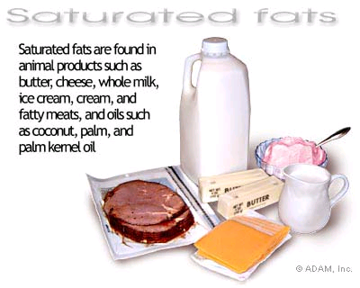
Saturated Fats
Fatty acid holds all the hydrogen atoms it can.
Animal fats, tropical oils.
Fat that is solid or semi-solid at room temperature, associated with heart disease.
No more than 10% of your fat intake.

Slide 26
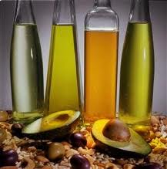
Unsaturated Fats
Missing hydrogen atoms.
Vegetable oils, nuts, and seeds tend to contain larger amounts of unsaturated fats.
Olive oil is a good source of healthful, unsaturated fat.
Liquid at room temperature, reduce risk of heart disease.

Slide 27
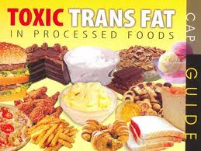
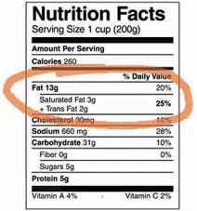
Trans Fat
Formed by a process called “hydrogenation”, which causes vegetable oil to harden.
As it hardens, it becomes more “saturated”
Stick margarine, snack foods, packaged baked goods (cookies and crackers).
Increases risks for heart disease
USDA now requires all trans fat to be listed on nutrition label

Slide 28
Health Issues of Fats
Your body needs a certain amount of fat to carry out its basic functions.
Consuming a lot of fats can lead to unhealthful weight gain, obesity, and other health risks.

Slide 29
Health Issues of Fats
The essential fatty acids are important to:
brain development
blood clotting
controlling inflammation
maintaining healthy skin and hair

Slide 30
The Role of Fats
Fats provide a concentrated form of energy.
Fats also absorb and transport fat-soluble vitamins (A, D, E, and K) through the bloodstream.

Slide 31
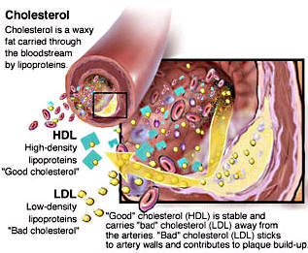
Cholesterol
Fat like substance found in foods of animal origin.
Body can make all it needs.
Creates cell walls, certain hormones, and Vitamin D.
High amounts lead to increase risk of heart disease.

Slide 32
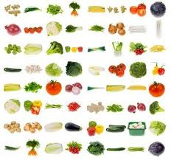
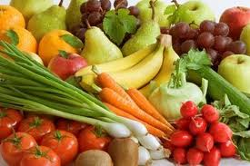
Vitamins
Vitamins
Compounds found in food that help regulate many body processes.
Do not supply energy but still necessary for carrying out various body functions.

Slide 33
Vitamins
TYPE
Description
EXAMPLES
Water-Soluble Vitamins
Dissolve in water
Vitamin C, folic acid, B vitamins
Fat-Soluble Vitamins
Stored in body fat
Vitamins A, D, E, and K

Slide 34
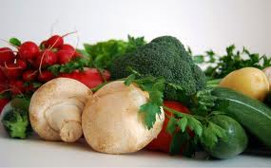
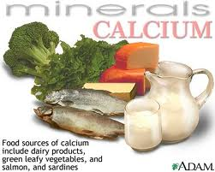
Minerals
Minerals
Elements found in food that are used by the body
Body cannot manufacture so must get from food
Calcium
Promotes bone health
Reduces “osteoporosis” which is a condition in which the bones become fragile and break easily.

Slide 35
Water
Water is essential for just about every function in your body.
Teen girls need about 9 cups of fluids a day.
Teen boys need about 13 cups of fluids a day.

Slide 36
Water
Functions of Water
Moving food through the digestive system.
Digesting carbohydrates and protein.
Aiding chemical reactions in the body.
Transporting nutrients and removing wastes.

Slide 37
Water
Functions of Water
Storing and releasing heat.
Cooling the body through perspiration.
Cushioning the eyes, brain, and spinal cord.
Lubricating the joints.

Slide 38
Water
Water Tips
Drink extra water before, during, and after exercise.
Drink extra fluids in hot weather to prevent dehydration.
Limit your consumption of coffee, tea, and soft drinks that contain caffeine.

Slide 39
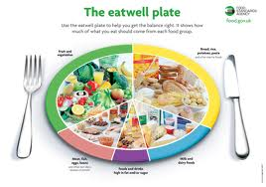
Chapter 10
Lesson 3

Slide 40
Guidelines for Eating Right
Dietary Guidelines for Americans
Set of recommendations about smart eating and physical activity for all Americans.
Guidelines published by the U.S. Department of Agriculture (USDA) and the Department of Health and Human Services (HHS)
Provide science-based advice for healthful living
Advice can be summed up in three key guidelines:
Make smart choices from every food group
Find your balance between food and activity
Get the most nutrition out of your calories

Slide 41
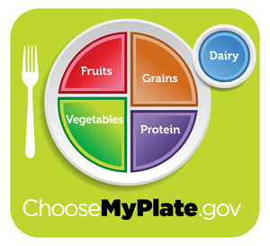
Making Smart Choices
Choosing a variety of foods from each food group will provide all the nutrients your body needs.
Five food groups: grains, vegetables, fruits, milk, meats and beans
Balancing Calories
● Enjoy your food, but eat less.
● Avoid oversized portions.
Foods to Increase
● Make half your plate fruits and vegetables.
● Make at least half your grains whole grains.
● Switch to fat-free or low-fat (1%) milk.
Foods to Reduce
● Compare sodium in foods like soup, bread, and frozen meals ― and choose the foods with lower numbers.
● Drink water instead of sugary drinks.

Slide 42
ChooseMyPlate.Gov
Provides practical information to individuals, health professionals, nutrition educators, and the food industry to help consumers build healthier diets.
Choosemyplate.gov is an interactive website that can help Americans make healthier food choices for themselves, their families, and their children.

Slide 43
Your Best Choices
Focus on fruits.
Vary your veggies.
Dietary Guidelines Recommendations
Get your calcium-rich foods.
Make half your grains whole.
Go lean with protein.
Limit certain foods.

Slide 44
Getting the Most From Your Foods
Nutrient-Dense Foods
Foods that have a high ratio of nutrients to calories
ie…large carrot vs. half ounce of potato chips – have same number of calories but the carrot provides more nutrients.
Importance of Breakfast
Need to refuel body after sleep. Body constantly needs energy.
Ideas: oatmeal, cereal, hard-boiled eggs, whole-grain muffins, bagel, toast with peanut butter, etc…something is better than nothing.

Slide 45
Sensible Snacks
Fresh fruit
There are plenty of healthful foods that you can easily enjoy when you need a quick bite.
Cut-up vegetables
String cheese
Unsalted nuts
Air-popped popcorn
Fat-free yogurt
Bread sticks

Slide 46
Eating Right When Eating Out
Follow these guidelines to make healthful food choices when you eat away from home.
Watch portion sizes.
Pay attention to how foods are prepared.
Add fresh vegetables and fruits.
Go easy on toppings.
Don’t drink your calories.

Slide 47
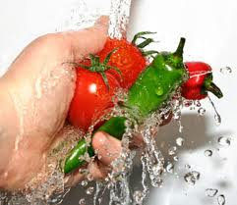
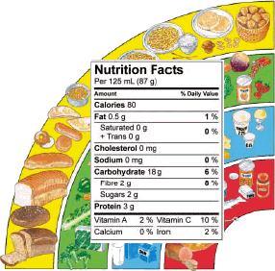
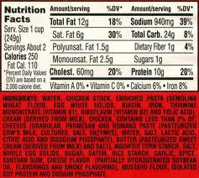
Chapter 10
Lesson 4

Slide 48
Nutrition Label Basics
Among other things, the food label lists
the name of the food product.
the amount of food in the package.
the name and address of the company that makes, packages, or distributes the product.
the ingredients in the food.
the Nutrition Facts panel, which provides information about the nutrients found in the food.

Slide 49
Nutrition
Ingredients in a food appear on the label in descending order by weight…the ingredient that makes up the largest share of the weight comes first.
Food Additives
Substances added to food to produce a desired effect.
Keep a food safe for a longer period of time
Boost its nutrient content
Improve taste, texture, or appearance
Some concern experts because of their possible effects on the body…Aspartame (sugar substitute) and Olestra (fat substitute).

Slide 50
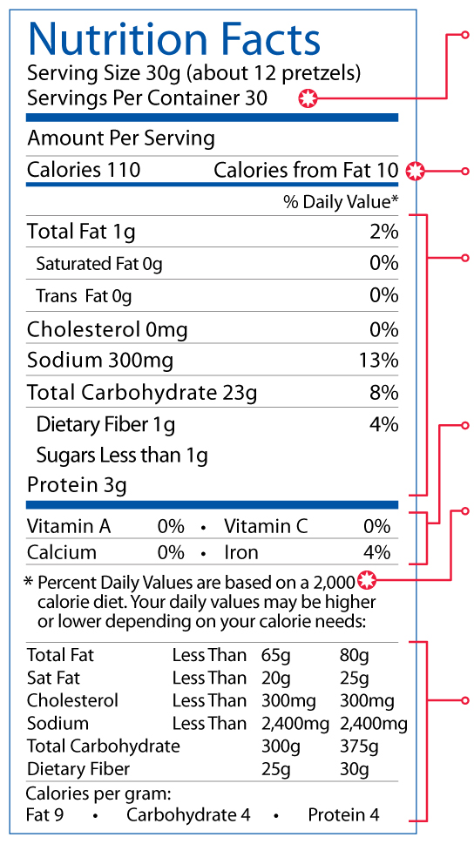
Nutrition Facts
Serving Size
Calories
Nutrients
Vitamins and Minerals
Footnote
Percent Daily Value

Slide 51
Nutritional Claims
Federal law gives uniform definitions for the following terms that make claims about nutritional value.
Free
Contains none, or an insignificant amount, of a given component.
Can be eaten regularly without exceeding your daily limits for fat, saturated fat, cholesterol, sodium, or calories.
Low
Light
Must contain one-third fewer calories, one-half the fat, or one-half the sodium of the original version.

Slide 52
Nutritional Claims
Reduced
The food contains 25 percent fewer calories, or 25 percent less of a given nutrient, than the original version.
High
Provides at least 20 percent of the daily value for a vitamin, mineral, protein, or fiber.
Good Source of
Provides 10 to 19 percent of the daily value for a vitamin, mineral, protein, or fiber.
Healthy
Must be low in fat and saturated fat; cholesterol, and sodium; and provide at least 10 percent of the daily value for vitamin A, vitamin C, iron, calcium, protein, or fiber.

Slide 53
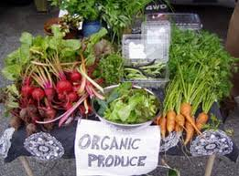
Organic Food Labels
Foods labeled as organic
are produced without the use of certain agricultural chemicals
cannot contain genetically modified ingredients
cannot be subjected to certain types of radiation

Slide 54
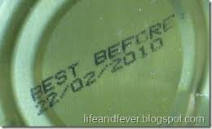
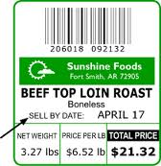
Open Dating
The last day on which a store should sell a product.
Sell by dates
Use by or expiration dates
The last day on which a product’s quality can be guaranteed.
Freshness dates
The last date on which a product is considered fresh.
The day on which a food was processed or packaged.
Pack dates

Slide 55
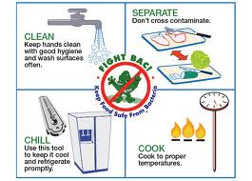
Food Safety
Foodborne Illness
Food poisoning
About 76 million Americans become ill as a result of foodborne illnesses each year.
Sources include: Bacteria (Campylobacter, Salmonella, E. Coli) and Viruses (Norwalk and Norwalk-like)

Slide 56
How Foodborne Illness Occurs
Cramps
Fever
Common Symptoms of Foodborne Illness
Diarrhea
Vomiting
Nausea

Slide 57
How Foodborne Illness Occurs
If the following symptoms are present, consult a doctor:
A fever higher than 101.5 degrees F
Prolonged vomiting or diarrhea
Blood in the stool
Signs of dehydration, including a decrease in urination, dry mouth and throat, and feeling dizzy when standing

Slide 58
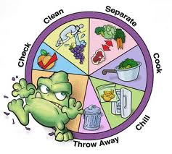
Keeping Food Safe to Eat
Pasteurization
Treating a substance with heat to kill or slow the growth of pathogens.
Clean
Wash (20 seconds minimum) and dry hands frequently, this includes cooking surfaces and utensils
Cross-contamination
The spreading of pathogens from one food to another
Separate
Store and keep foods away from each other
Cook
Heat foods to a high enough temperature to kill pathogens
Chill
Refrigeration slows the growth of harmful bacteria

Slide 59
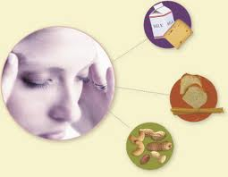
Food Sensitivities
Food Allergy
Condition in which the body’s immune system reacts to substances in some foods.
Symptoms range from mild to life threatening.
Anaphylaxis can be life threatening as the throat can swell and heart has difficulty pumping blood.
Food Intolerance
A negative reaction to food that doesn’t involve the immune system – more common that a food allergy.

Slide 60
Food Sensitivities
Milk
Eggs
The most common allergens are found in these foods. Food labels must say if a food product contains any of these ingredients or any protein derived from them.
Peanuts
Tree Nuts
Soybeans
Wheat
Fish
Shellfish

Slide 61
Food Sensitivities
The symptoms of food allergies vary from mild to life threatening. Mild symptoms include:
Gastrointestinal symptoms such as nausea, vomiting, or diarrhea.
Skin irritations, such as rashes, hives, or itching.

