Slide 1
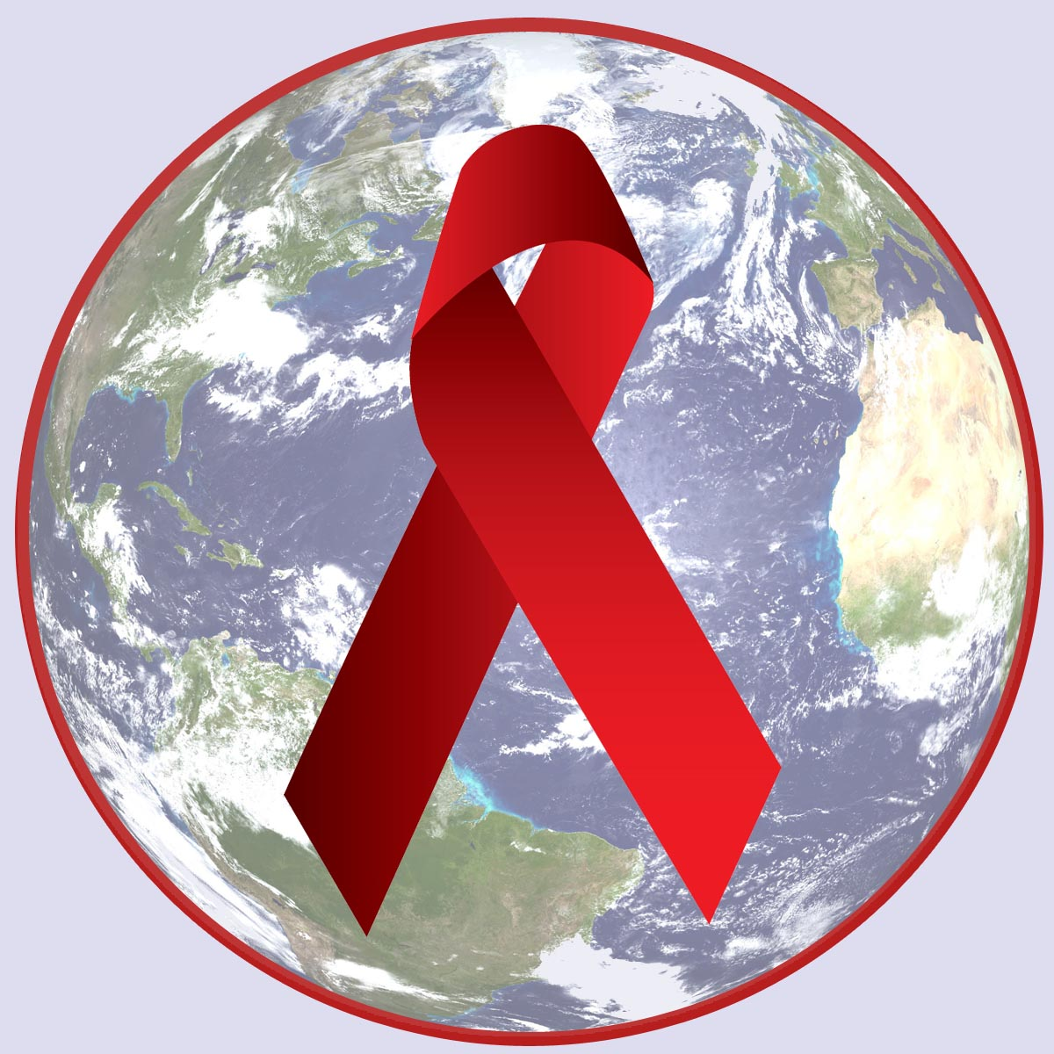
HIV/AIDS
HIV/AIDS
Chapter 24; Lesson 3
Chapter 24;
Lesson 3

Slide 2

What is HIV/AIDS?
Human Immunodeficiency Virus (HIV) – a virus that attacks the immune system.
Once HIV enters the body, it finds and destroys the white blood cells that fight disease.
The final stage of an HIV infection is AIDS.
Acquired Immunodeficiency Syndrome- a disease in which the immune system is weakened.

Slide 3

HIV/AIDS
HIV is a worldwide concern – one of the most serious public health problems facing our world.
Health care officials consider HIV/AIDS a pandemic.
Many young people who are infected do not know it.

Slide 4
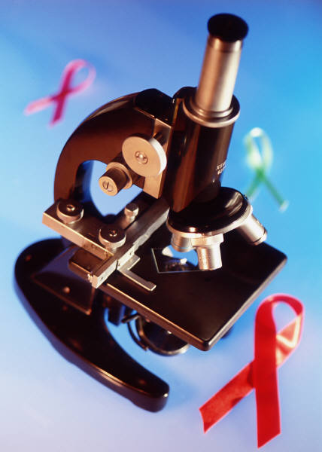
HIV/AIDS Facts
AIDS has become one of the deadliest diseases in human history
More than 25 million people around the world have died of this disease, including more than 500,000 Americans
Approx. 12 million of people who have HIV/AIDS are in the 15-24 age group
Half of all new HIV infections are among young people
Everyday about 7,000 young people become infected

Slide 5
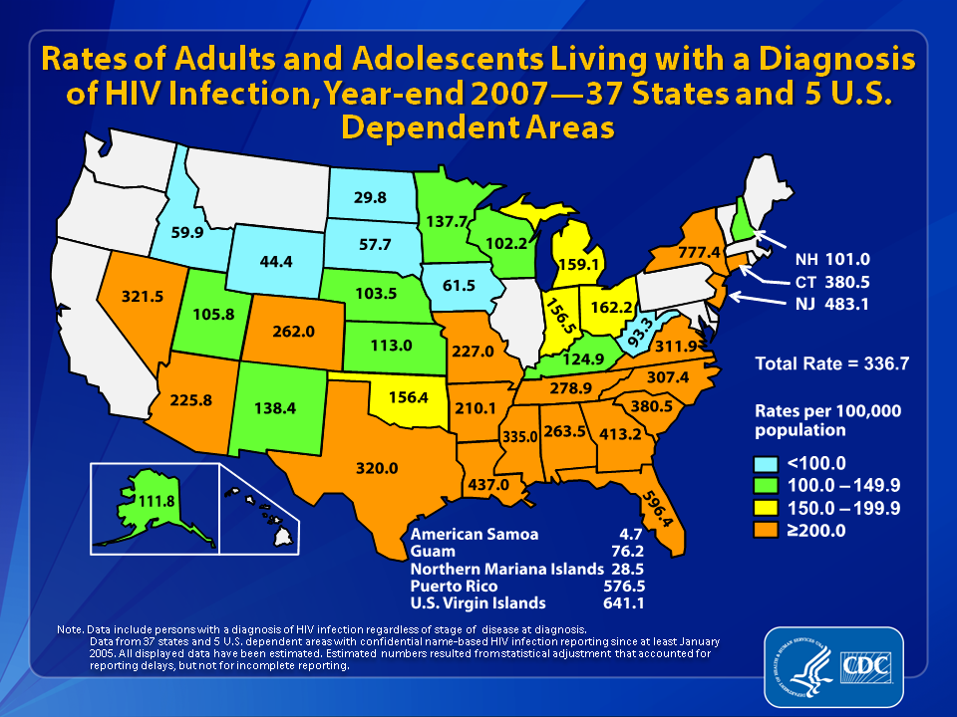

Slide 6


Slide 8
Map of Metro Area:
Living HIV/AIDS Cases by County of Residence, 2010

Slide 9
Understanding HIV
HIV is fragile virus and cannot live outside human body
Exposure to air at room temp kills virus.
HIV cannot spread through airborne transmission, through casual contact such as shaking hands or hugging, or from insect bites

Slide 10
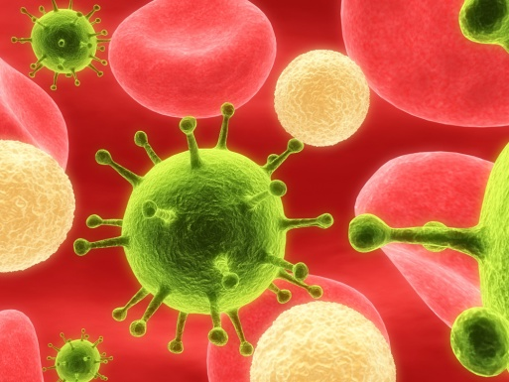
How is HIV Transmitted?
During Sexual Intercourse
By Sharing Needles
From Mother to Baby

Slide 11
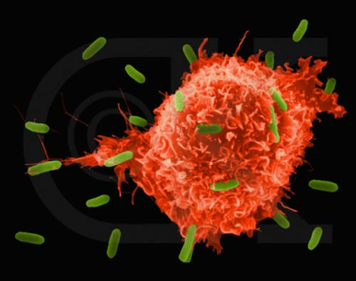
How HIV/AIDS Affects the Immune System
HIV attacks the body’s immune system by destroying lymphocytes.
Lymphocytes are specialized white blood cells that perform many immune functions, such as fighting pathogens.
As more lymphocytes are destroyed, the immune system becomes weaker and weaker.
The body then becomes vulnerable to AIDS-opportunistic illnesses, infections the body could fight off if the immune system were healthy.

Slide 12
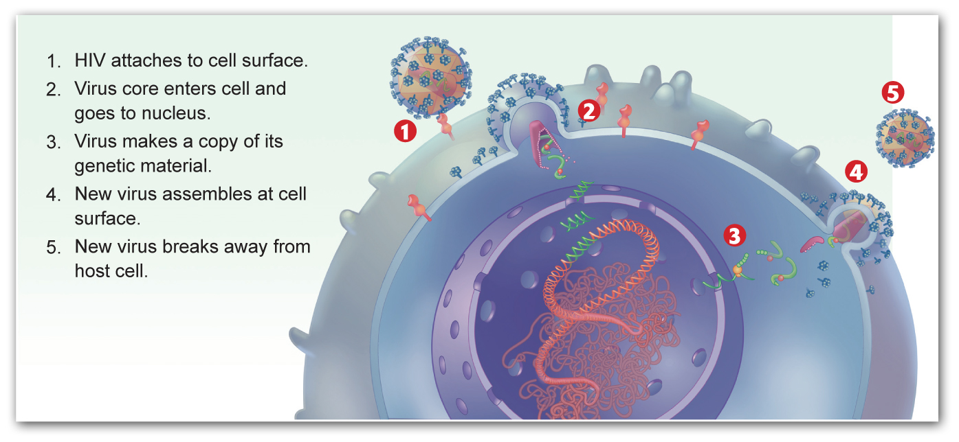
How HIV Attacks Cells

Slide 13

How HIV/AIDS Affects the Immune System
Asymptomatic stage
HIV infection usually goes through identifiable stages before progressing to AIDS:
Middle stage
Symptomatic stage
AIDS stage

Slide 14

How HIV/AIDS Affects the Immune System
The virus invades and takes over helper T cells
Asymptomatic stage
Patients experience fever, headache, sore throat, rash, diarrhea, and enlarged lymph nodes.
Middle stage
Patients experiences flu-like symptoms, such as headache, fever, body aches, swollen glands, diminished appetite, weight loss, and skin rashes. Helper T cells fall to 200-400 per mL of blood.
Symptomatic stage
Patients have immune systems that are so weakened that they may die from illnesses from which they would ordinarily recover. Helper T cells drop to less than 200.
AIDS stage

Slide 15
Giving or Receiving Blood;
Is it Safe?
According to the CDC (Centers for Disease Control), “The U.S. blood supply is among the safest in the world.”
Health care professionals are required to always use sterile needles to draw blood.
All donated blood has been tested for HIV since 1985.

Slide 16
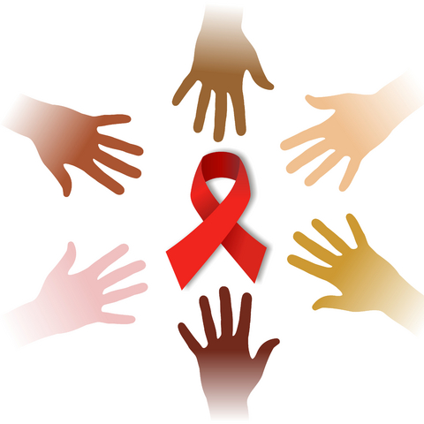
Preventing and Treating Hiv/AIDS
Preventing and Treating
HIV/AIDS
Chapter 24; Lesson 4
Chapter 24;
Lesson 4

Slide 17


Preventing HIV/AIDS
There are many actions you can take to avoid contracting HIV/AIDS.
CDC estimates that about 25% of people in the US who are infected with HIV do not know they are infected.
Because they may not know, they may unknowingly spread the virus to others.

Slide 18
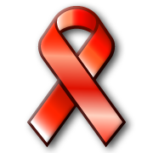
Ways you can prevent the spread of HIV/AIDS
Practice abstinence
Do not share needles
Avoid situations where drug and alcohol use might compromise your decision making.
Use refusal skills when you feel pressured to engage in risky behaviors.
Knowing as much as you can about the people around you and their behaviors can help you make responsible and informed decisions.

Slide 19
Diagnosing HIV/AIDS
Several tests are used to diagnose HIV/AIDS
If someone believes he or she may have been exposed to HIV, person needs to be tested
Testing available in doctor’s office, local health department or hospital and sites that specialize in HIV testing
Blood sample or an oral specimen from between the inside of the cheek and gum is collected and sent to a laboratory for analysis
Results available within two weeks

Slide 20
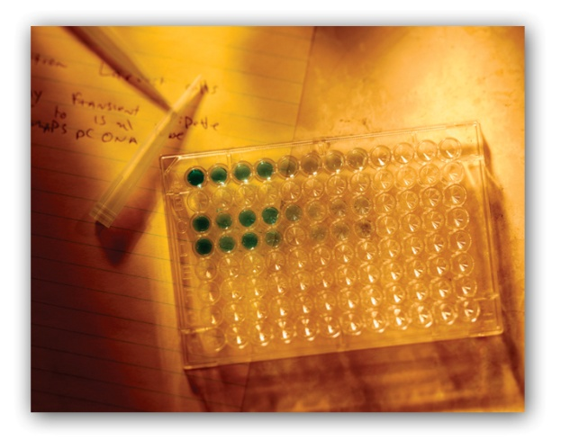
Types of Laboratory HIV Tests
The most common lab tests to screen, diagnose, and confirm HIV are EIA and Western Blot Tests.
EIA Test (Enzyme Immunoassay)- Test that screens for the presence of HIV antibodies in the blood.
Western Blot Test- Test that detects HIV antibodies and confirms the results of earlier EIA tests.

Slide 21
Other Lab Tests
Two other tests- RNA and the CD4 may be run when a Western Blot tests is positive.
These two tests give more of a complete picture of an HIV-infected person’s condition, and if the Dr. needs to prescribe medication or not.
Rapid Test- HIV test that produces results in only 20 minutes.
The rapid test can be used in situations where the infected person may not come back to learn the results of the test.

Slide 22
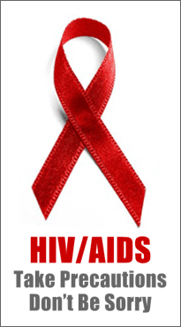
Home Testing Kits
Home testing kits are marketed on the Internet, newspapers, and magazines.
Most are not TRUSTWORTHY!!
Check to make sure that the test
is approved by the FDA.

Slide 23

Benefits of Early Diagnosis
Begin proper medical care early to slow the progress of the virus.
Avoid behaviors that could spread HIV to others.
Gain peace of mind when
the results are negative.

Slide 24
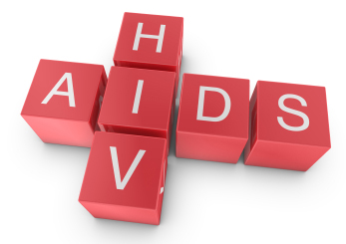
Treating HIV/AIDS
Since the early 1980’s, drugs have been developed that slow the growth of HIV and treat some of the symptoms.
No drug yet exists to cure HIV/AIDS.
Many of the drugs available are also used to treat opportunistic infections. (ex. Pneumonia, cancers, etc.)
To slow the growth of AIDS,
patients take combination drugs.

